Slide 1
CEIS485 Powerbi dashboard

Slide 2
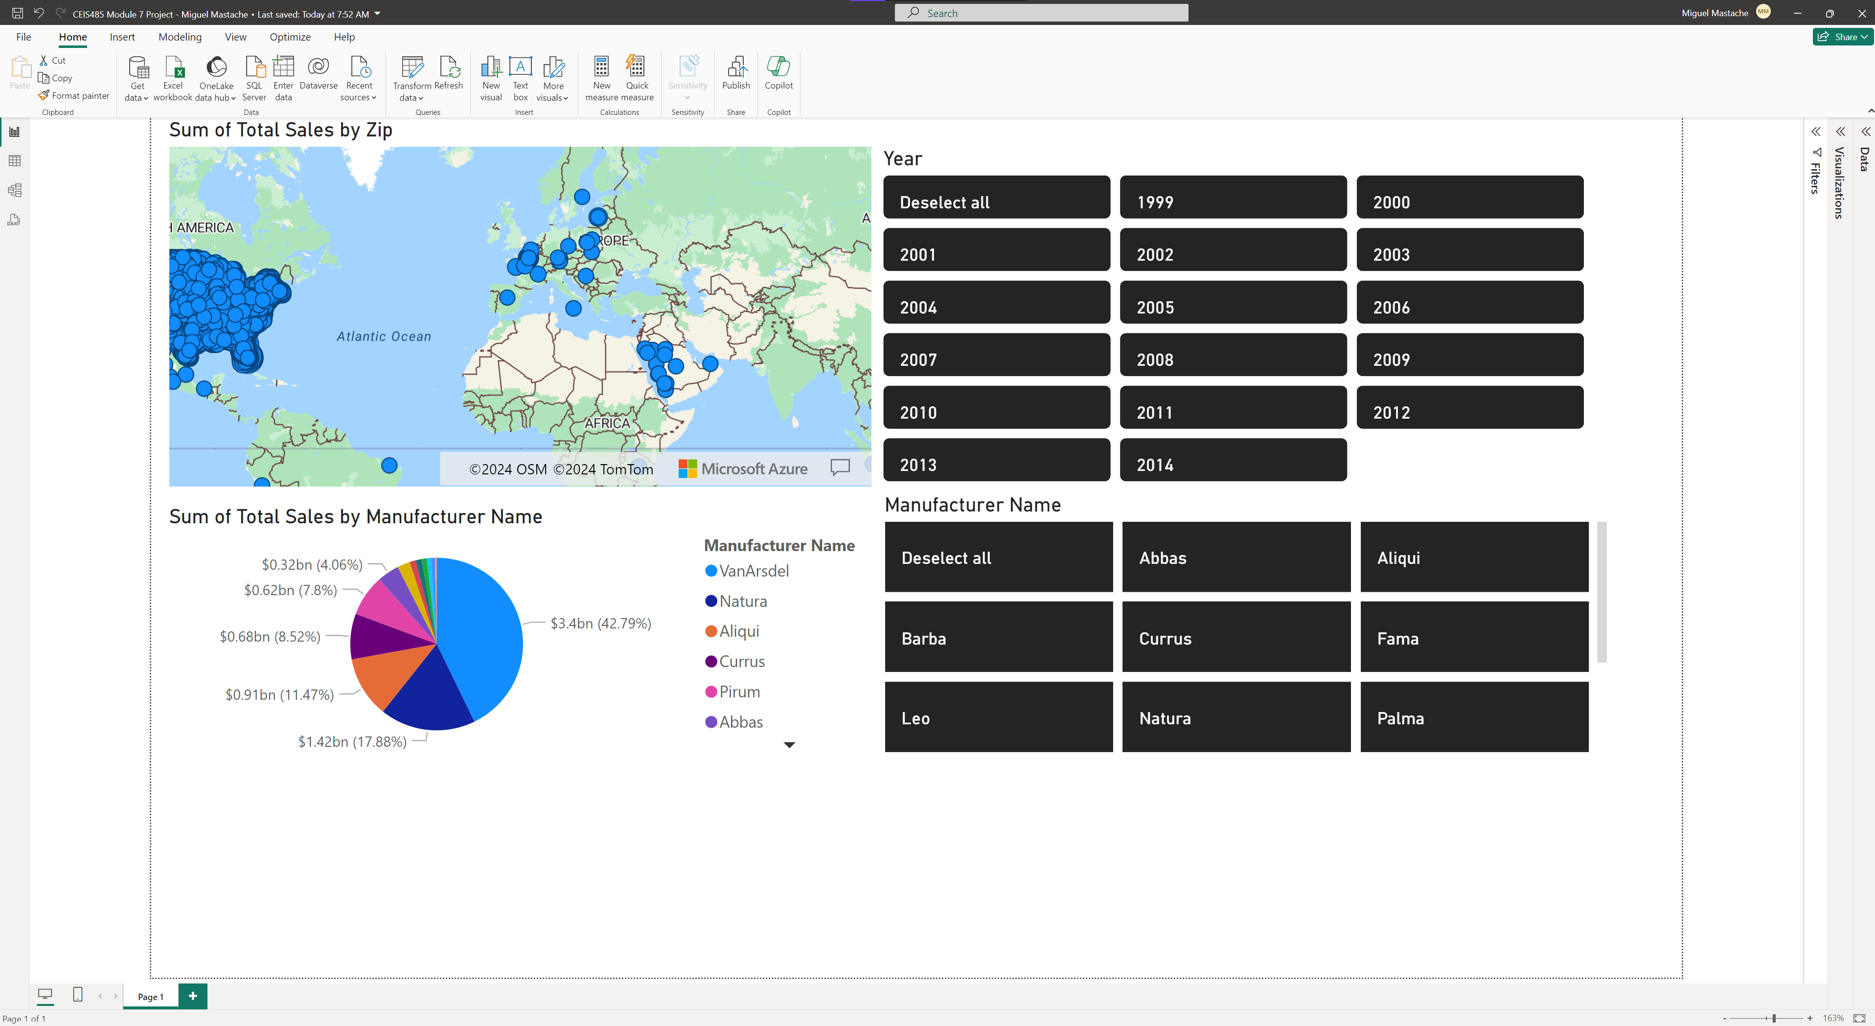

Slide 3
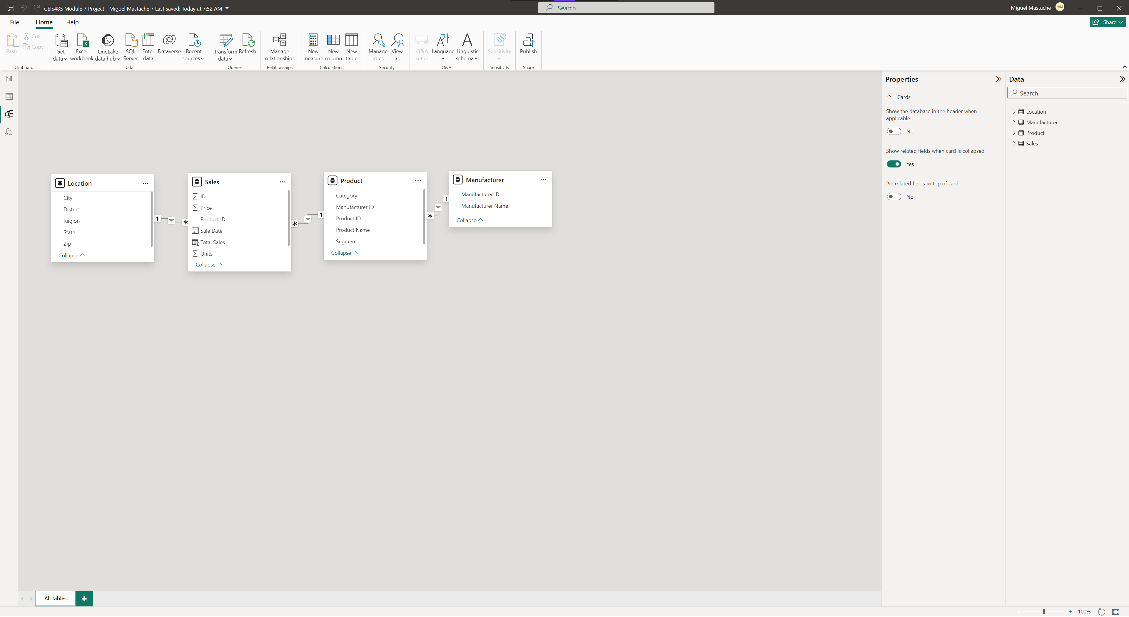

Slide 4
Skills developed
During this course I learned how to use, modify and update Excel’s Data Model.
How to use commands such as VLOOKUP, as well as how to create a dashboard in excel.
I also learned how to import an excel data model in to POWERBI.
How to develop a dashboard in POWERBI

Slide 5
challenges
Challenges to overcome, limitations in the remote desktop environment. PowerBI could not connect to online environment to publish dashboard. This was overcome by work around of documenting completion of dashboard visually.
Not being able to use Excel for Mac, because it does not have the data model, used work windows laptop instead because of limitations of remote desktop environment.
Not being able to use PowerBI on Mac, due to lack of online account access. Used Windows work laptop to develop material for assignments.

Slide 6
Thank You

