Slide 1
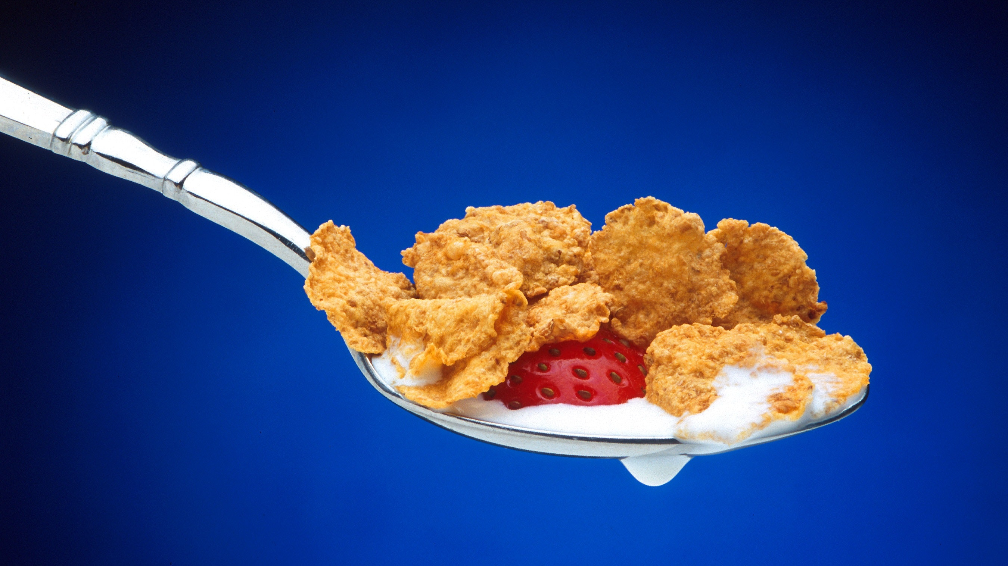
Cereal ratings
Linear regression model
Ceis312
Miguel mastache
6/24/23

Slide 2
Introduction
This model attempts to create a linear regression model using dataset features describing the different attributes of several cereals. This linear regression attempts to forecast the Consumer Reports rating for the cereal based off its features. The goal for the model is to have an R² greater than 0.70.

Slide 3
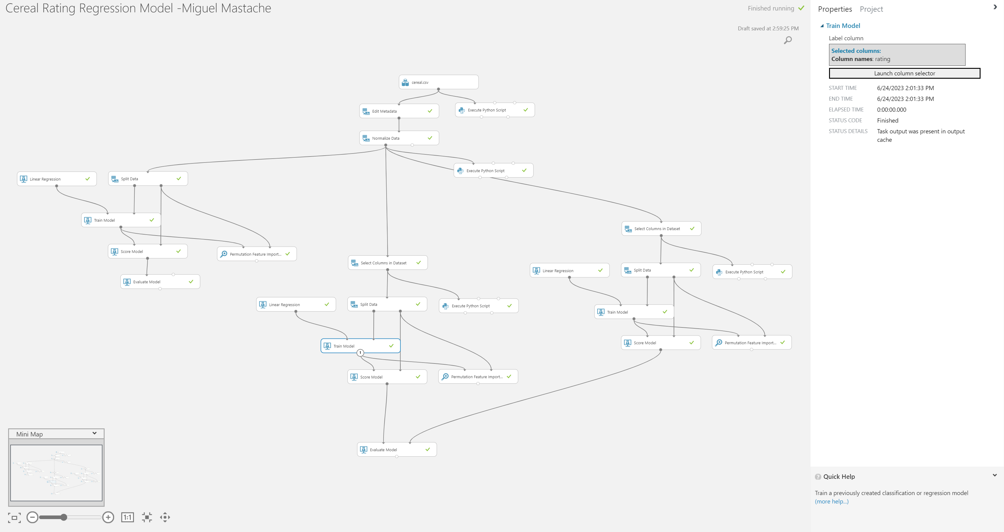
Linear regression Model

Slide 4
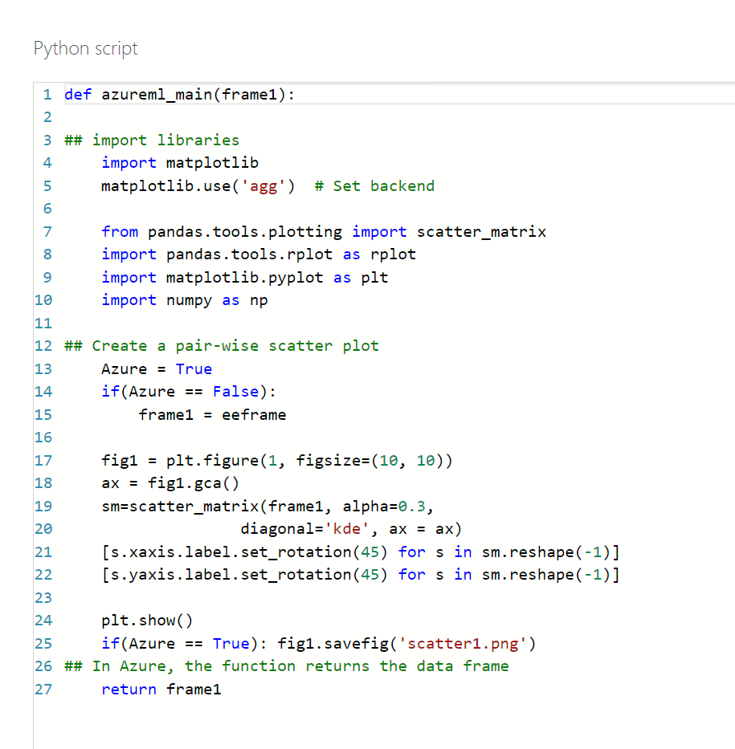
Python code for Pairwise scatter plot visualization

Slide 5
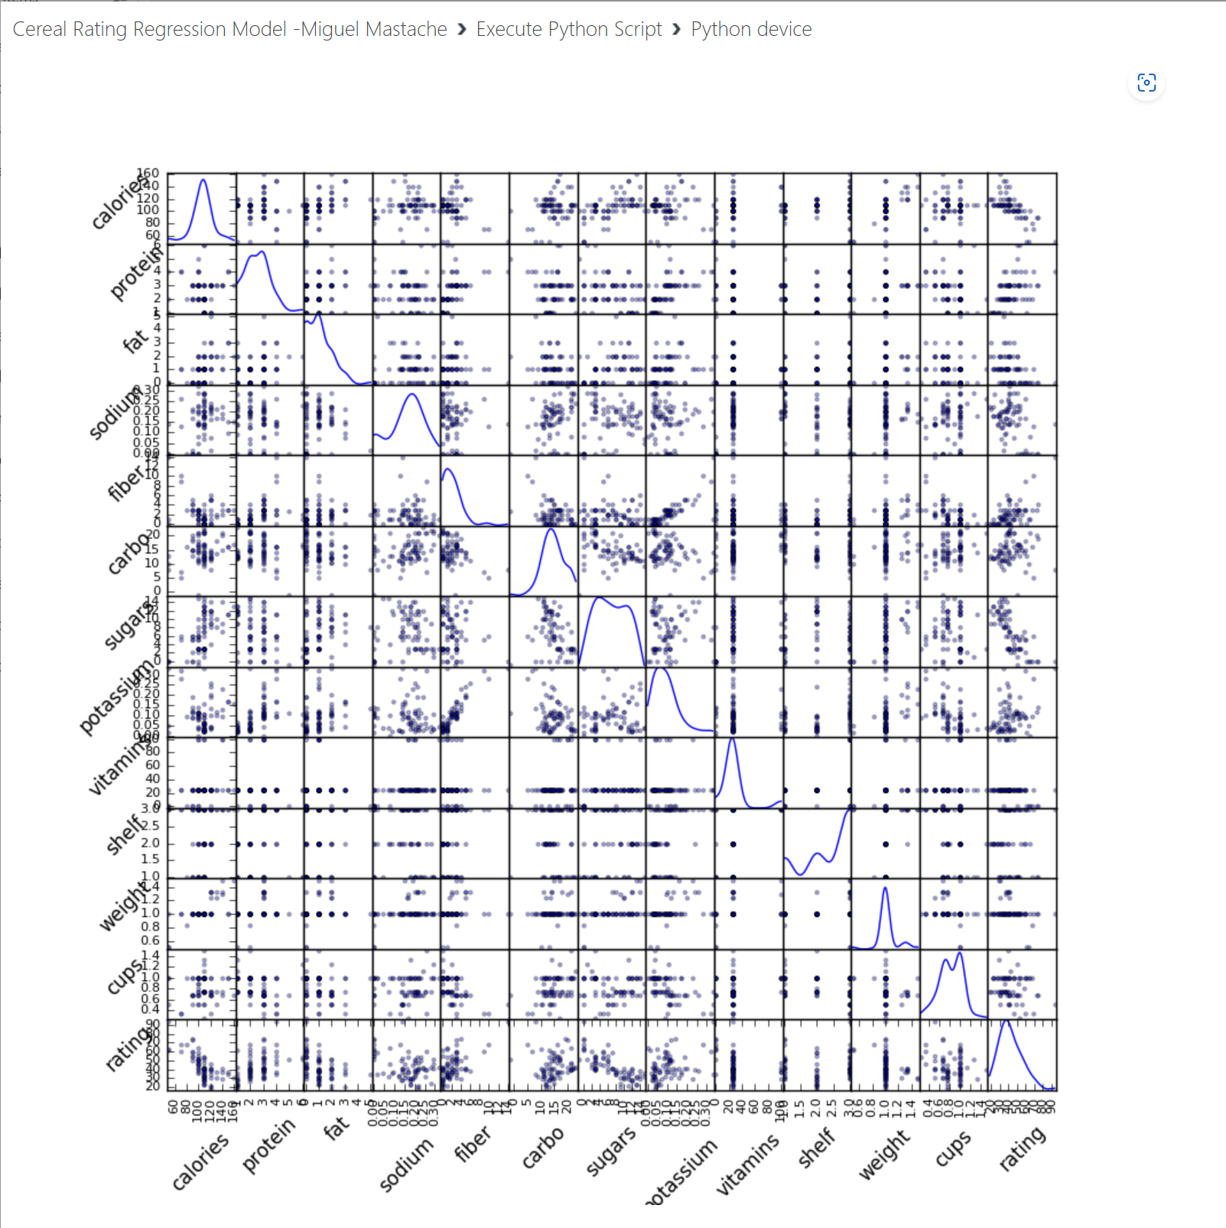
PRE- Normalized pairwise-scatterplot
As can be seen in the rating column. We have several variables that have two groupings, and don’t seem to have any correlation to rating. Cups, Weight, Shelf, Vitamins, Potassium, Carbohydrates, Sodium, seem to be clustered together, not affect the rating.

Slide 6
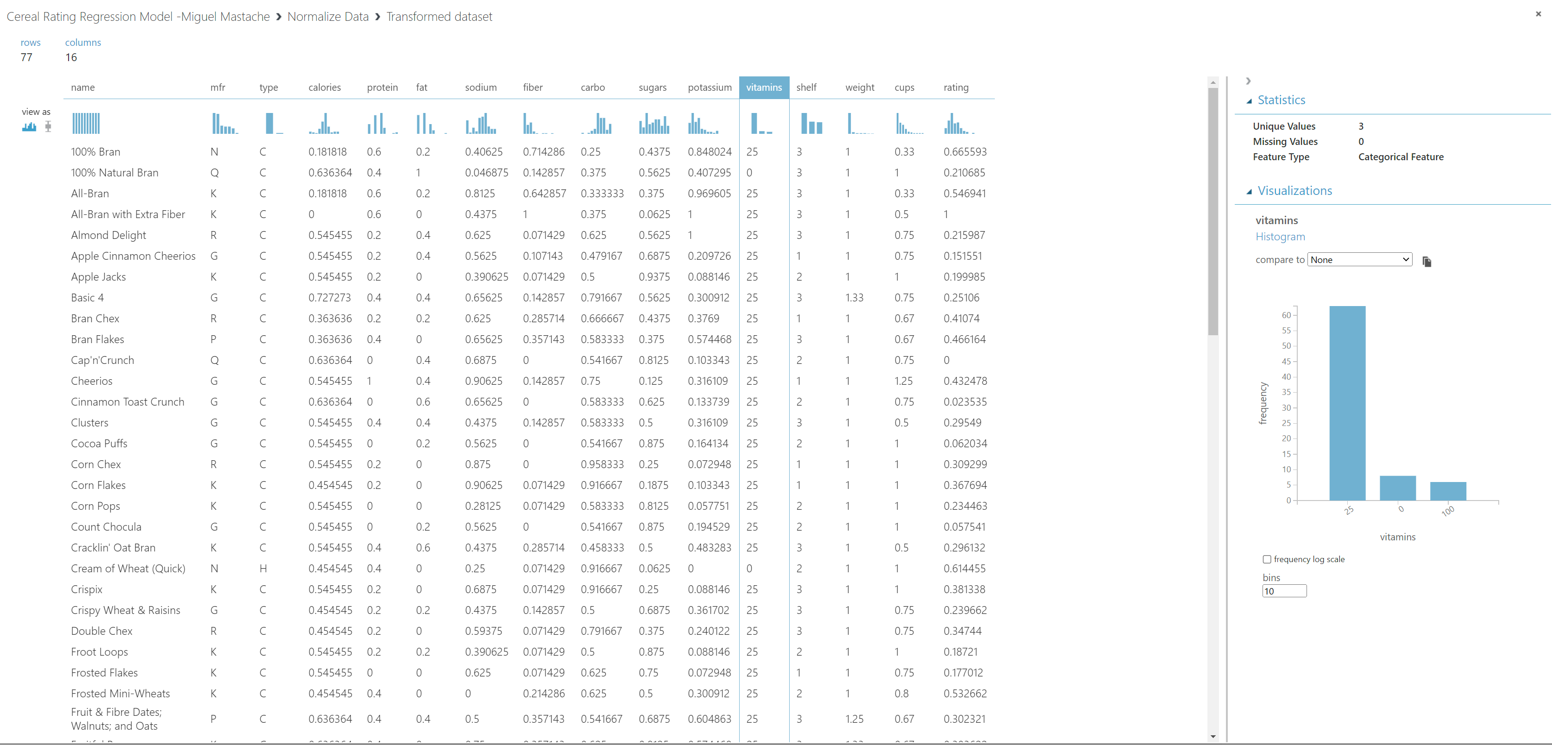
Normalized feature data
Features were made categorical based off o the initial pairwise plot, and numerical features were normalized.

Slide 7
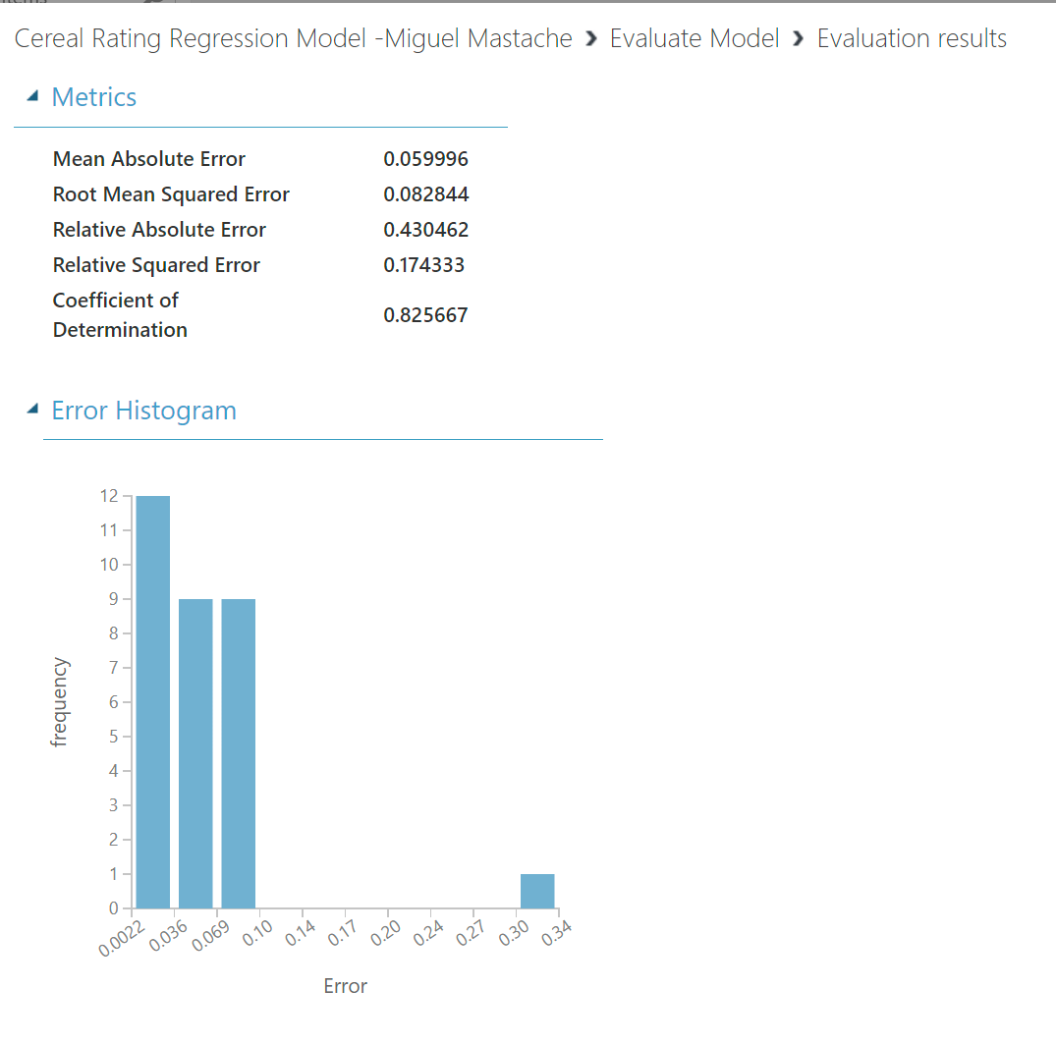
Post normalized regression model
Using all the post normalized features, we attain an R² of 0.83 with a Root Mean Squared Error of .082844. This is significantly better than the R² of 0.70 we are were aiming for.

Slide 8
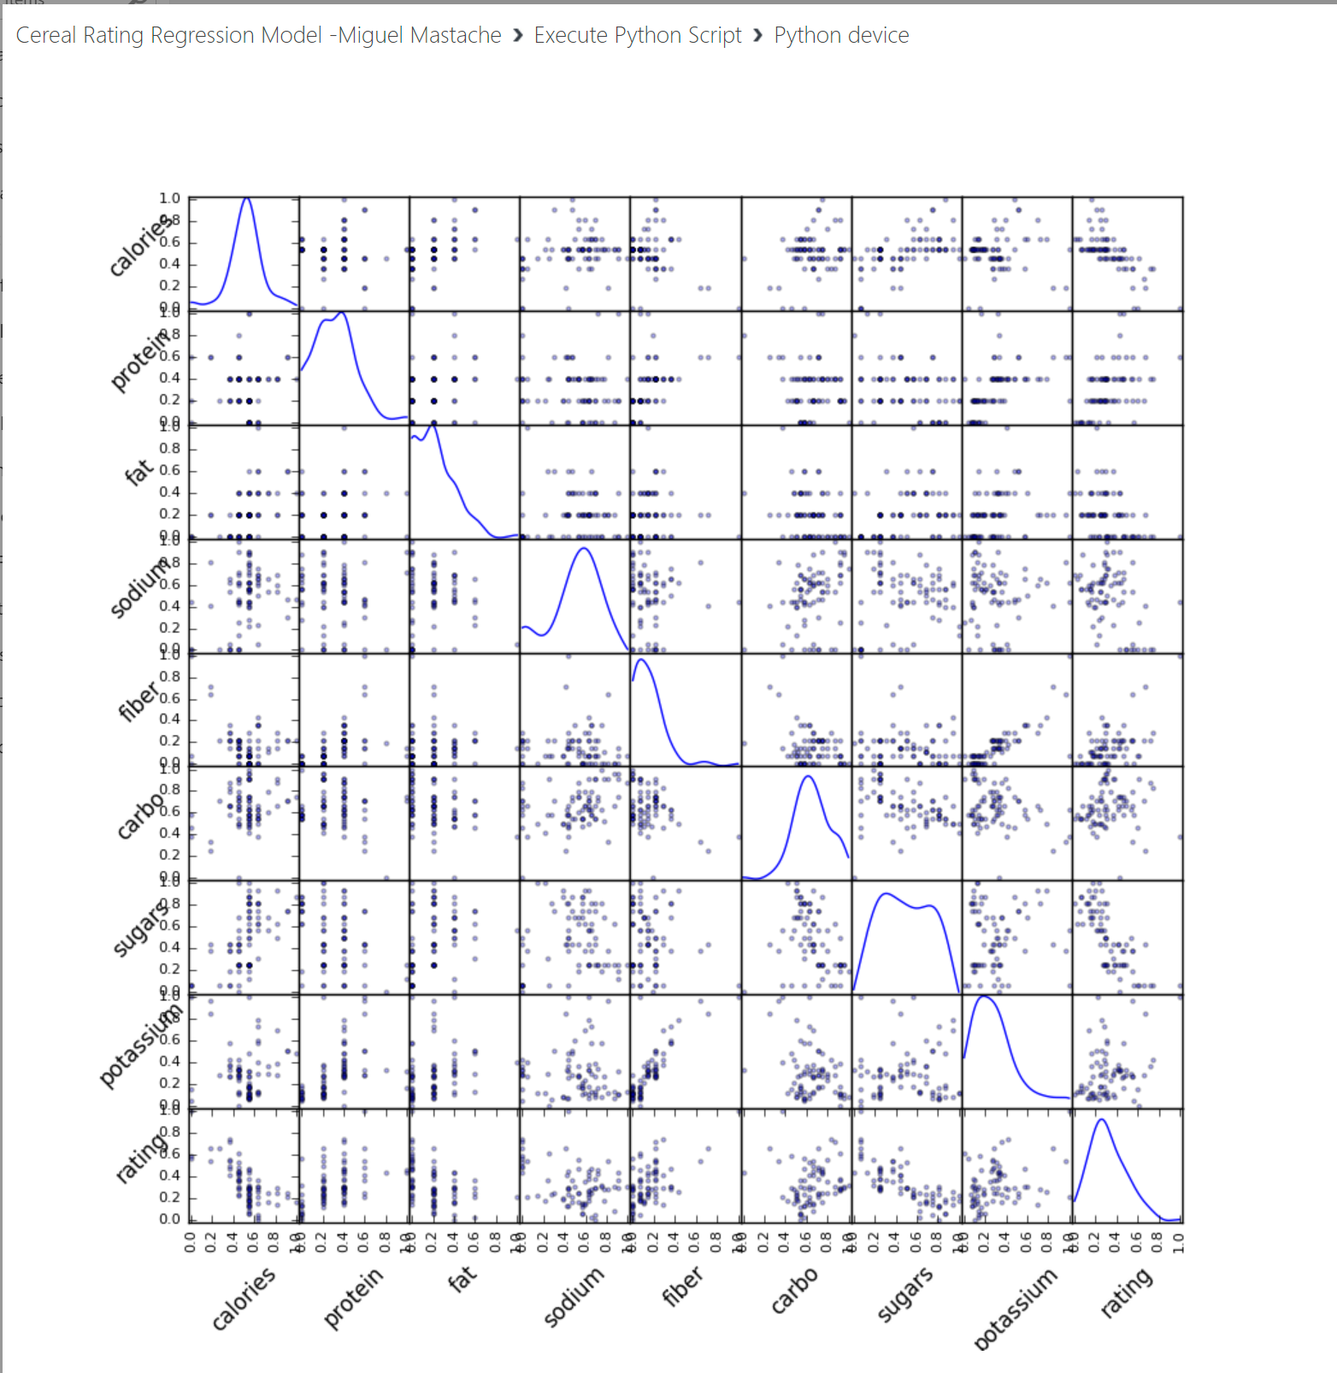
POST NORMALIZED PAIRWISE SCATTERPLOT
Several of the features have been converted to categorical features, therefore they aren’t ideal for use as numerical features for linear regression. Among those are vitamins, shelf, weight and cups.

Slide 9
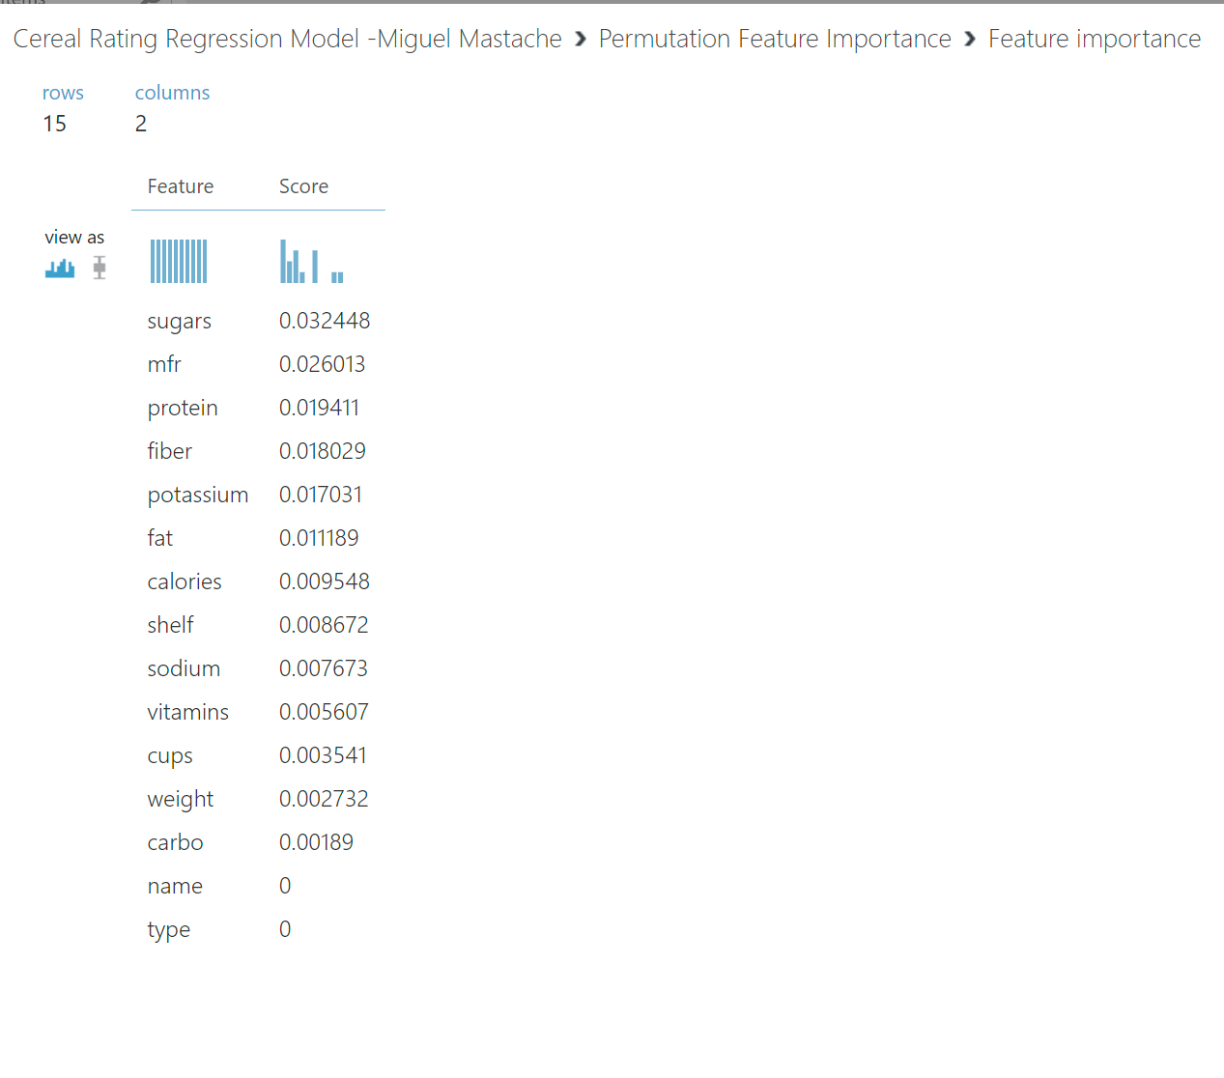
Post normalized Permutation feature importance
Viewing the weights of the features in the linear regression model. We can see that the following features seem to be minor contributors: calories, shelf, sodium, vitamins, cups, weight, carbo, name and type. This makes sense as the review of the pairwise scatterplot indicated several of these didn’t seem to have strong correlations to the rating.

Slide 10
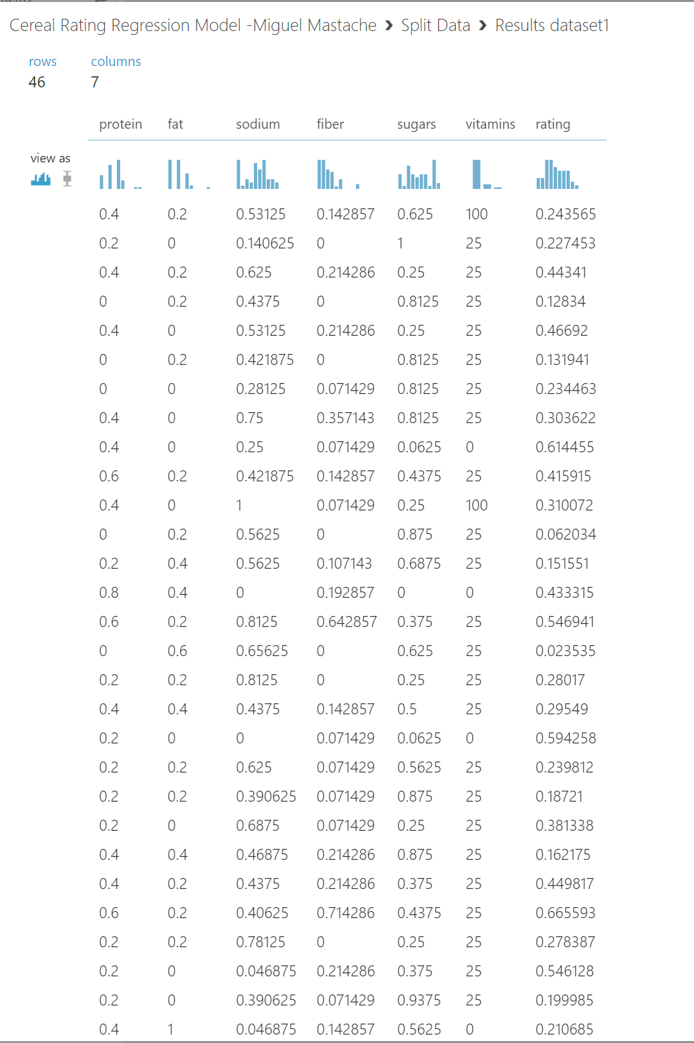
Split data set used for training linear regression model
You can see the data output from the data split module for training the mode, and which features were ultimately selected to predict the rating.

Slide 11
Iteration of normalized features
In a separate model instance, each feature whose weight was less than 1/100th was tested, for impact on the Coefficient of Determination, and Root Mean Squared Error. Where each feature was iteratively eliminated, and the path with the highest R² was chosen. The features that were challenged were identified using the Permutation Feature Importance output, and selections were made based on the output of the Evaluate Model module.

Slide 12
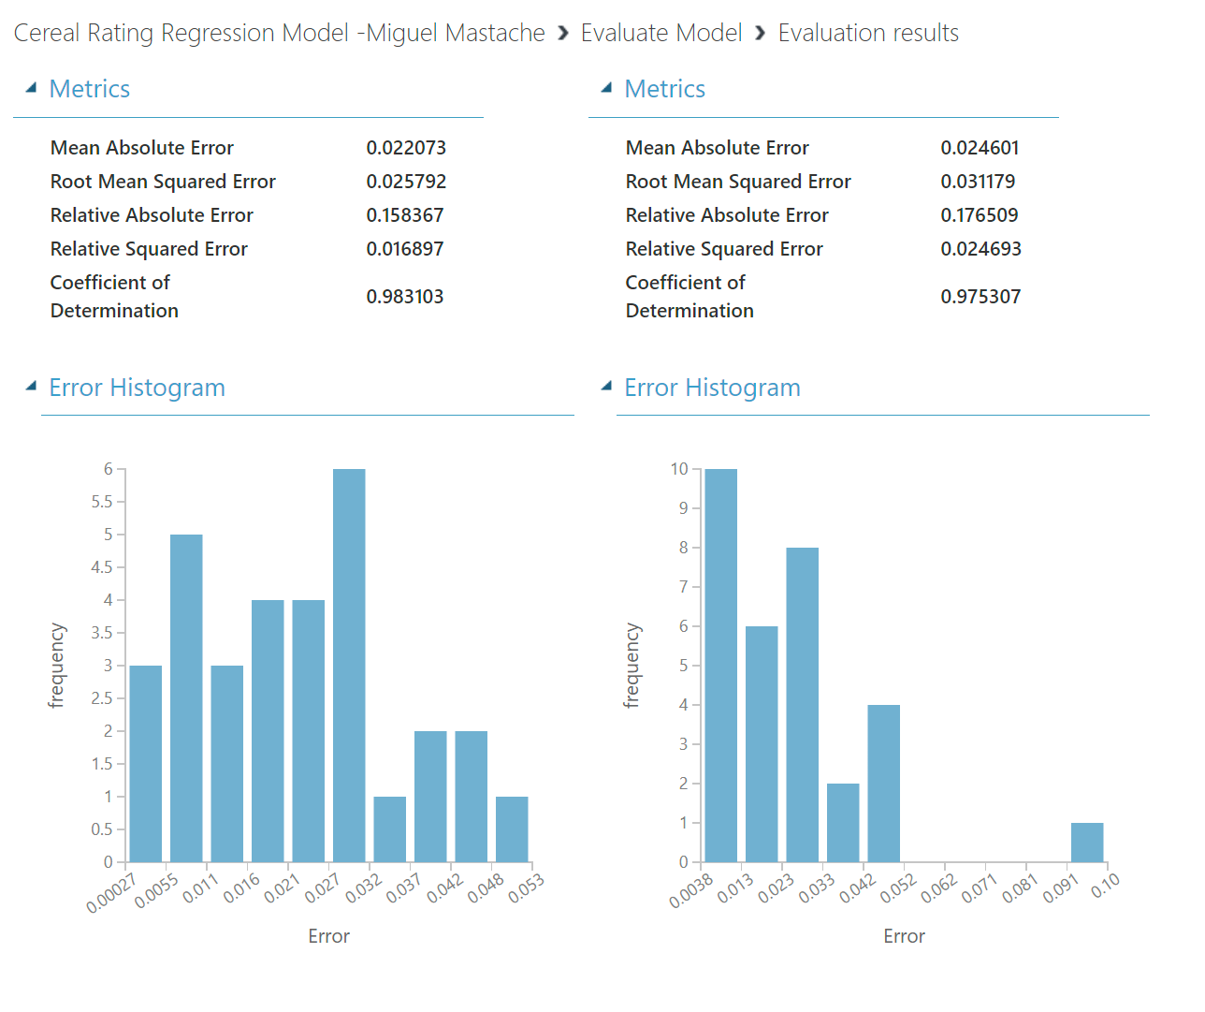
Final Evaluation of remaining models
The iteration process eliminated all features with a weight less than 1/100th. The model final model is on the left, with an R² of 0.98, and a Root Mean Squared Error of 0.26. The next closes model, included vitamins as a feature and as can be seen it increased error, and lowered R² to 0.975

Slide 13
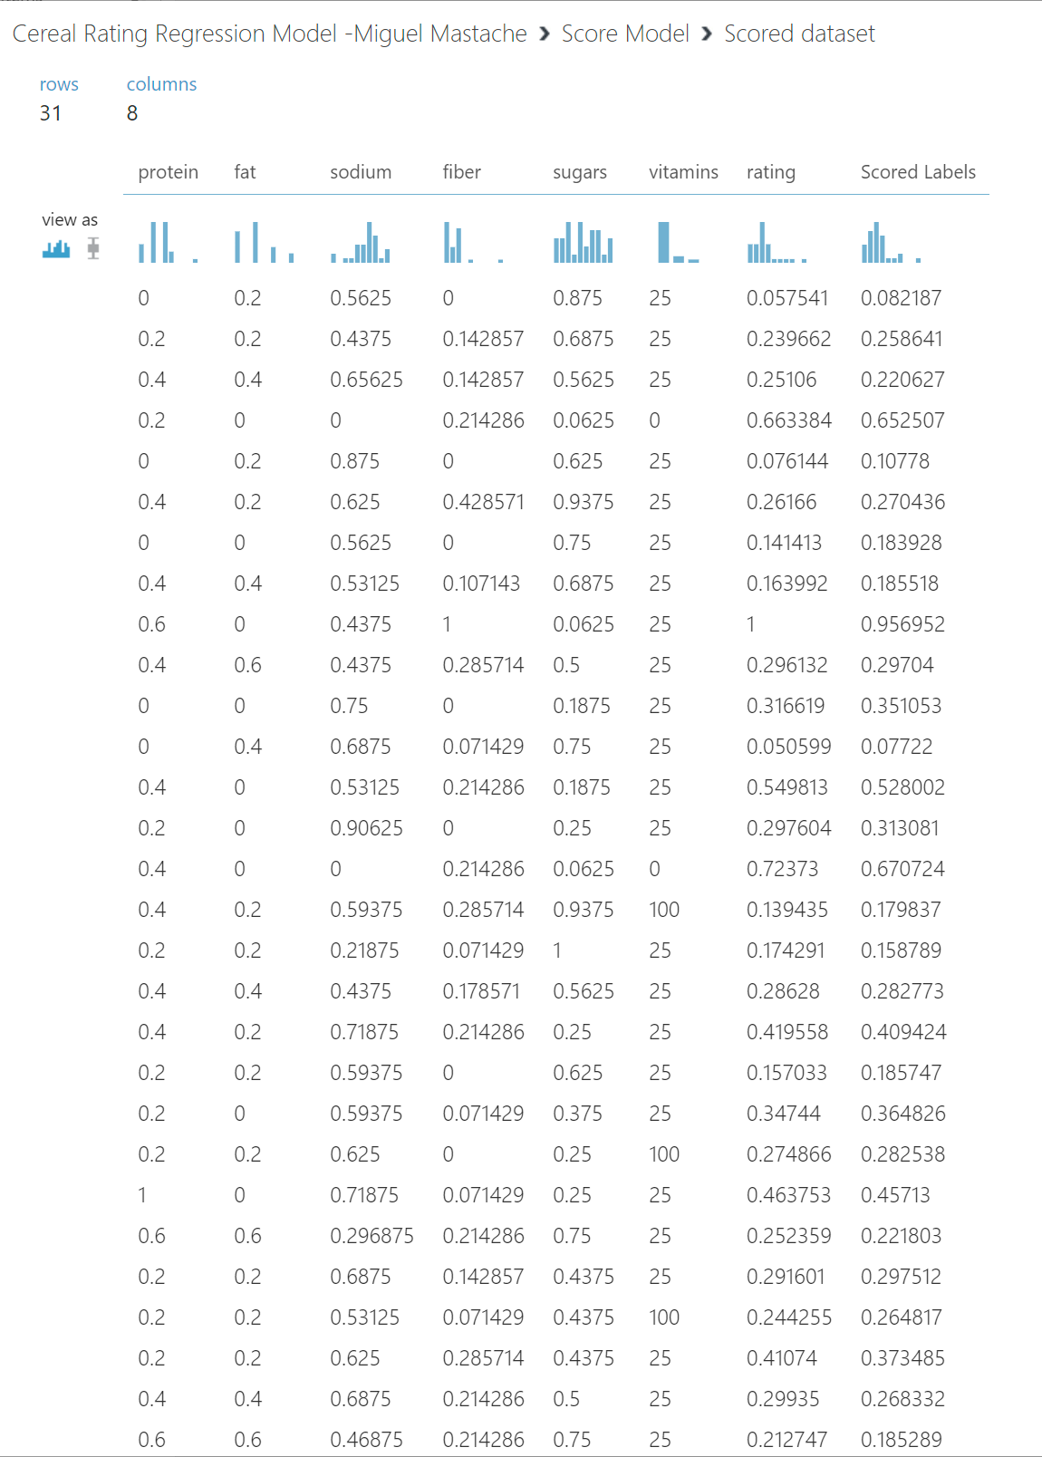
SCORE for FINAL LINEAR REGRESSION MODEL
As can be the scored labels, are very close to the rating as indicated by consumer reports.

Slide 14
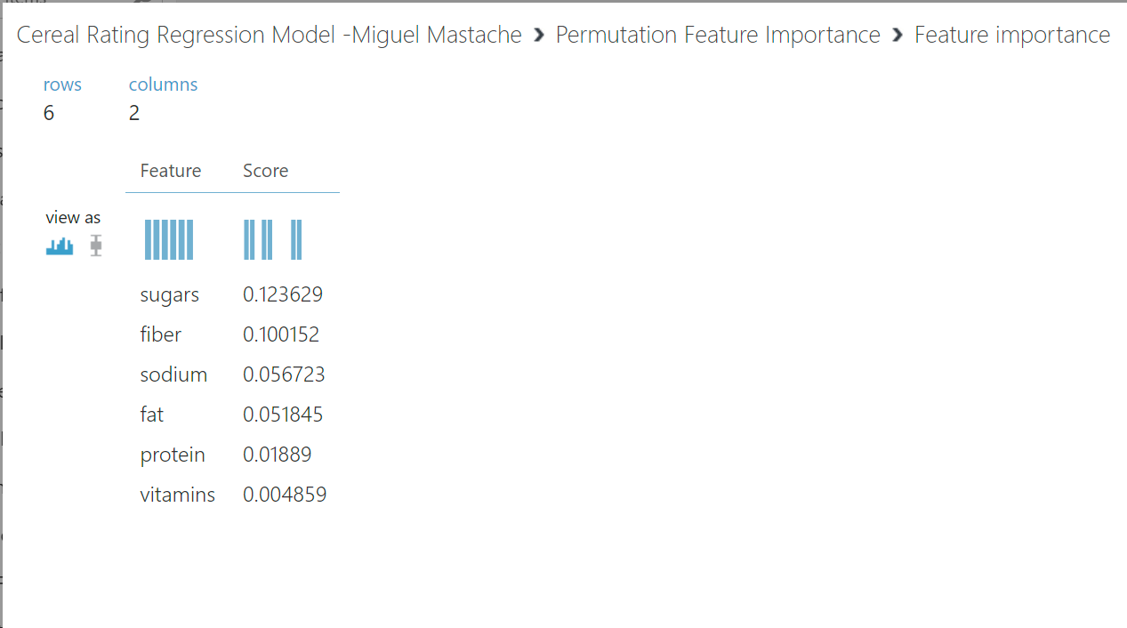
Final Permutation feature importance
The most pertinent features to predicting the Consumer Reports Rating were sugars, fiber, sodium, fat, protein and vitamins.

Slide 15
Challenges
The biggest challenge for this project was not knowing enough about the data set. While no missing data was found, I did not trust the dataset 100%, especially when it came to values that were 0, for sugars, protein, fat etc. Verification with other data sets was not possible, because it was unknown if rounding was used, and inconsistencies in other source data made it difficult to eliminate these values as valid. In the end the decision was made to include them, because of inconsistences in serving size. Also, removal of the data was not possible, as numerical features that are blank show as a valid value of 0, when there should be a way to identify them as missing, so the missing data module will remove them.
Other challenges faced were poor explanations of what each step accomplished in the homework exercises, and emphasis on step by step, how to perform analysis, and not understanding of analysis.
Ultimately however, experimentation, and external reference to other websites, provided enough insight to be able to perform the analysis.

Slide 16
Career Skills obtained
I have developed the basic skill to reproduce this linear regression, based on the features and how to analyzed and improve the ML regression model to make feature predictions. I suspect this model could be improved through validation of the date entered into the model.
Additionally I am able to visually inspect the features for possible relationship with the forecasted attribute.

Slide 17
Conclusion
The models was able to achieve a coefficient of determination of 0.98 an improvement from then initial value of 0.83. Visual inspection proved to be rather reliable in identifying features with a relationship to the rating. Being able to iterate over what features to omit, was particularly helpful, because individual features were eliminated 1 by 1 until the model reached an inflection point where performance degraded with further removal of features. Ultimately, I believe this is a good model for forecasting cereal ratings.

