Slide 1
inStock
Python Stock Tracking Project
By Miguel Mastache
10/28/22

Slide 2
CEIS150 Module 1
Software Environment Setup
By Miguel Mastache
10/28/22

Slide 3
Introduction
inStock is a simple stock tracking application. It is capable of importing historical stock information, from either Yahoo! Finance, via CSV or web scraping. This app is able to save your stock purchase history, and produce reports based on your purchase history.

Slide 4
Environment
This part of the project focus’ on setting up the environment used to develop the stock tracking application.

Slide 5
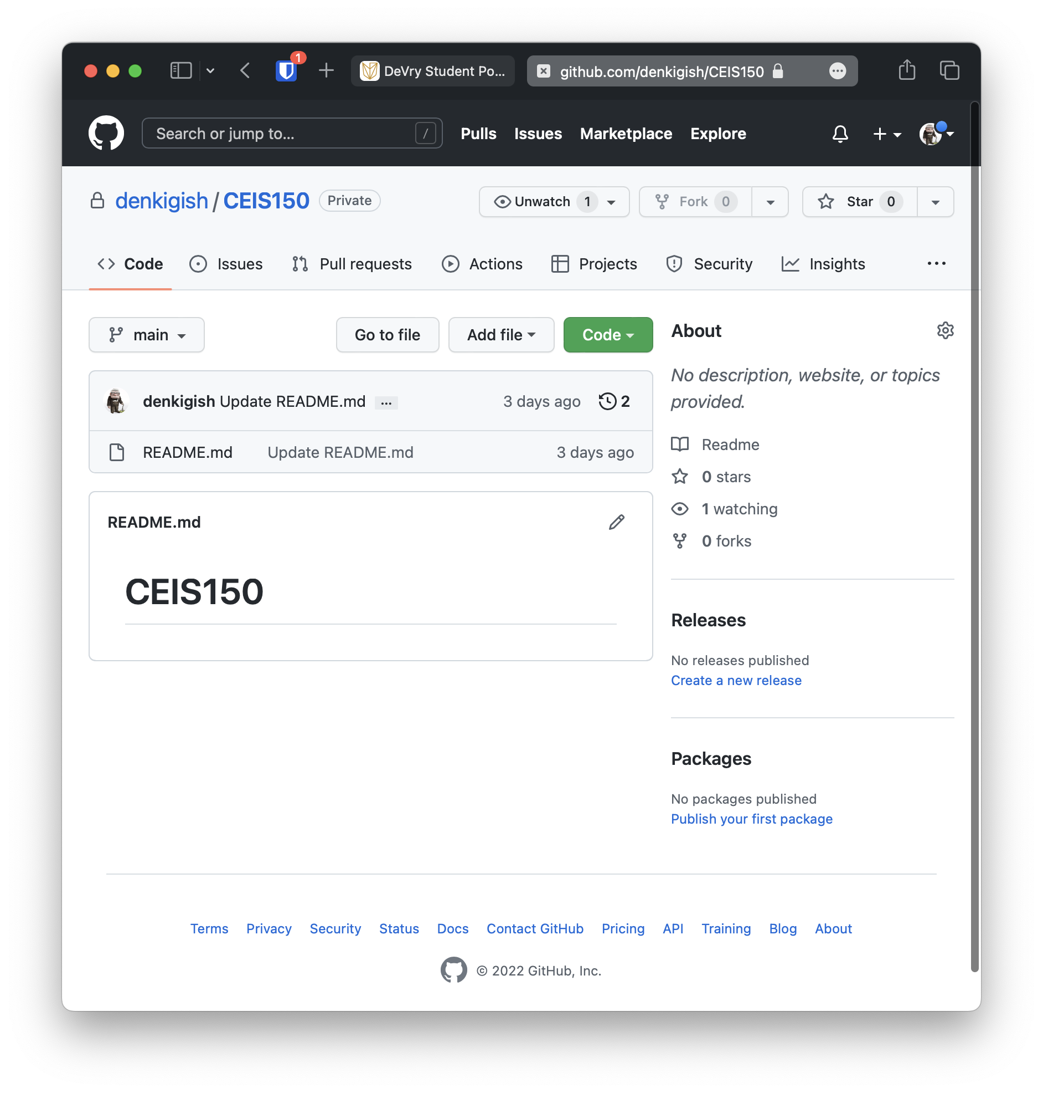
GitHub
Screen shot of GitHub project repository.
For this class, I setup a GitHub repository. It can be found at:
https://github.com/denkigish

Slide 6
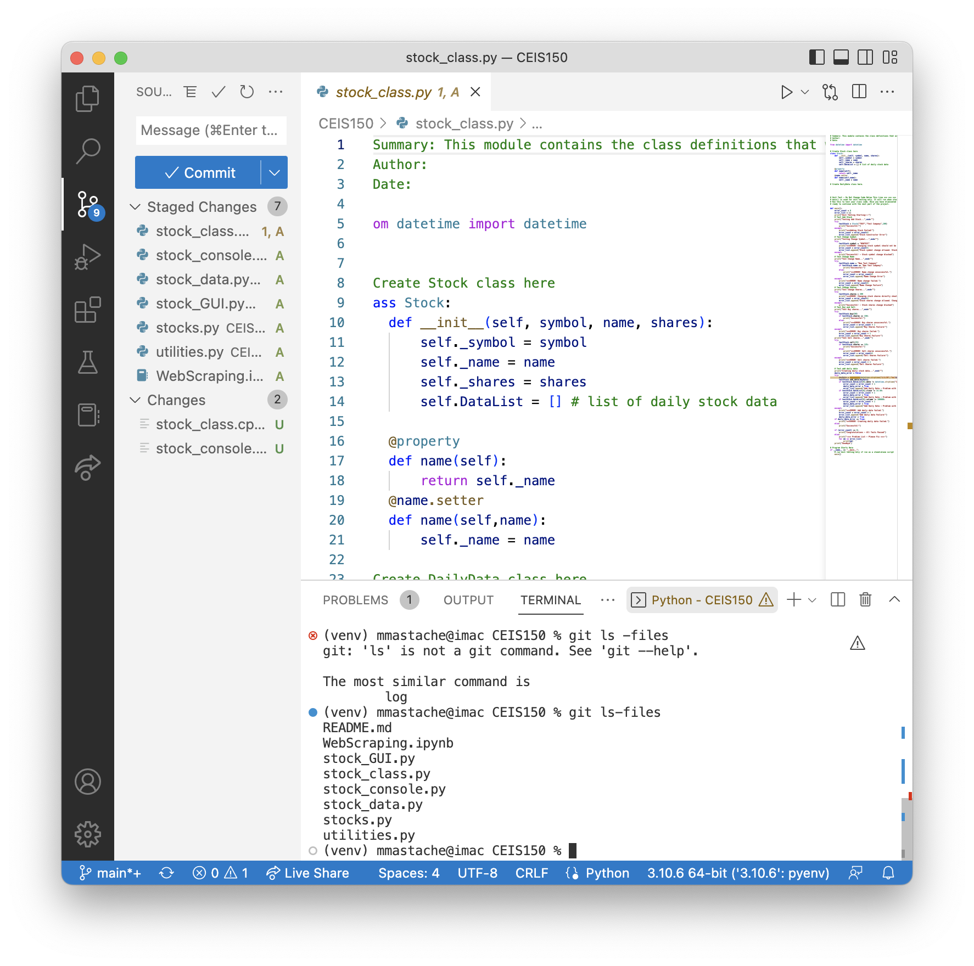
IDE & Starter Files
Screen shot of your IDE (Spyder or VS Code) with the project Starter Files loaded.
Also chose to use the VS Code IDE for development of the project. Shown is VS Code with the starter files loaded.

Slide 7
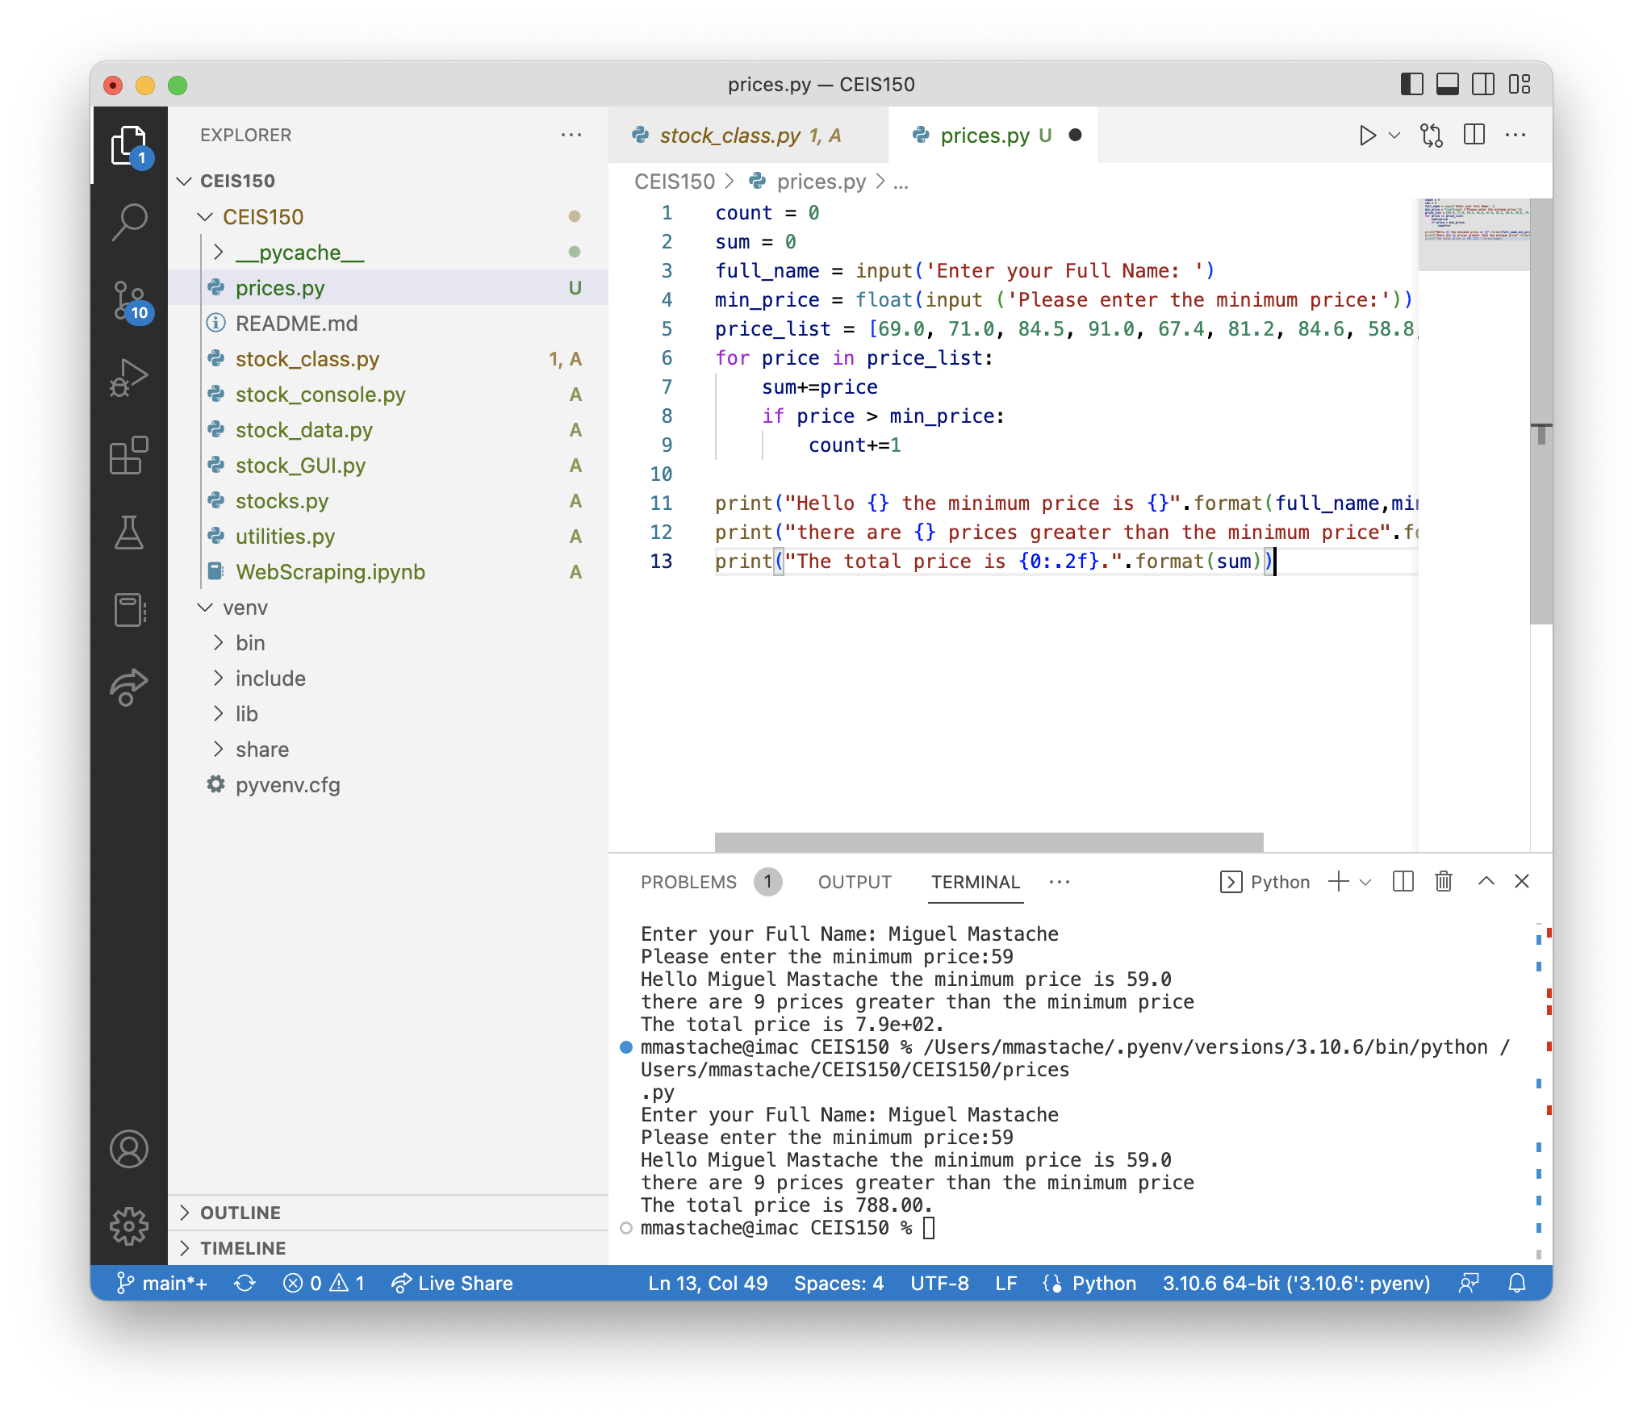
Program
Screen shot of Python program running successfully.
prices.py working with price list, summing, and counting stocks above minimum price.

Slide 8
UML and Class Definition
This section covers the development of the classes needed to work with our stock and history data. These classes are the foundation of my program.

Slide 9
Rubric
Activity | Requirement(s) | Points
Class Diagram | Class Diagram | 10
Class Code | Screen Shot of Class Code | 15
Unit Test | Screen Shot of Unit Test | 5

Slide 10
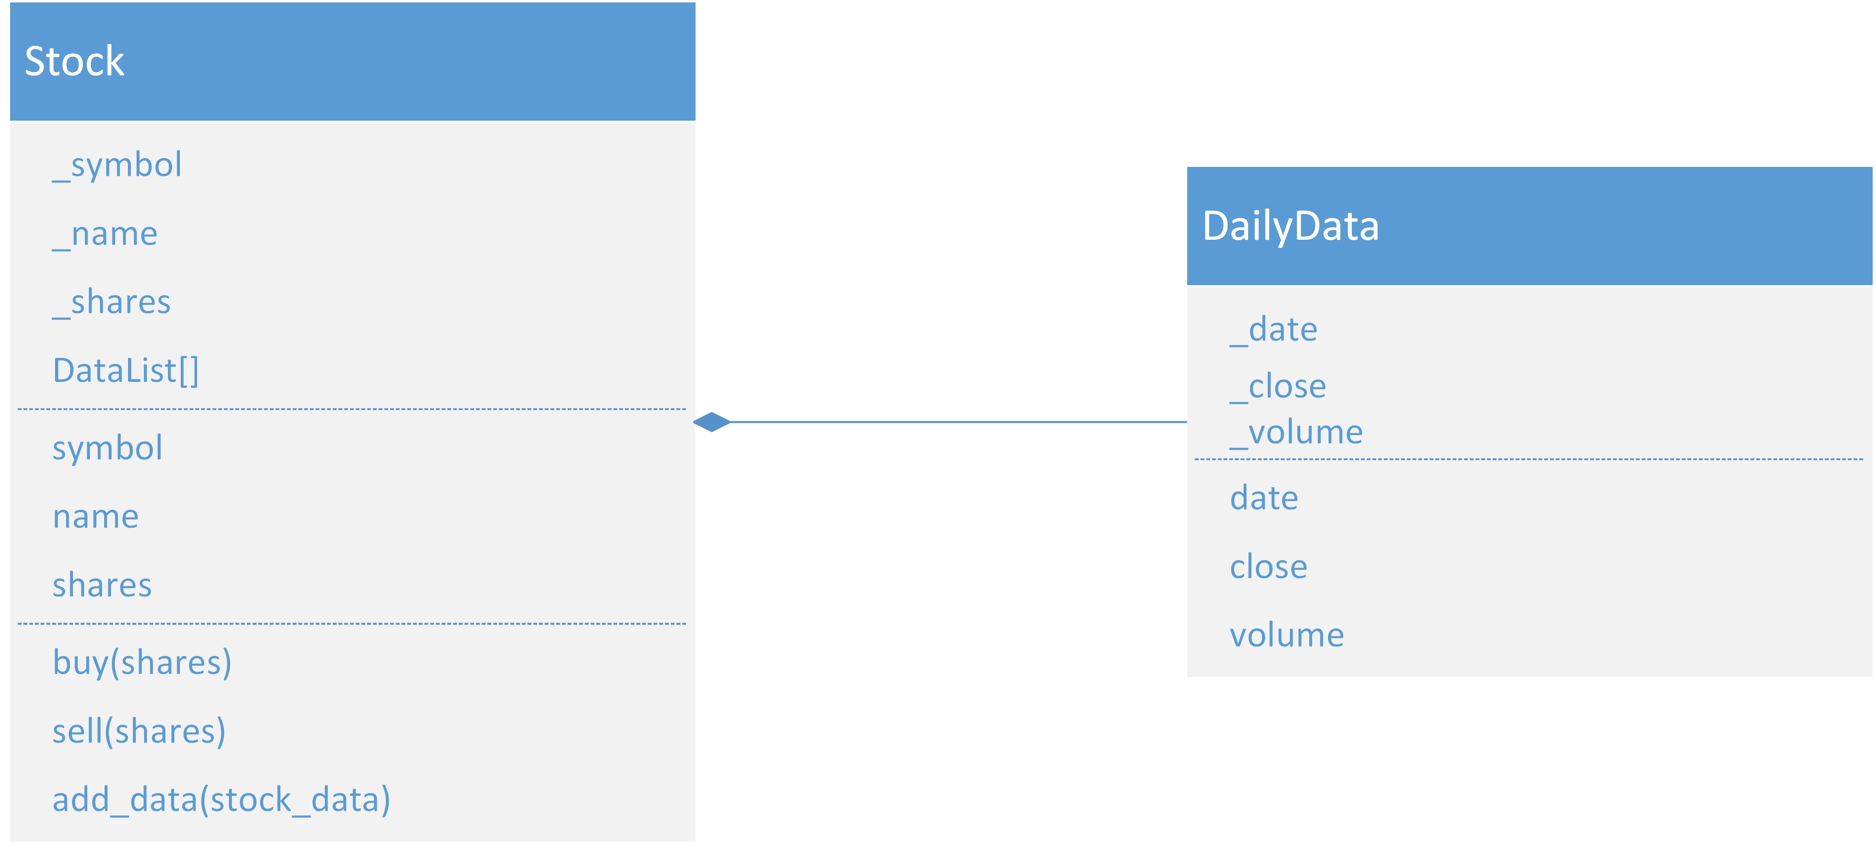
Class Diagram
Paste your Visio Class Diagram

Slide 11
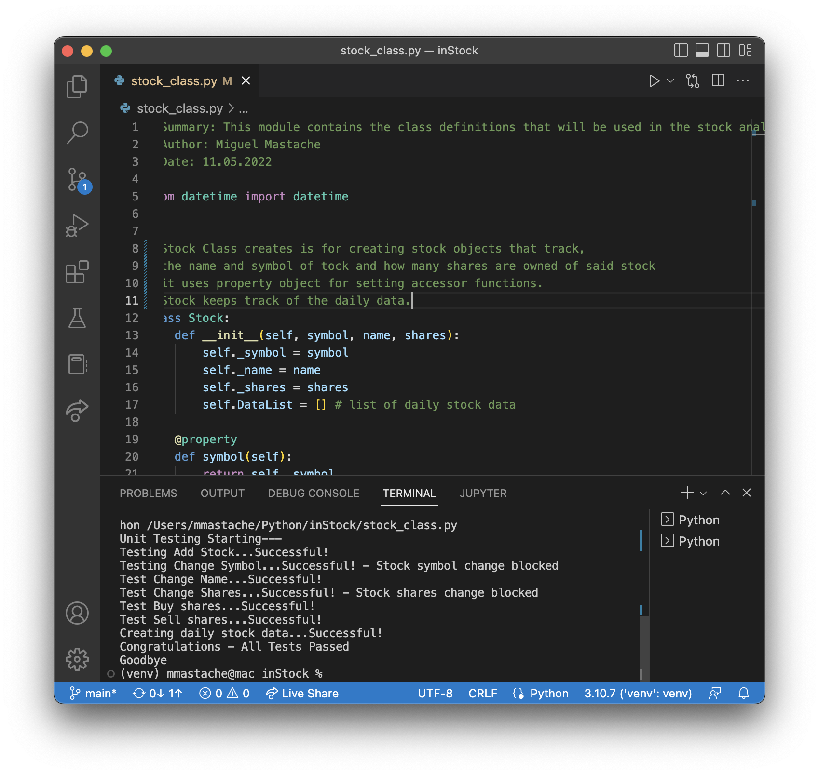
Class Code
Screen Shot of your stock_class.py file.

Slide 12
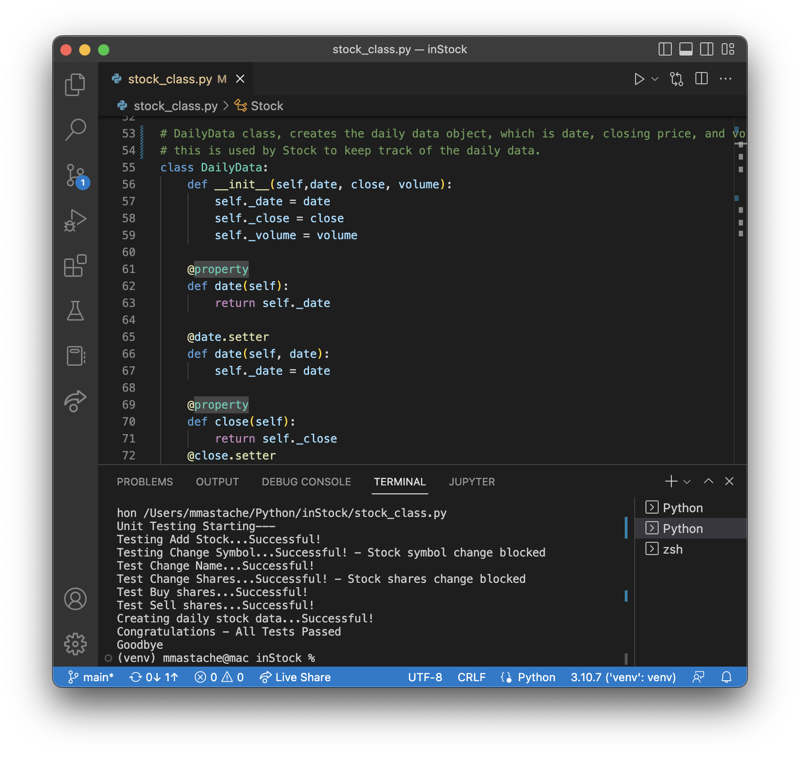
Unit Test
Screen Shot of your successful unit test.

Slide 13
Rubric
Activity | Requirement(s) | Points
Adding a Stock | Screen Shot of adding stock data | 20
Listing all Stocks | Screen Shot of listing 3 stocks | 10
Daily data | Screen Shot of adding daily data | 10

Slide 14
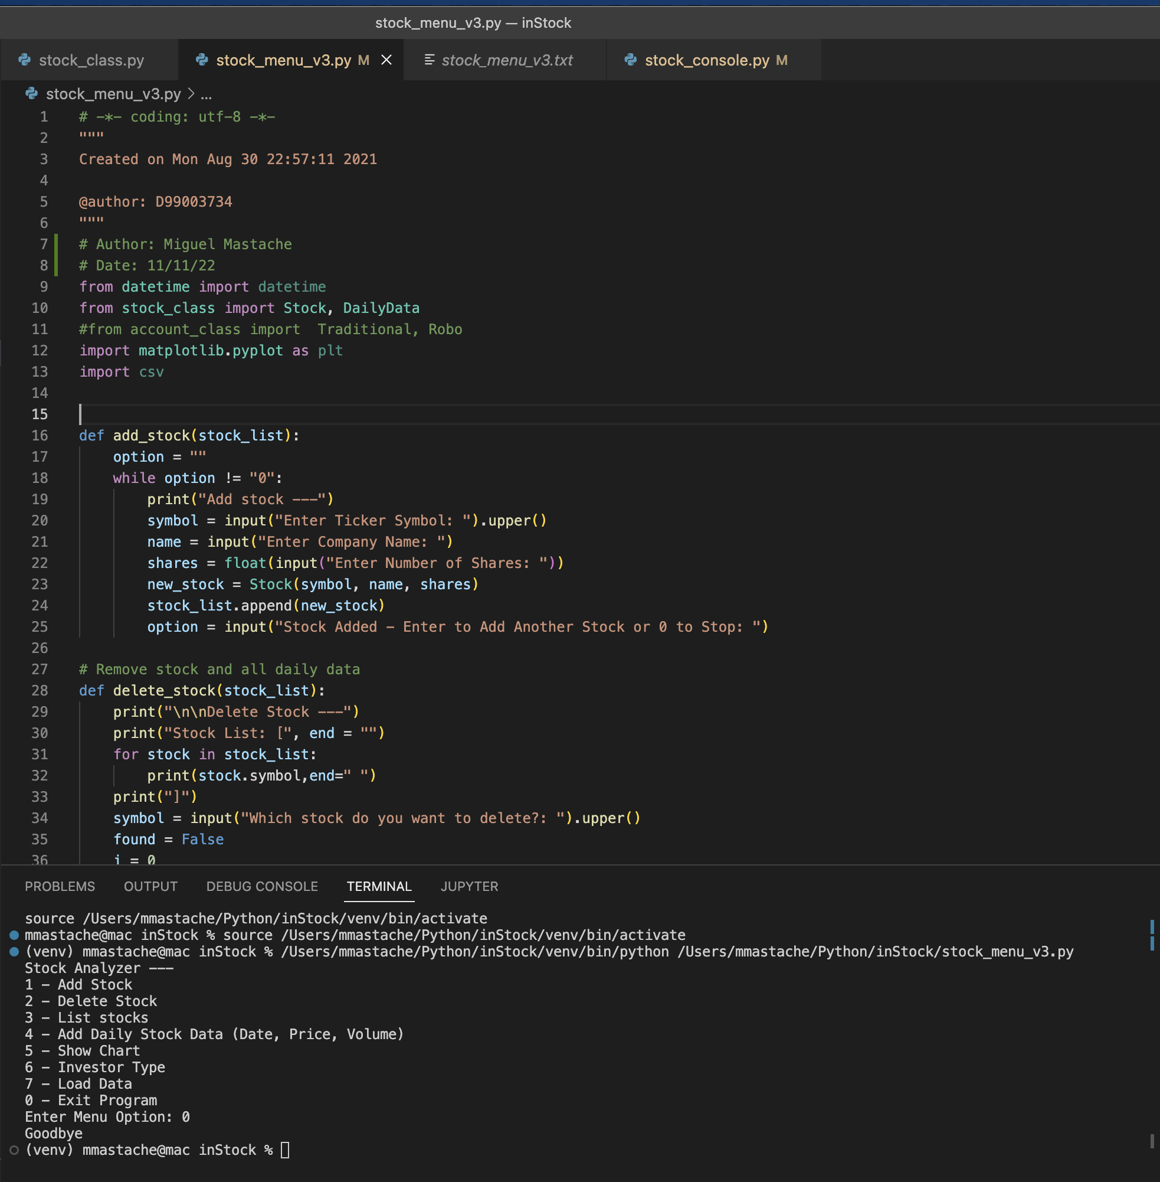
Code
Code snippet.

Slide 15
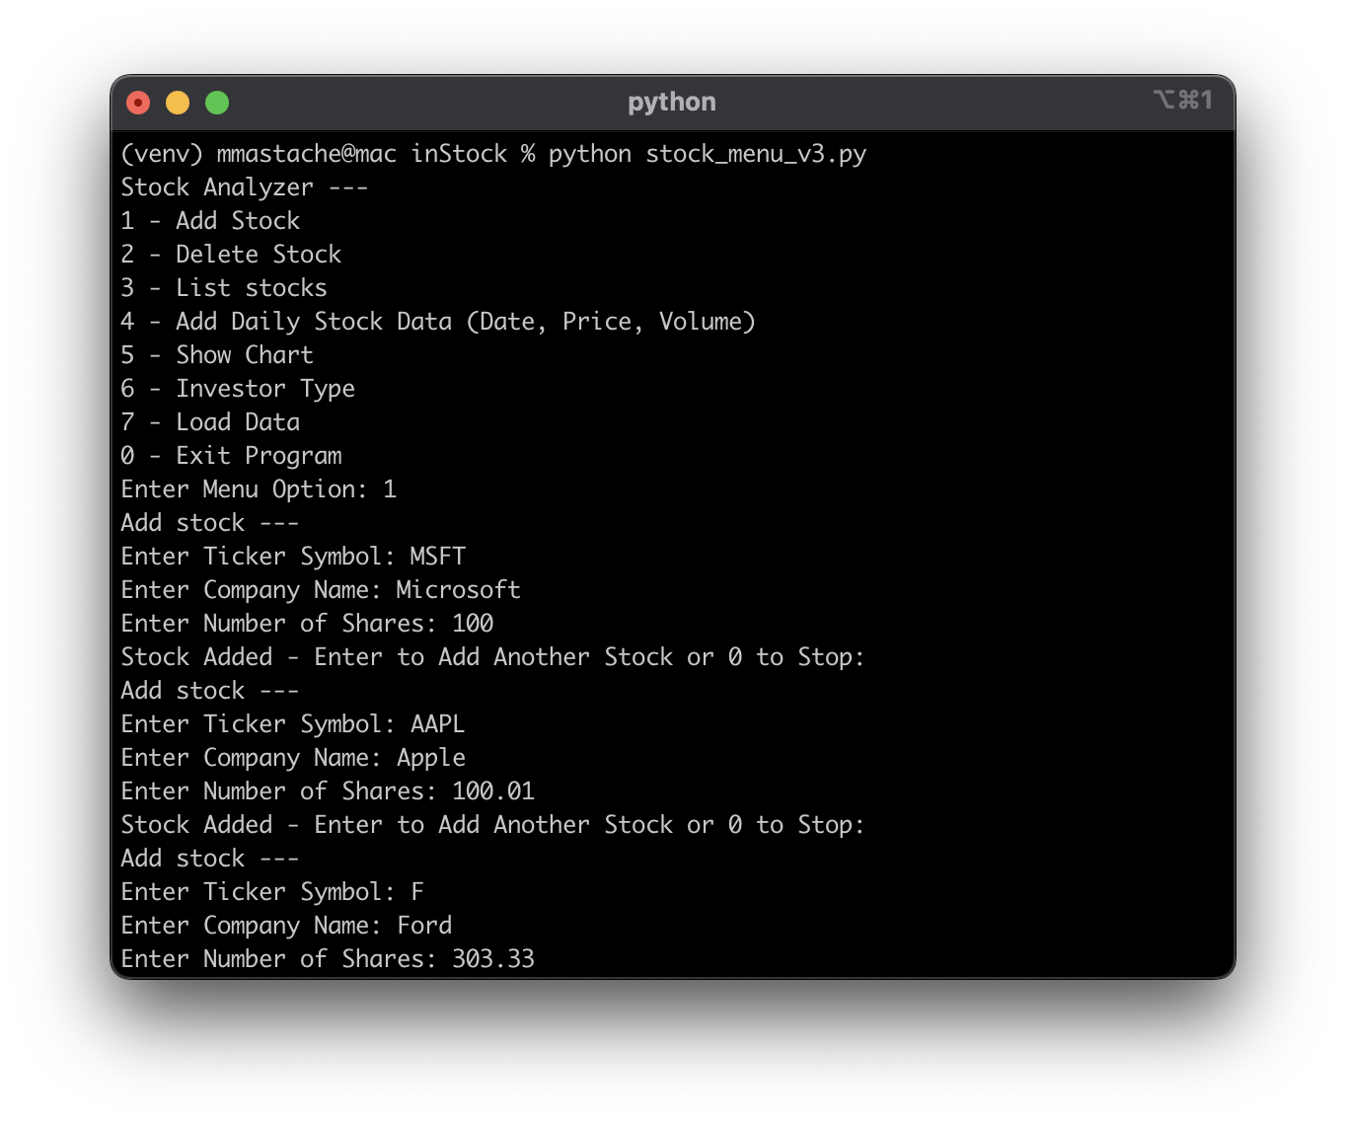
Adding a Stock
Paste a screen shot of your working Stock program.

Slide 16
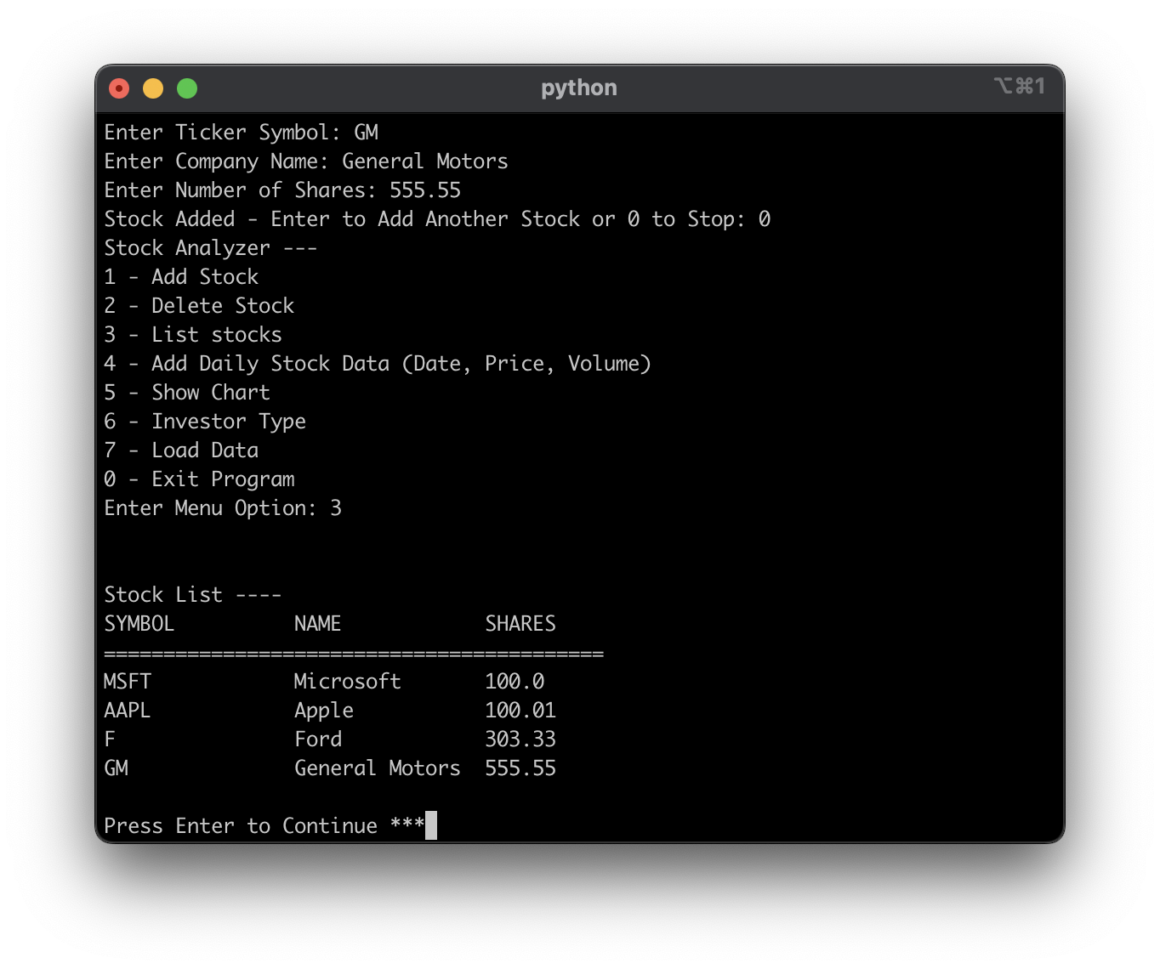
Listing 3 Stocks
Paste a screen shot of your working Stock program.

Slide 17
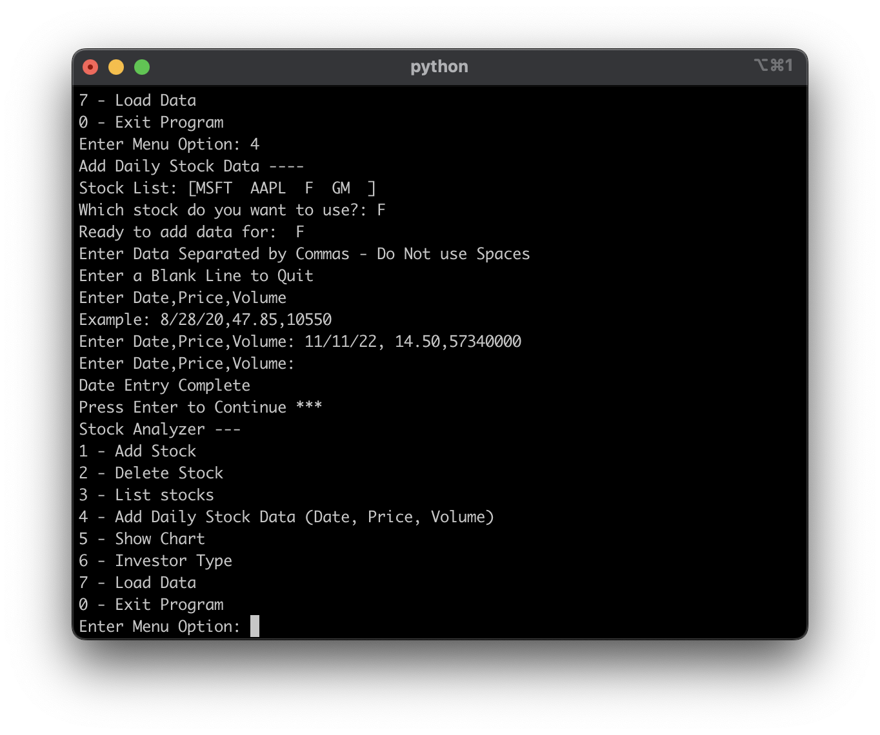
Daily Data
Paste a screen shot of your working Stock program.

Slide 18
CEIS150 Module 4
Inheritance
Summary Report
By Miguel Mastache
11/16/22

Slide 19
CEIS150 Module 4
Inheritance
Summary Report
By Miguel Mastache
11/16/22

Slide 20
Rubric
Activity | Requirement(s) | Points
Inherited classes | Screen shot of classes | 15
Unit Tests | Screen Shot of unit tests working | 15
Main program | Screenshot of classes in main | 10

Slide 21
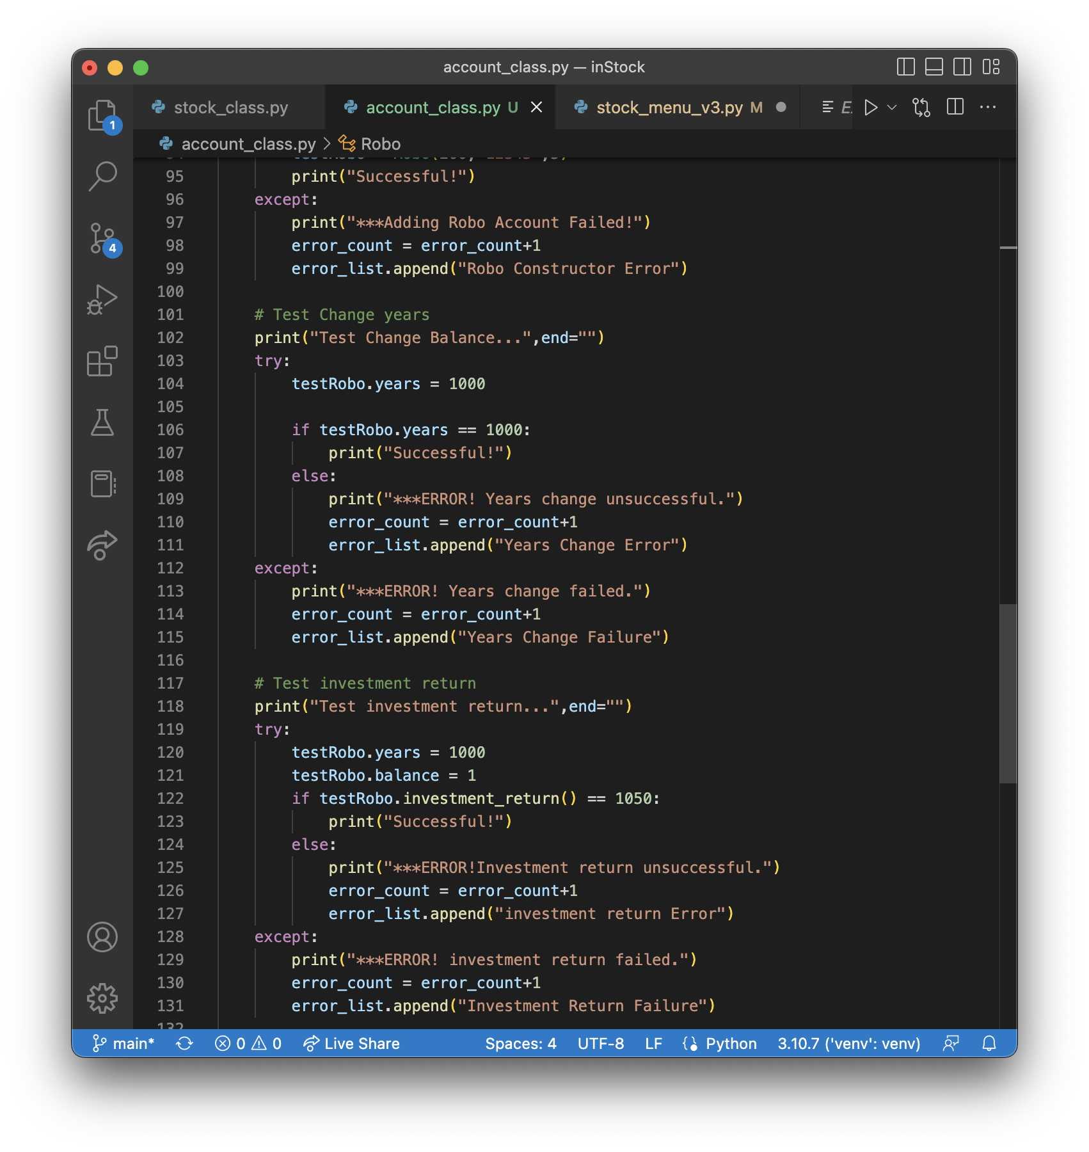
Inherited classes
Paste a screen shot of your classes

Slide 22
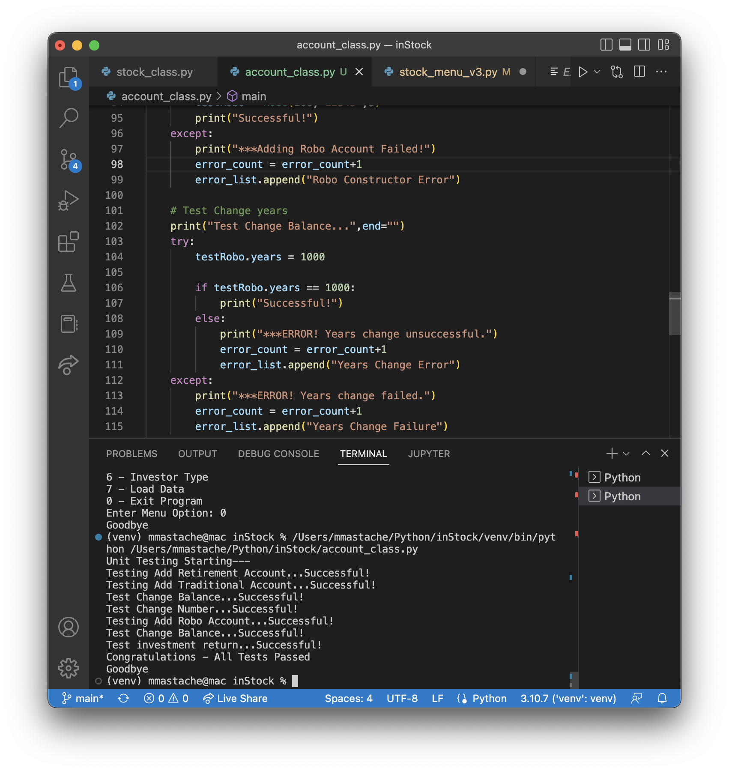
Unit Tests
Paste a screen shot of your unit tests successfully completed

Slide 23
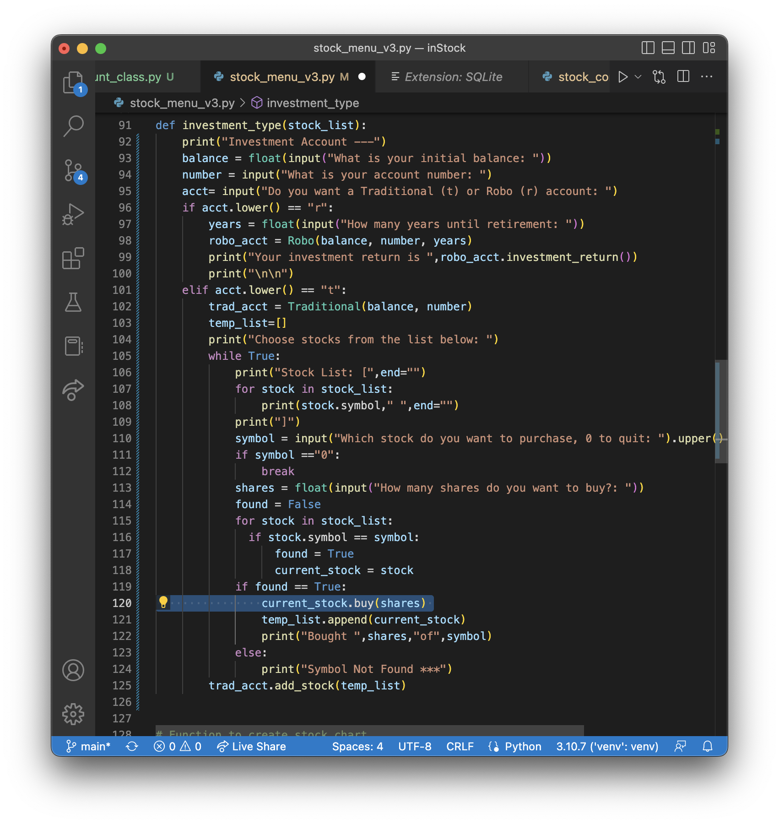
Stock menu program
Paste a screen shot of your classes in the main program

Slide 24
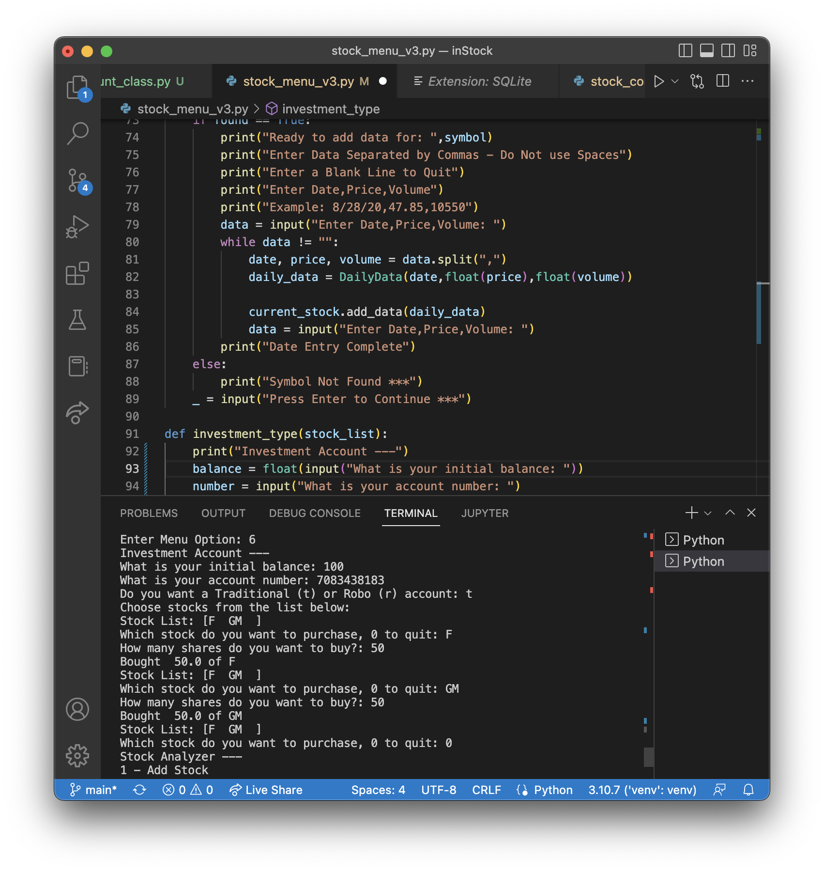
Stock menu program
Traditional Account

Slide 25
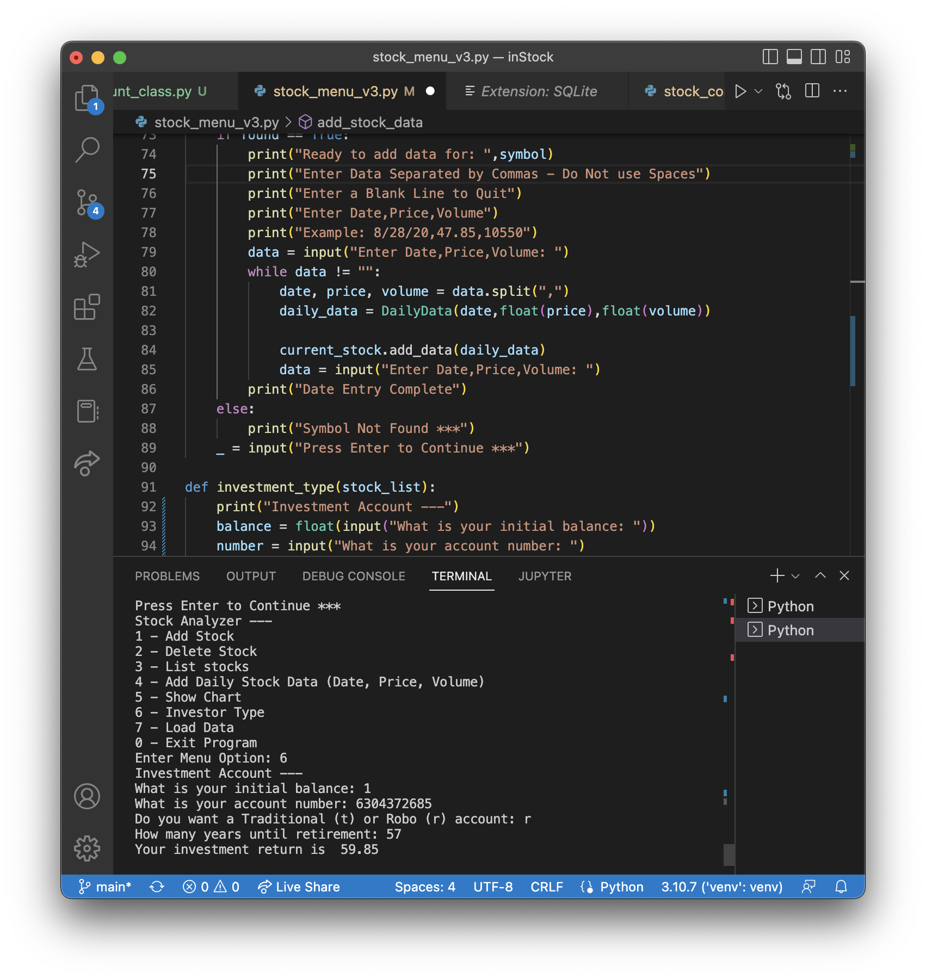
Stock menu program
Robo Account

Slide 26
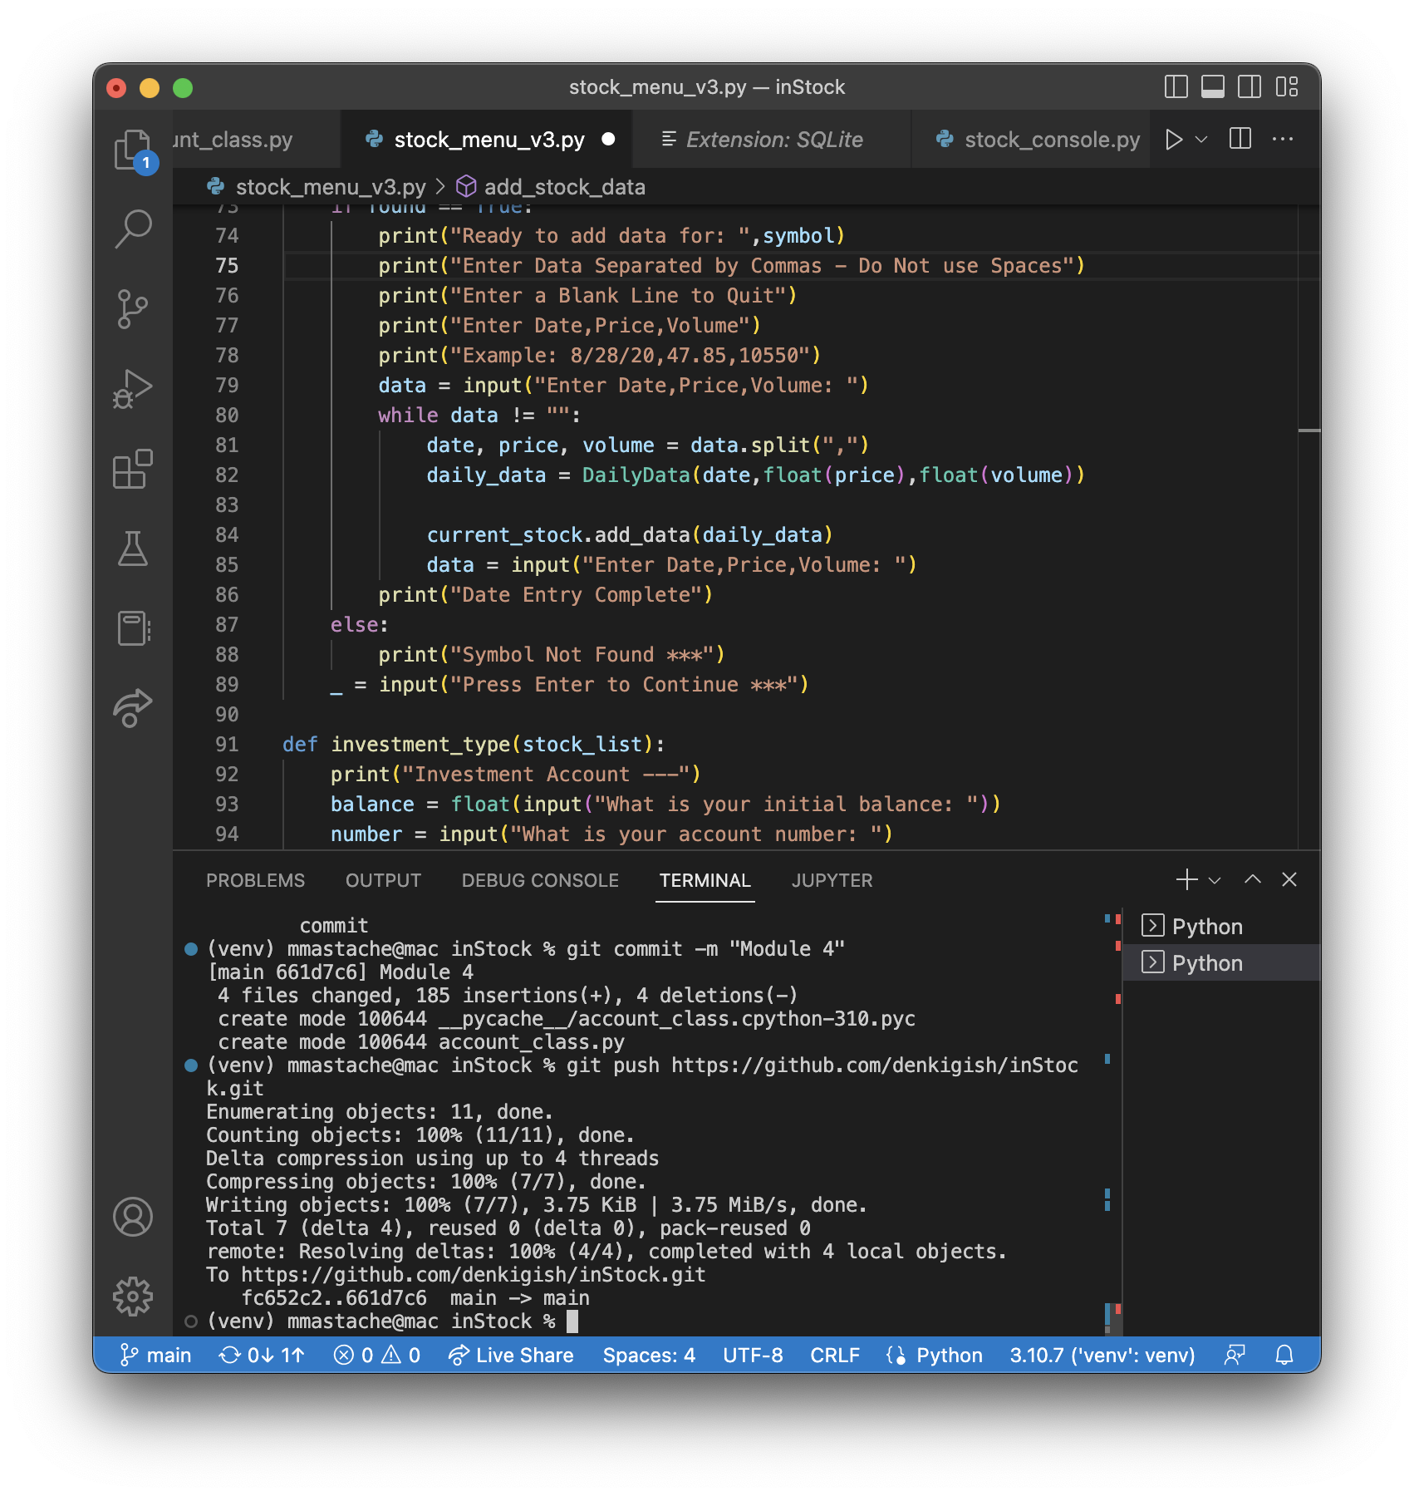
Github Push

Slide 27
CEIS150 Module 5
Creating a Chart
By Miguel Mastache
11/21/22

Slide 28
Rubric
Activity | Requirement(s) | Points
Chart | Screen shot of working Chart | 40

Slide 29
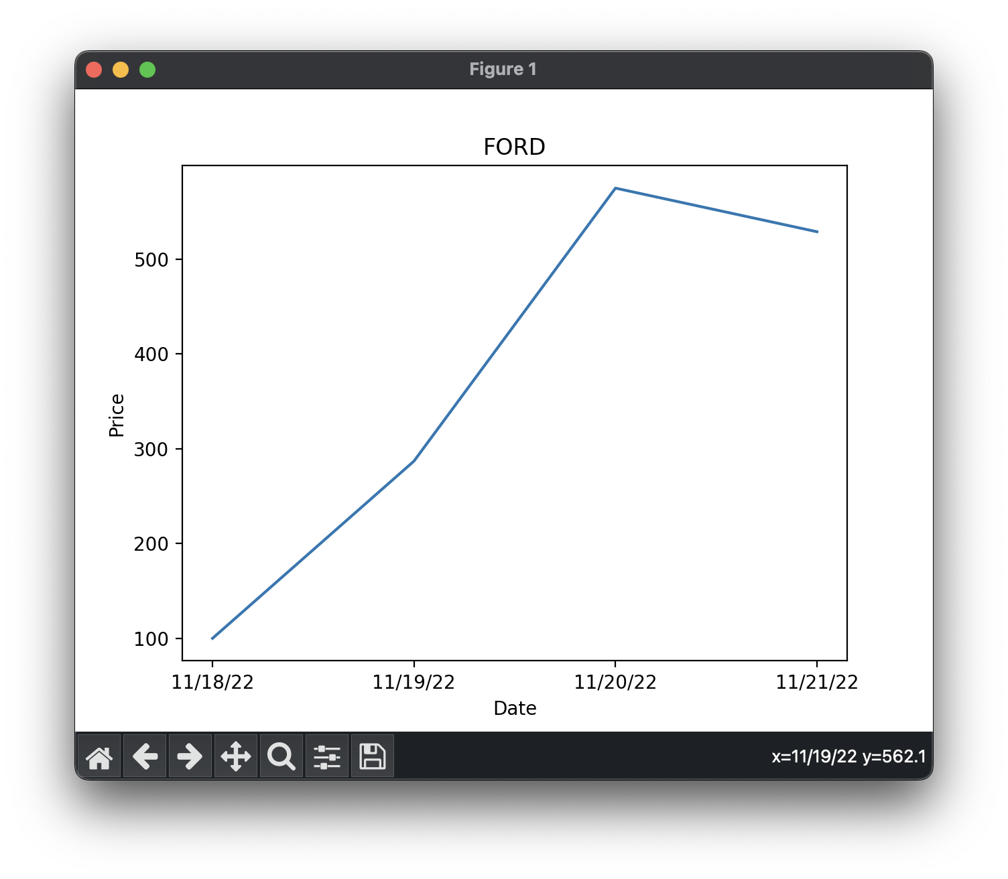
Chart
Paste a screen shot of your stock chart.

Slide 30
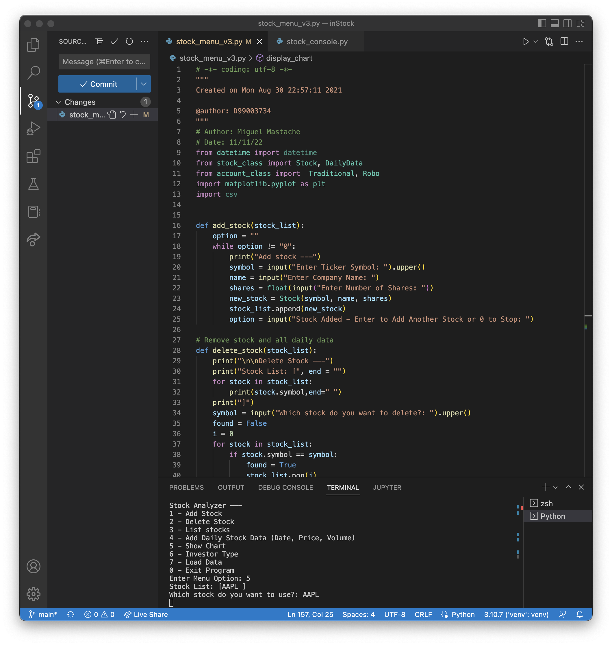
Code

Slide 31
CEIS150 Module 6
Loading Data
By Miguel Mastache
12/3/22

Slide 32
Rubric
Activity | Requirement(s) | Points
File | Screen shot of file in File Explorer | 20
Importing data | Screenshot of chart from historical data import | 20

Slide 33
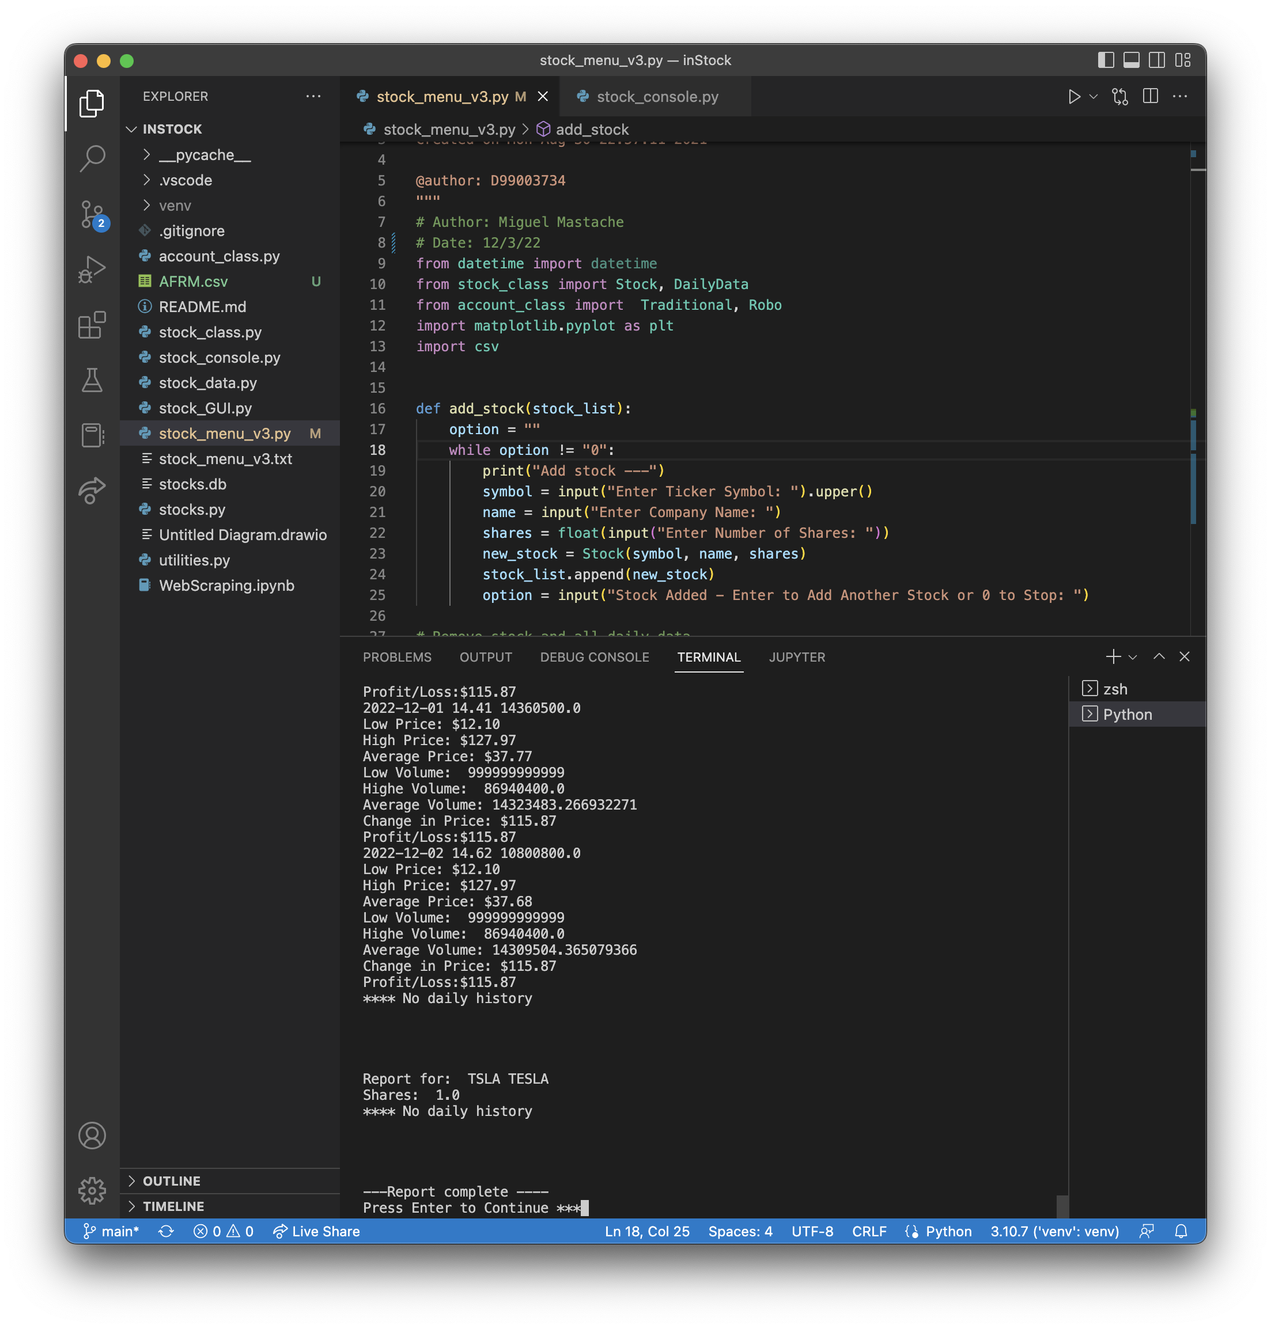
Code

Slide 34
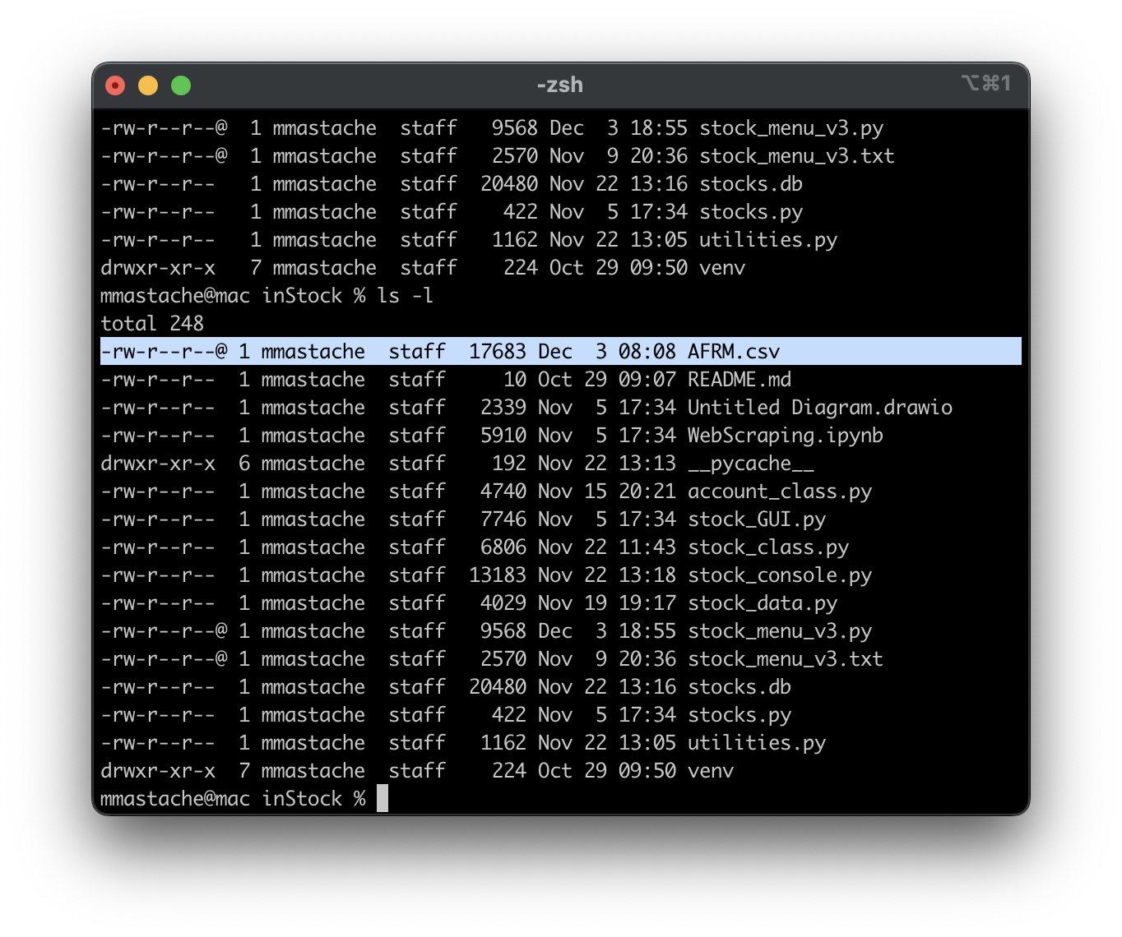
File
Paste a screen shot of the file downloaded from Yahoo finance

Slide 35
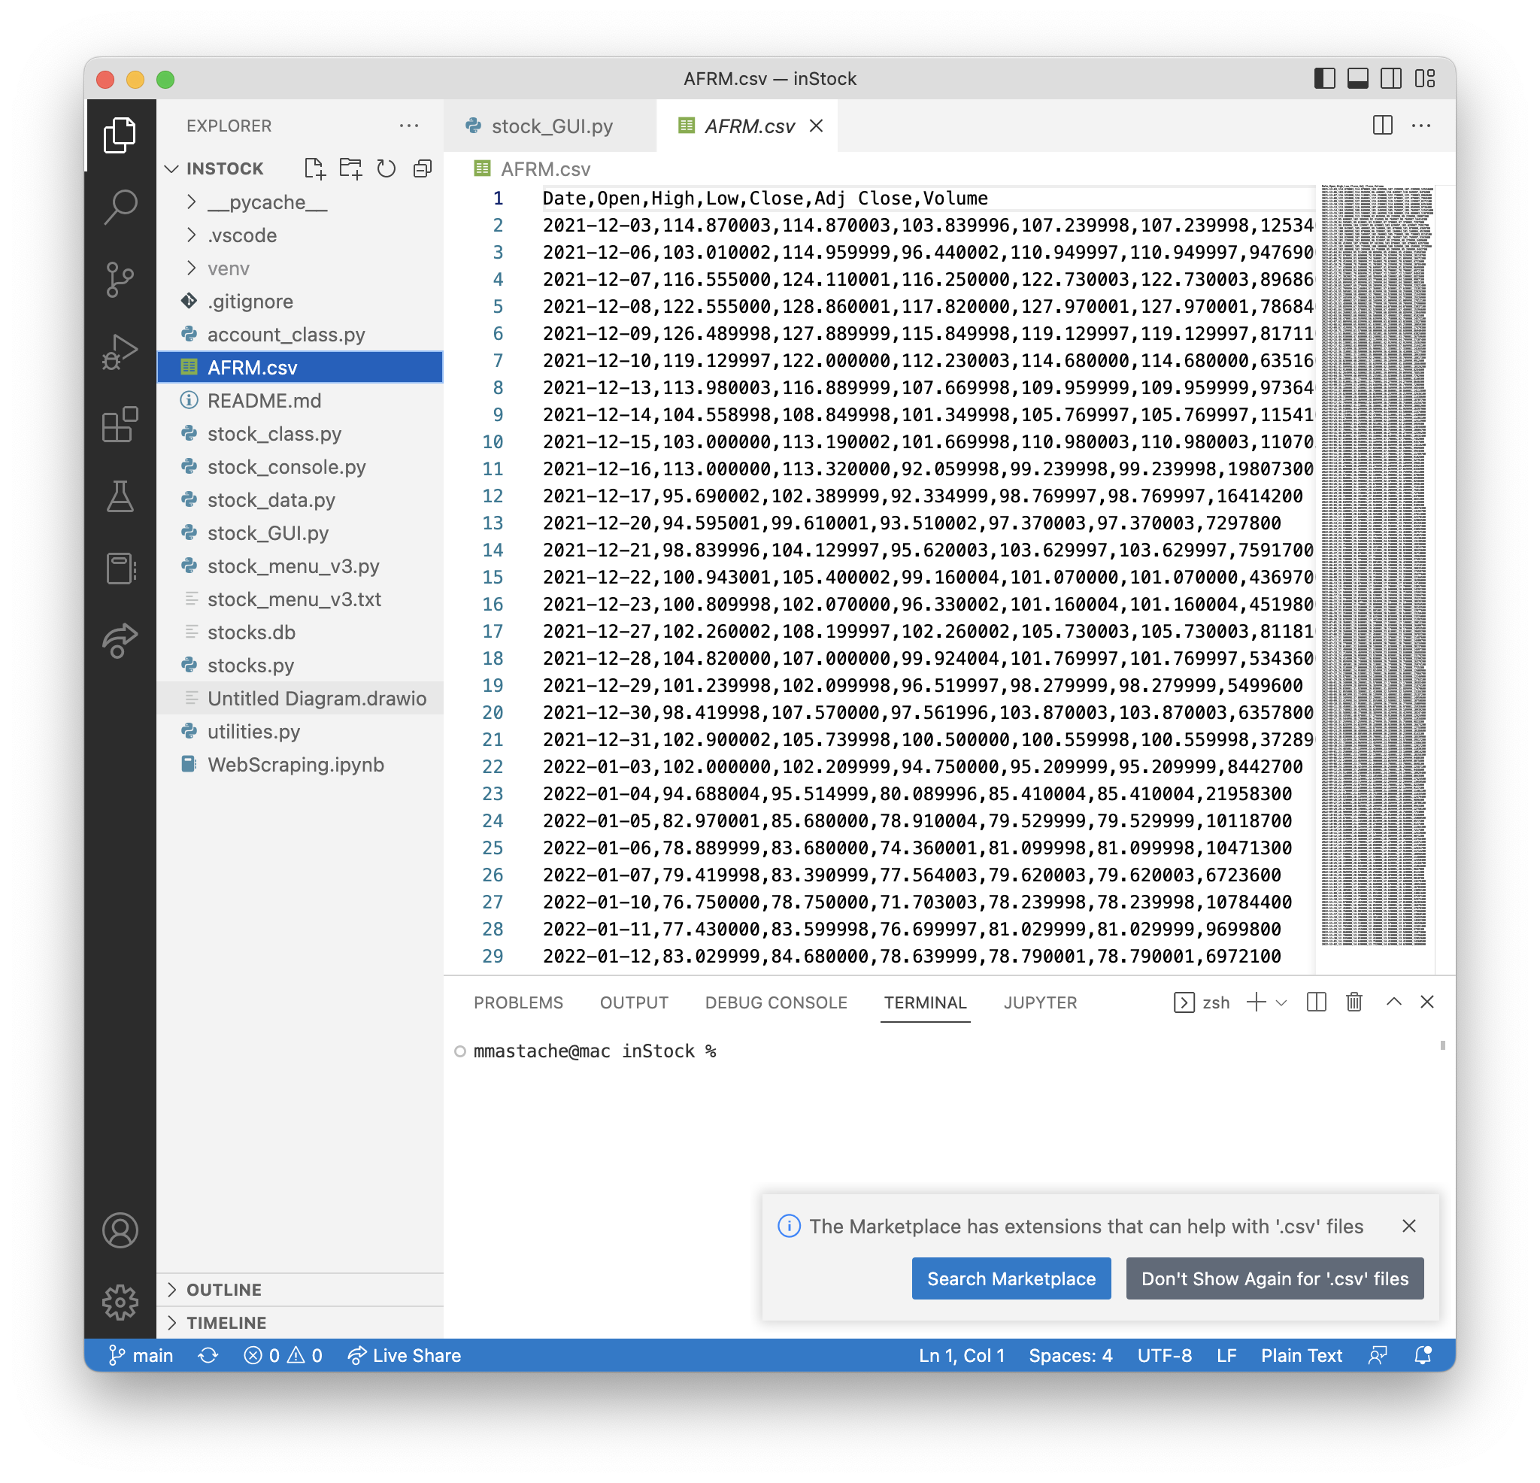
File
Paste a screen shot of the file downloaded from Yahoo finance

Slide 36
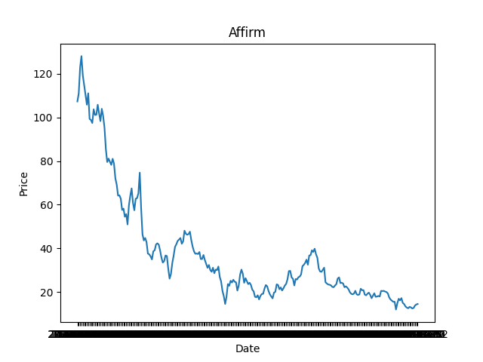
Importing data
Screenshot of the historical data import

Slide 37
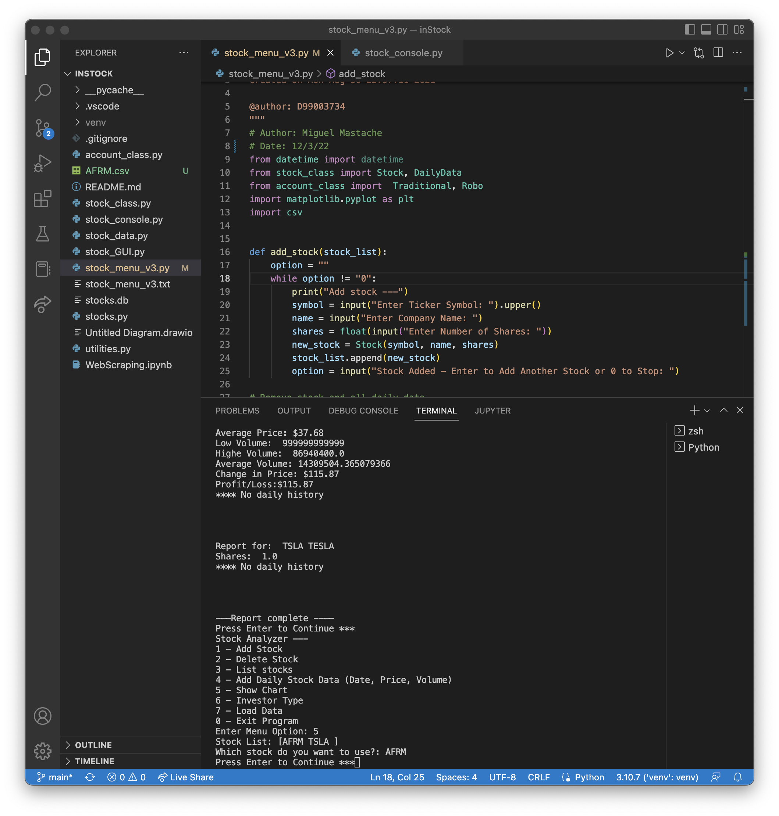
Importing data
Screenshot of the historical data import

Slide 38
CEIS150 Module 7
GUI
By Miguel Mastache
12/6/22

Slide 39
Rubric
Activity | Requirement(s) | Points
Stocks in GUI | Screen shot of working program | 15
History complete | Screen shot of working History Tab | 15
Report Complete | Screen shot of Report Complete | 10

Slide 40
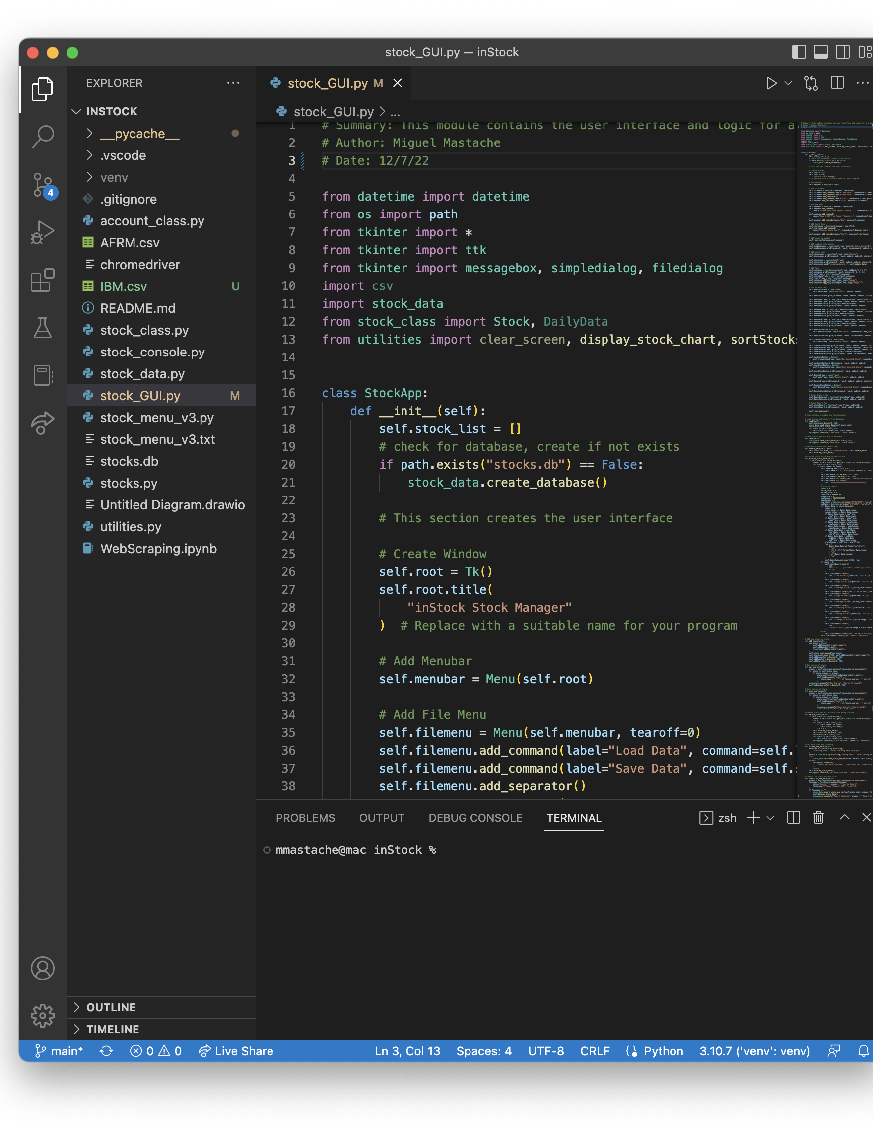
Code

Slide 41
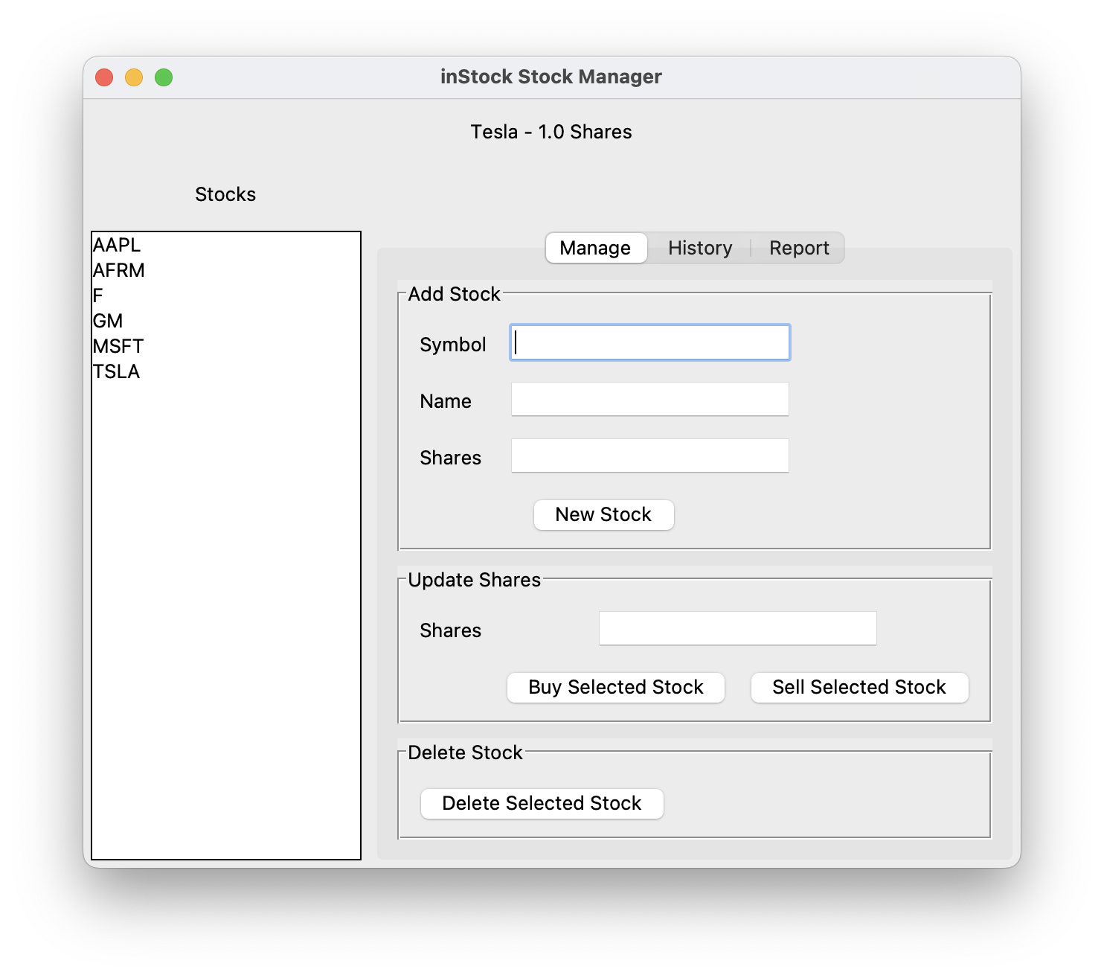
Stocks in GUI
Paste a screen shot of your GUI working

Slide 42
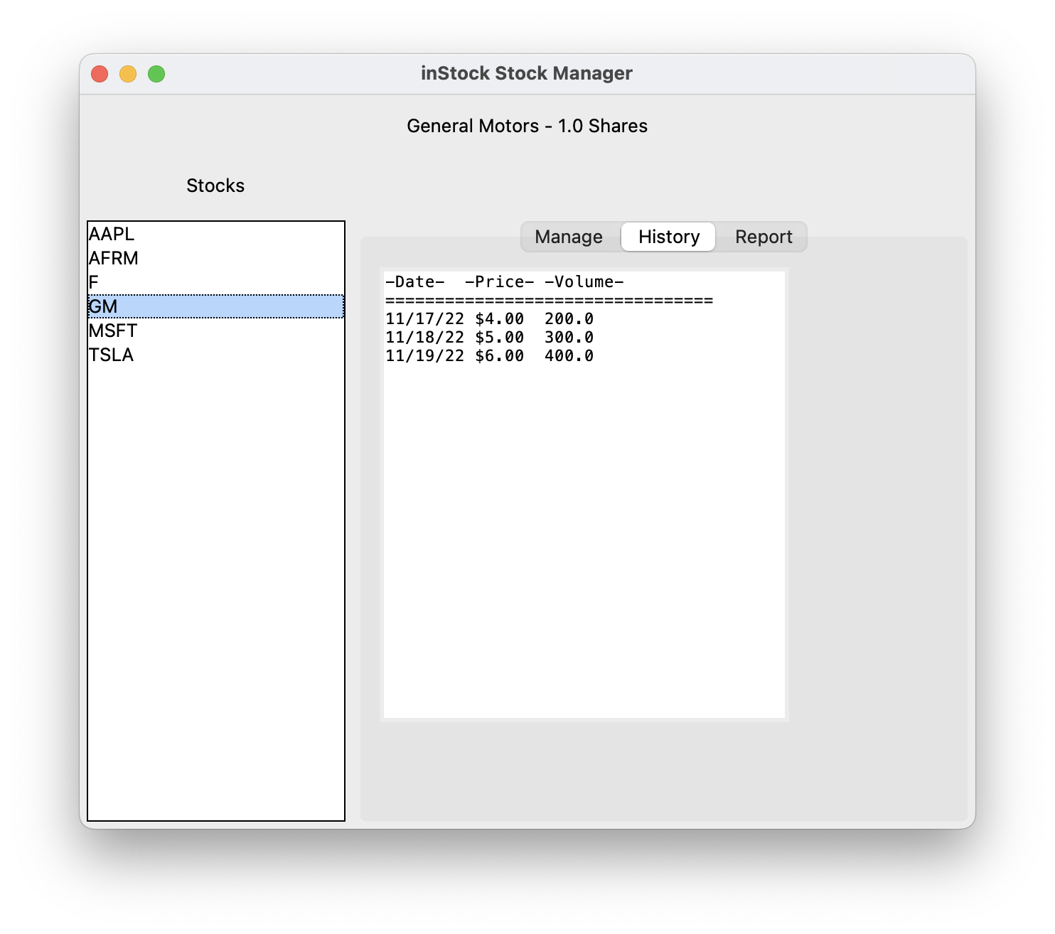
History Tab
Paste a screen shot of your History tab with import working.

Slide 43
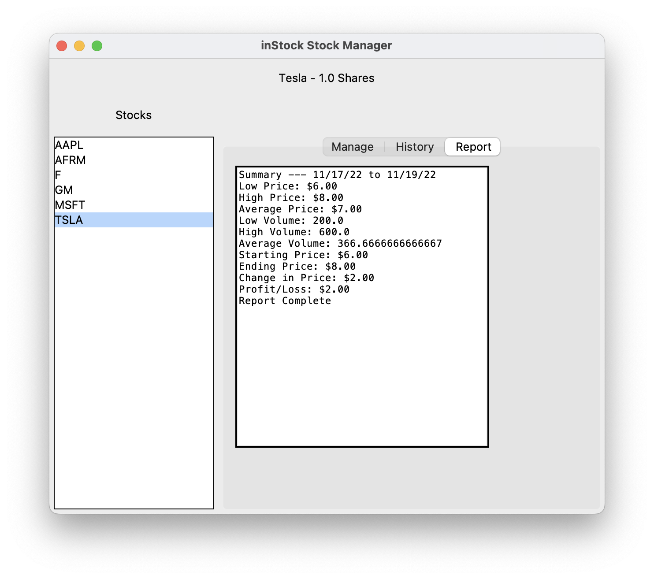
Report Complete
Paste a screen shot of your Report tab

Slide 44
CEIS150 Module 7
Web Scraping

Slide 45
Rubric
Activity | Requirement(s) | Points
History | Screen shot of working History Tab | 15
Report | Screen shot of working Report Tab | 10
Import Complete | Screen shot of Import Complete | 5

Slide 46
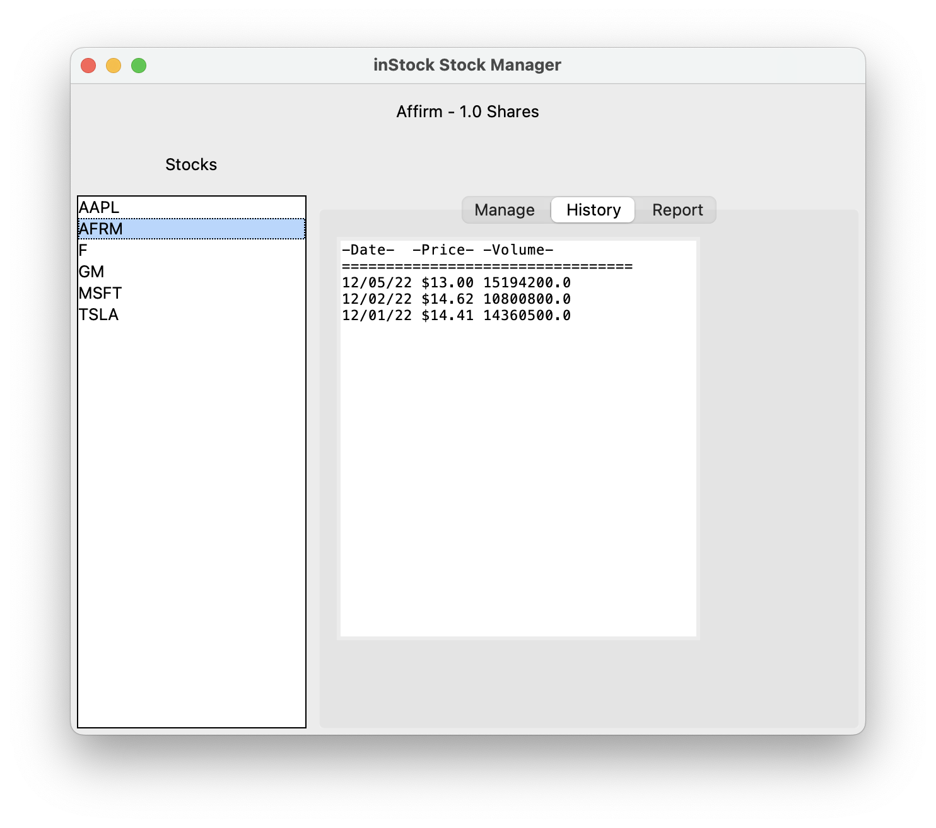
History Tab
Paste a screen shot of your history tab.

Slide 47
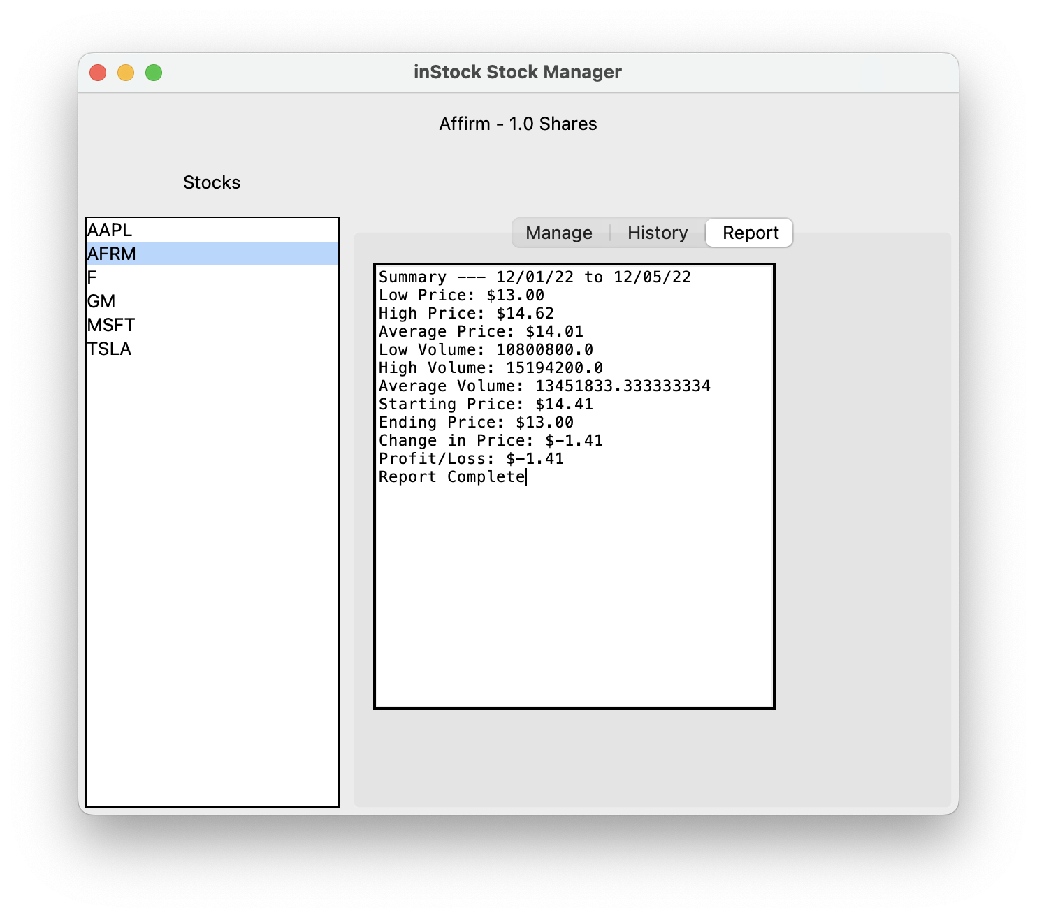
Report Tab
Paste a screen shot of your report tab.

Slide 48
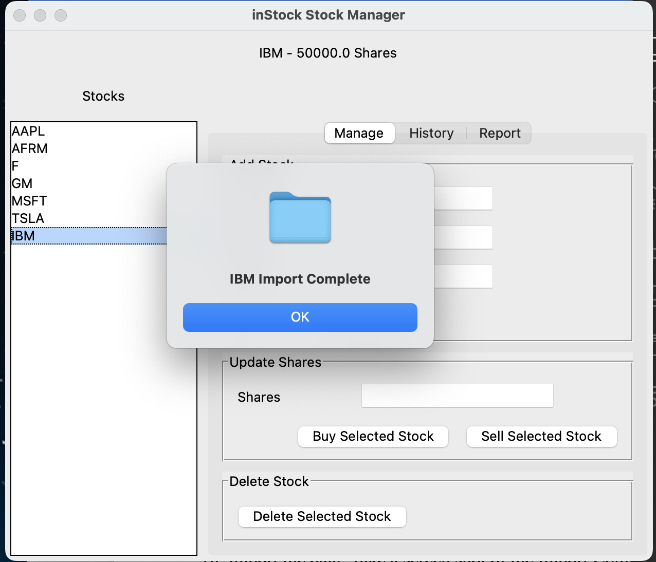
Import Complete
Paste a screen shot of your Import Complete confirmation message.

