Slide 1
inStock Advanced
Python Stock Tracking Project
By Miguel Mastache
10/28/22

Slide 2
Introduction
inStock is a simple stock tracking application. It is capable of importing historical stock information, from either Yahoo! Finance, via CSV or web scraping. This app is able to save your stock purchase history, and produce reports based on your purchase history.

Slide 3
Environment
This part of the project focus’ on setting up the environment used to develop the stock tracking application.

Slide 4
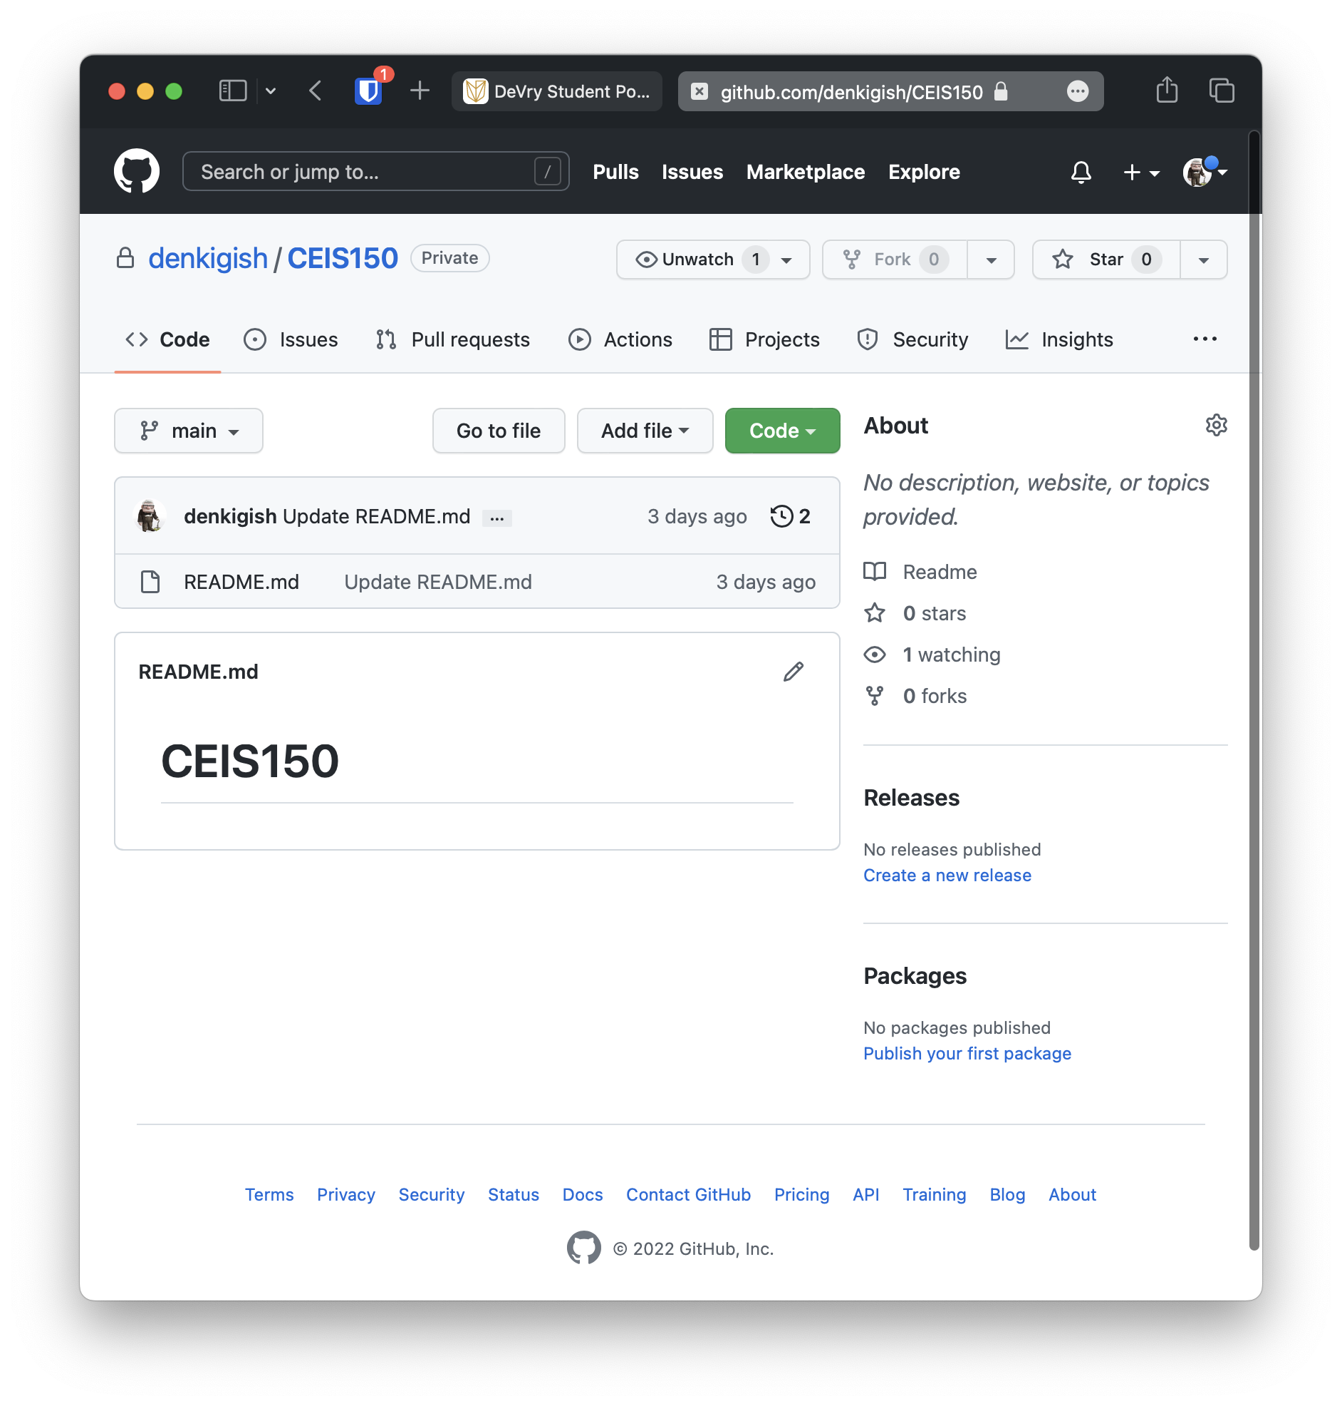
GitHub
Screen shot of GitHub project repository.
For this class, I setup a GitHub repository. It can be found at:
https://github.com/denkigish

Slide 5
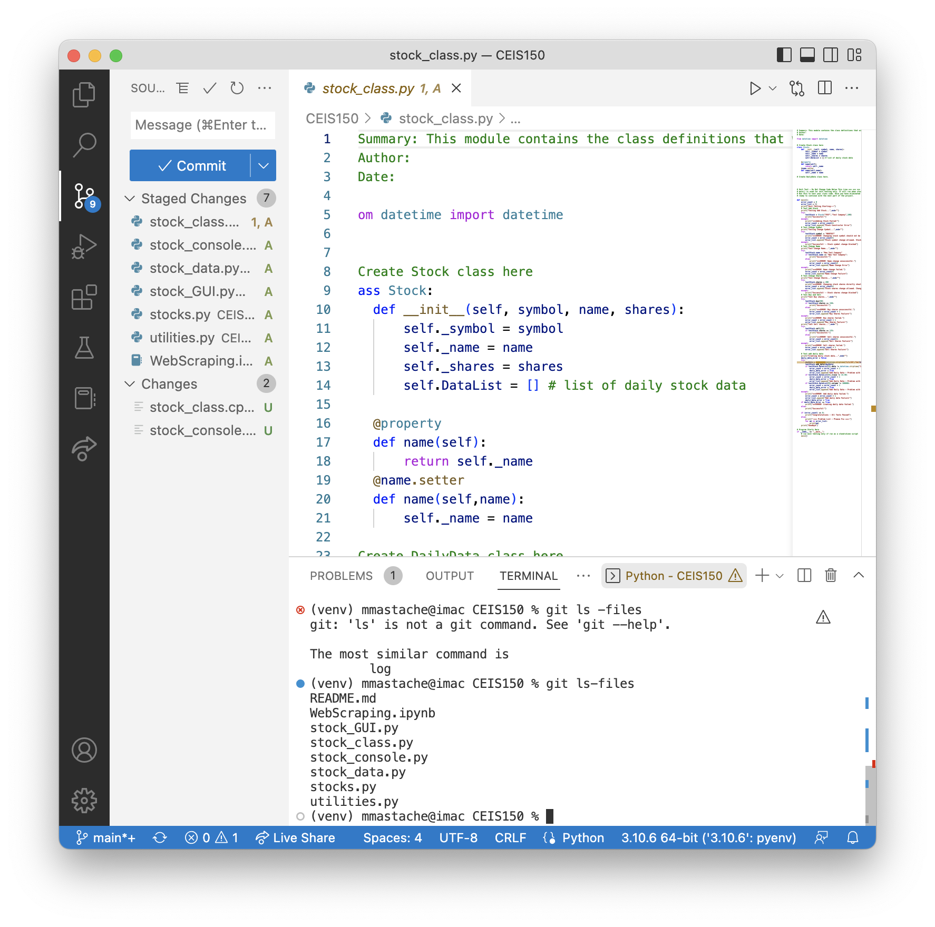
IDE & Starter Files
Screen shot of your IDE (Spyder or VS Code) with the project Starter Files loaded.
Also chose to use the VS Code IDE for development of the project. Shown is VS Code with the starter files loaded.

Slide 6
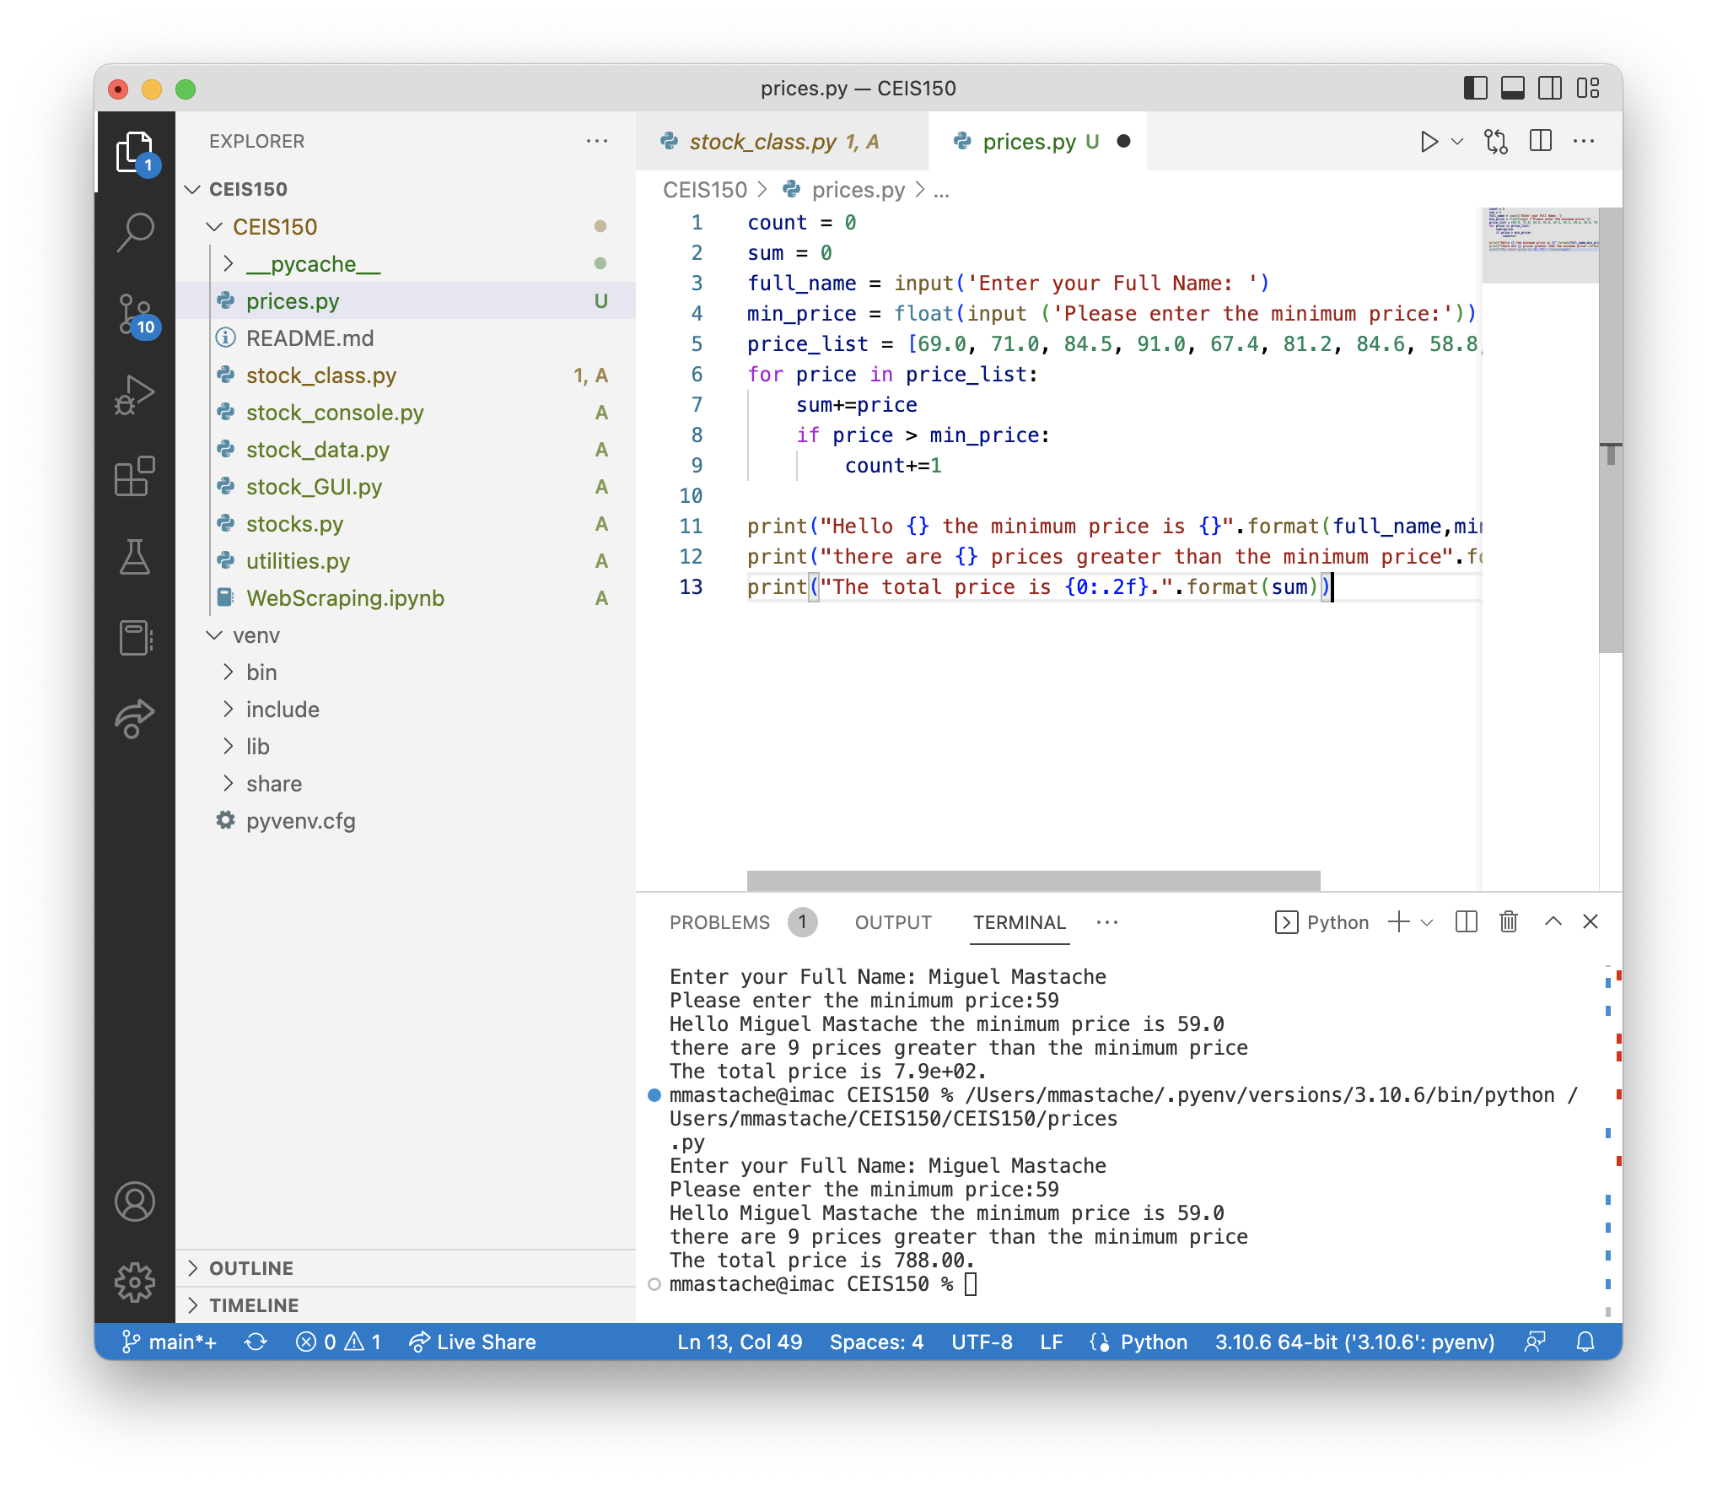
Program
Screen shot of Python program running successfully.
prices.py working with price list, summing, and counting stocks above minimum price.

Slide 7
UML and Class Definition
This section covers the development of the classes needed to work with our stock and history data. These classes are the foundation of my program.

Slide 8
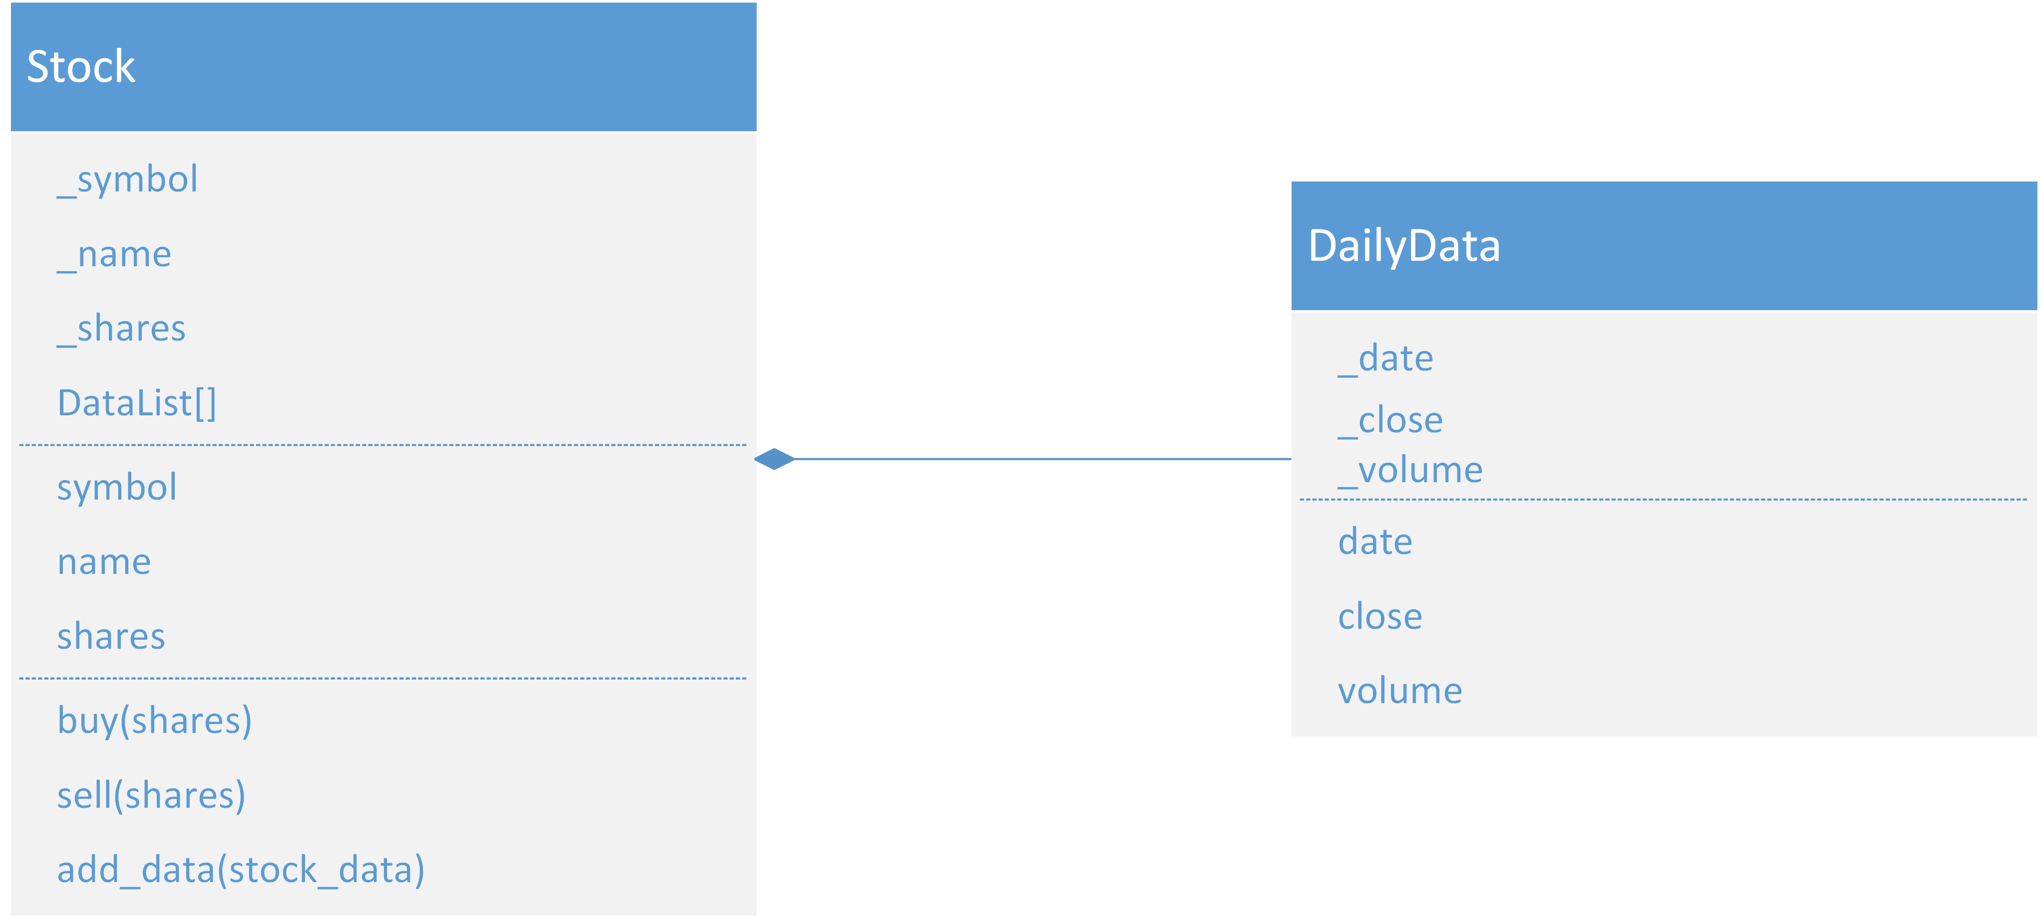
Class Diagram
Paste your Visio Class Diagram

Slide 9
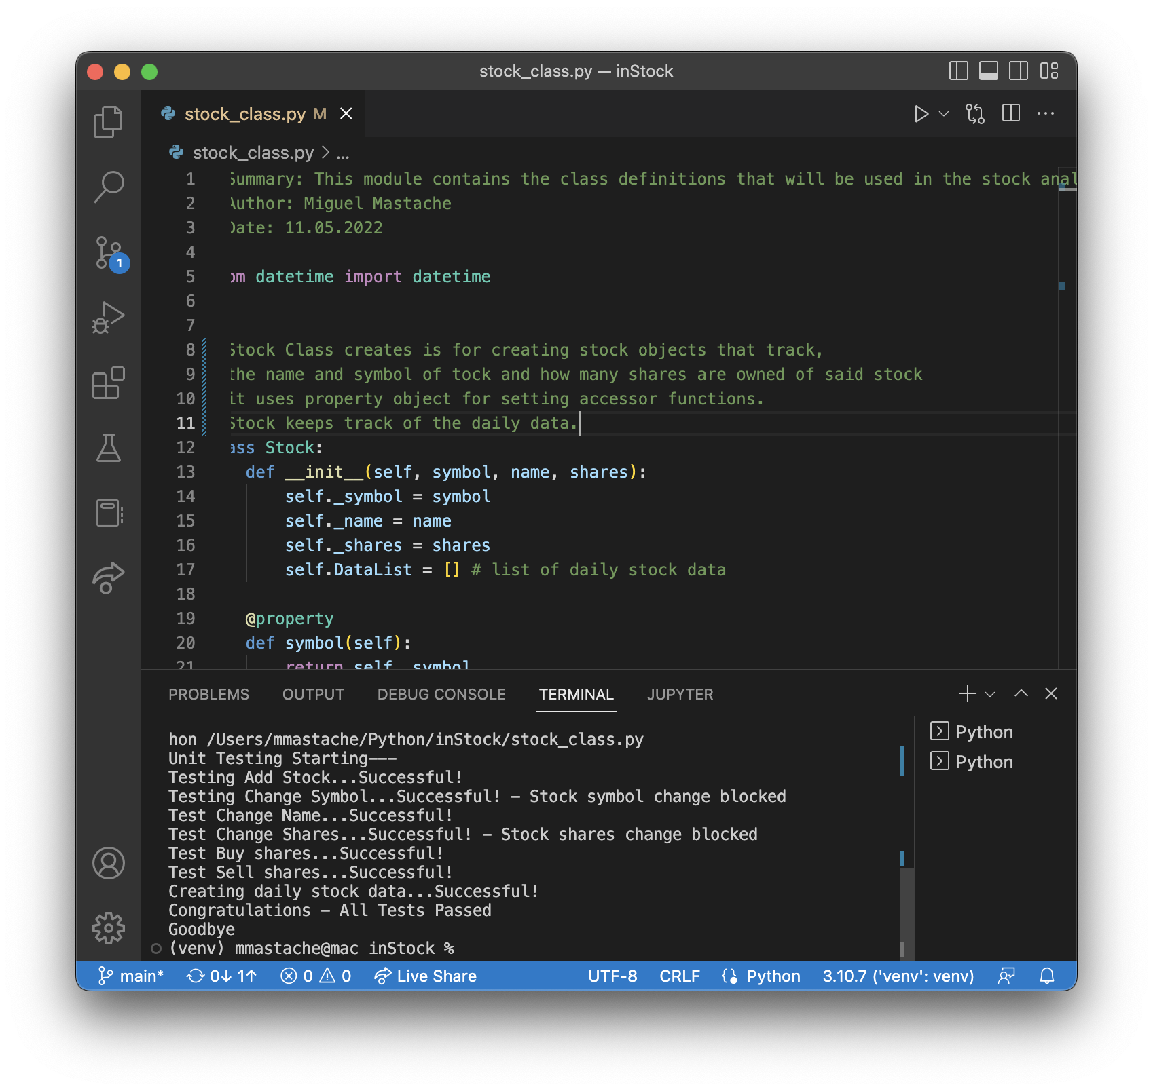
Class Code
Screen Shot of your stock_class.py file.

Slide 10
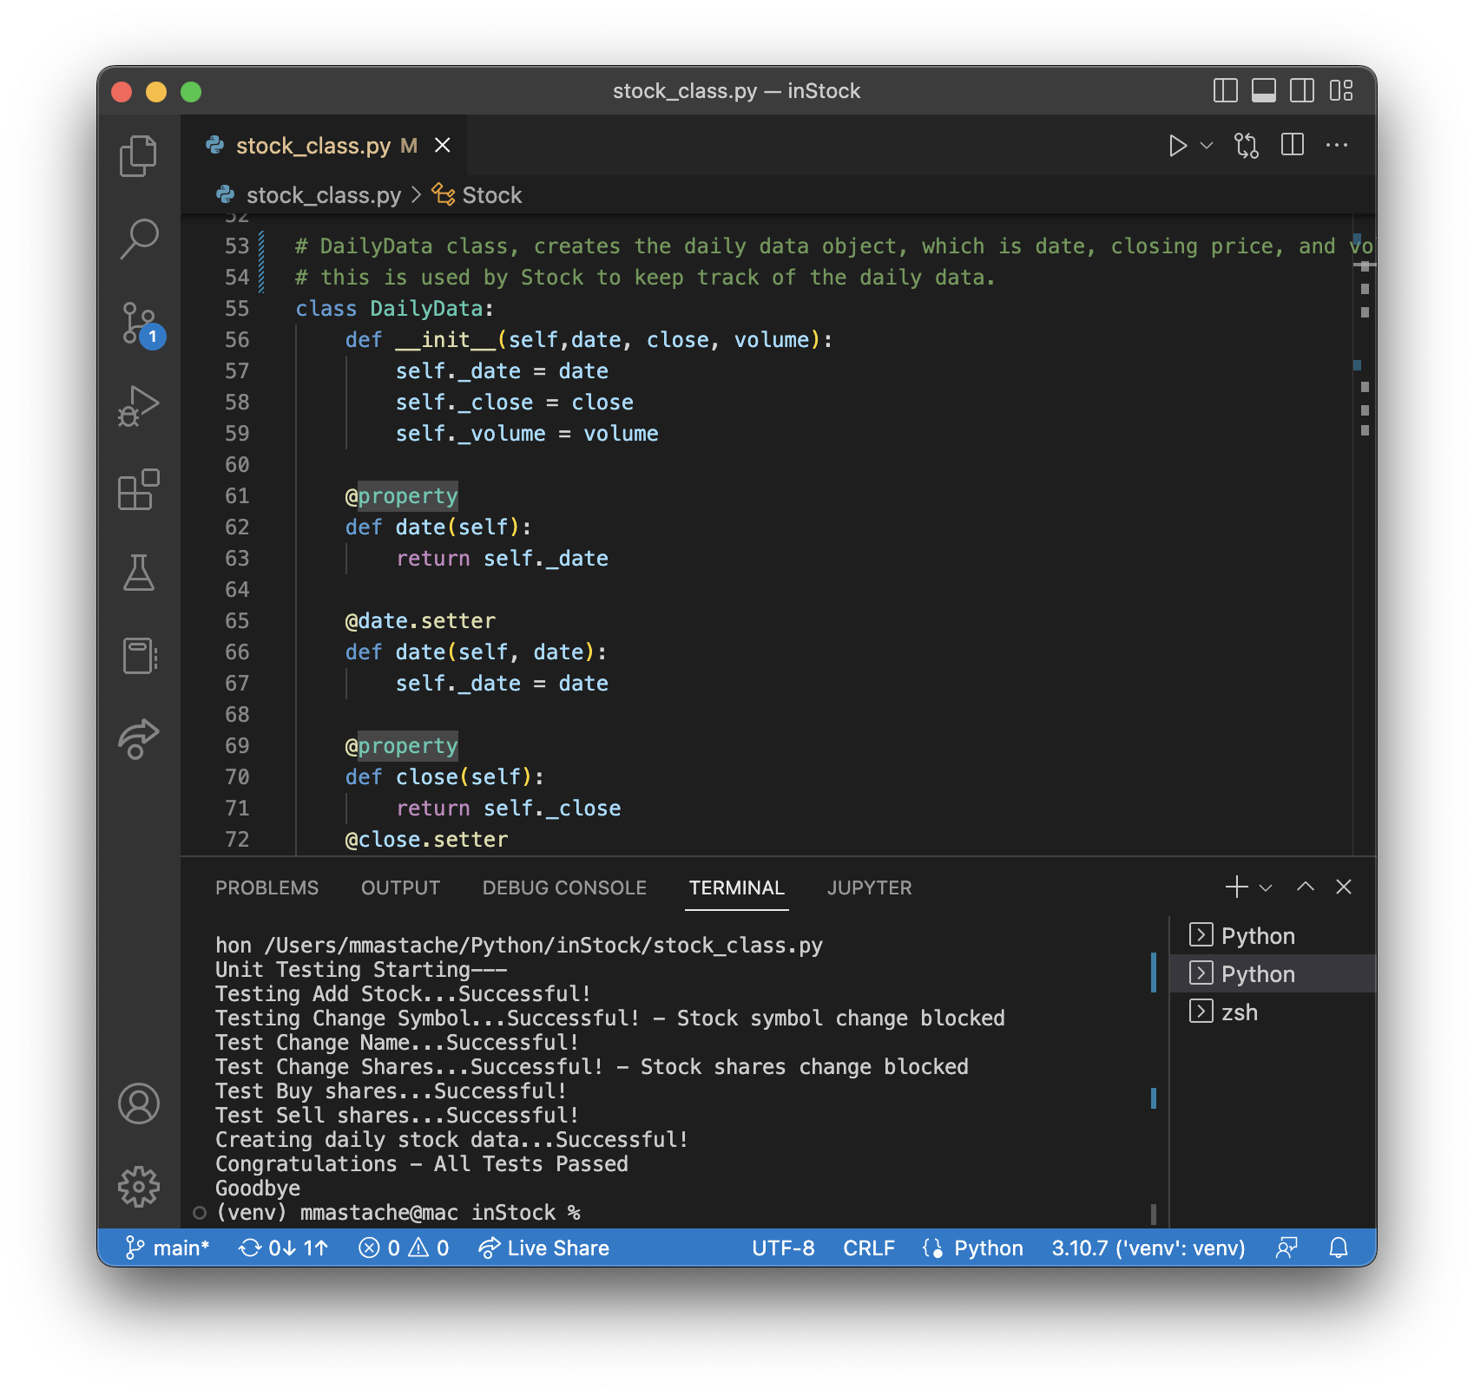
Unit Test
Screen Shot of your successful unit test.

Slide 11
Console Interface
This section covers the creation of console-based interface for working with stocks and the stock price history. It develops the code for adding stock, and its daily data.

Slide 12
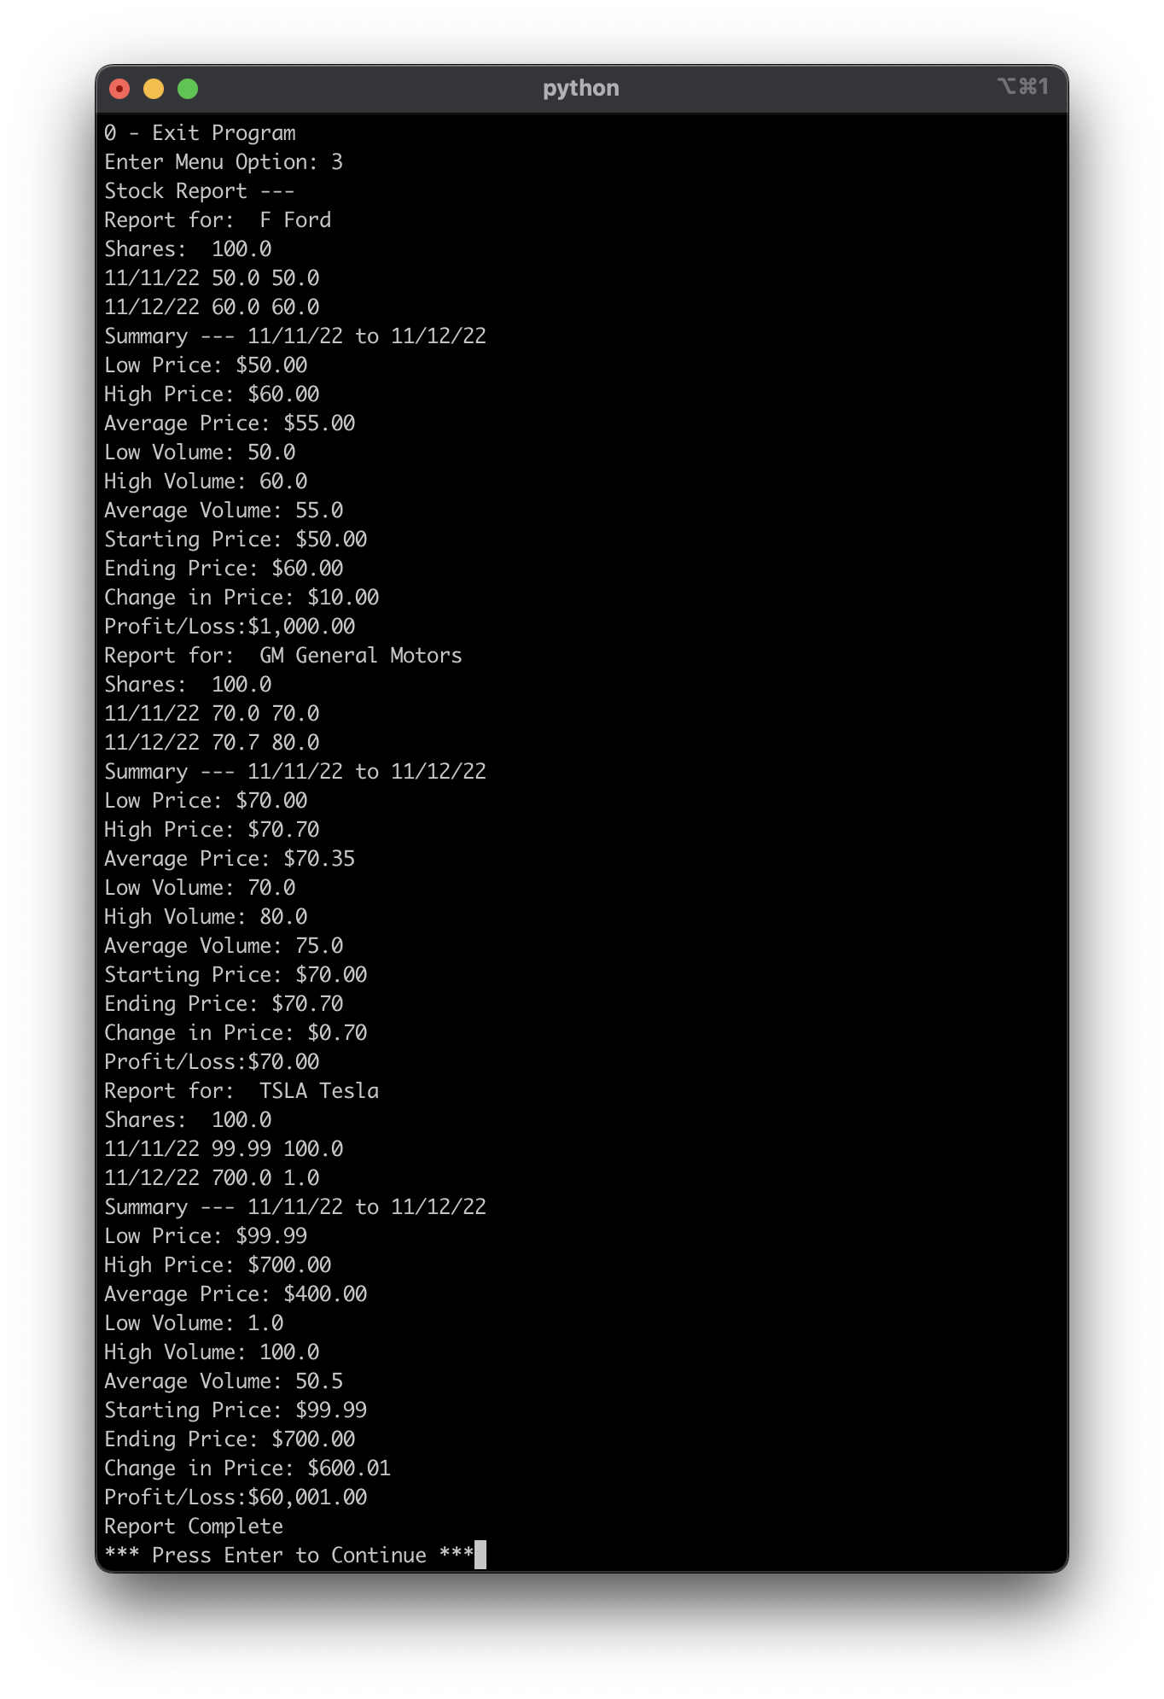
Report
Paste a screen shot of your working Stock Report.

Slide 13
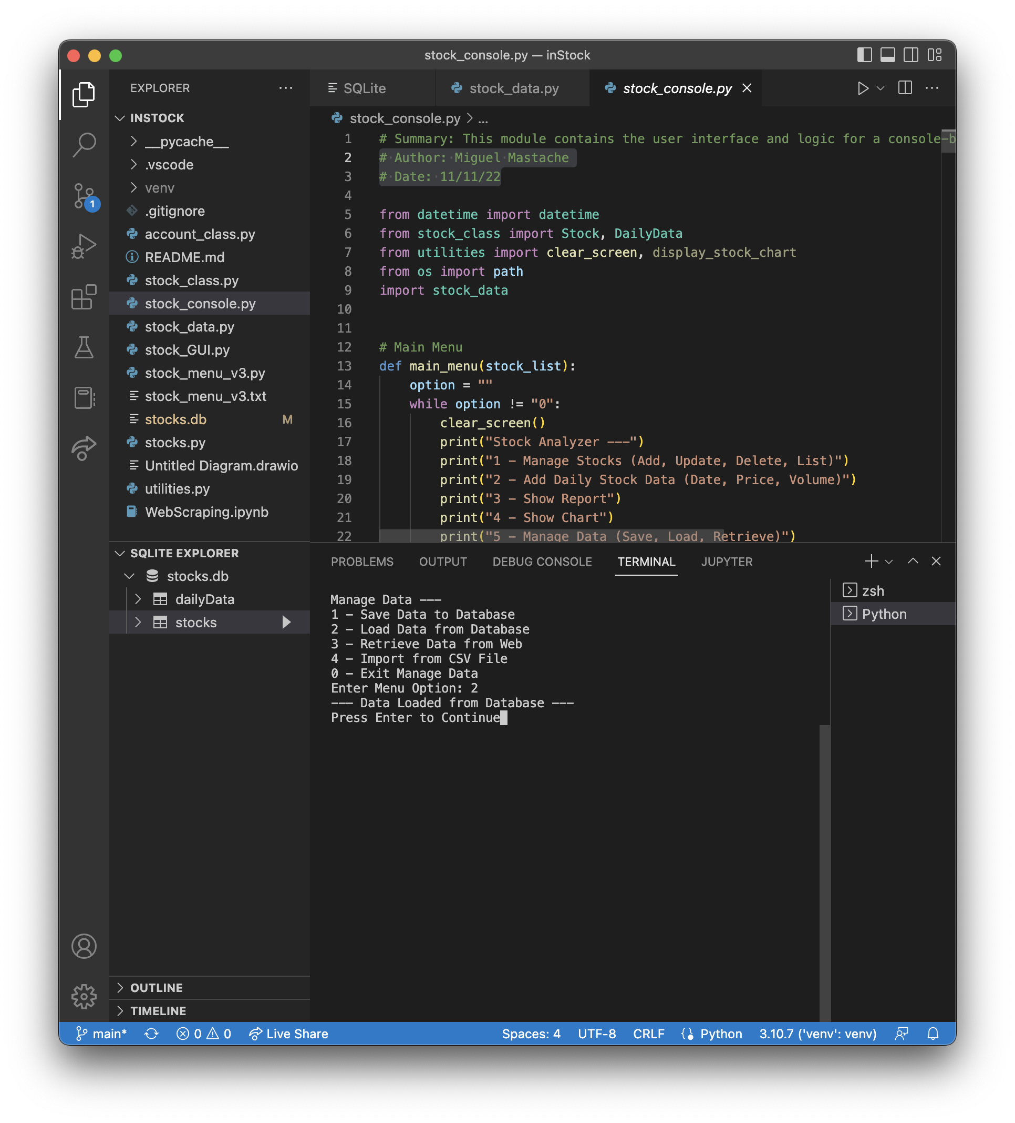
Load Database
Paste a screen shot of your Data Loaded from Database message.

Slide 14
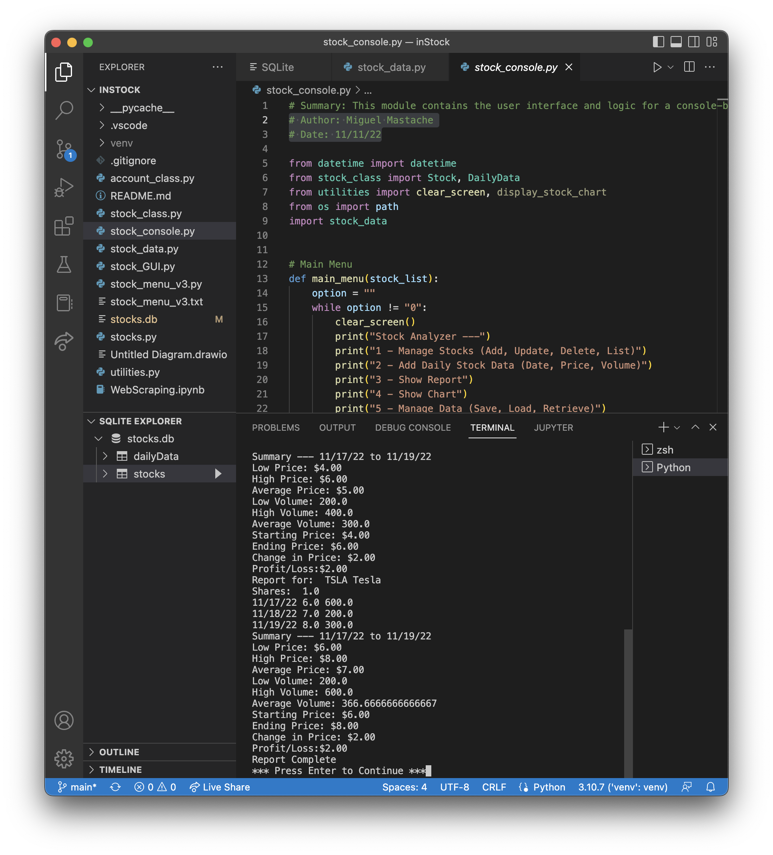
Report
Paste a screen shot of your working Stock Report.

Slide 15
Charts
In this section, we use the matplotlib library to display charts for the stock data.

Slide 16
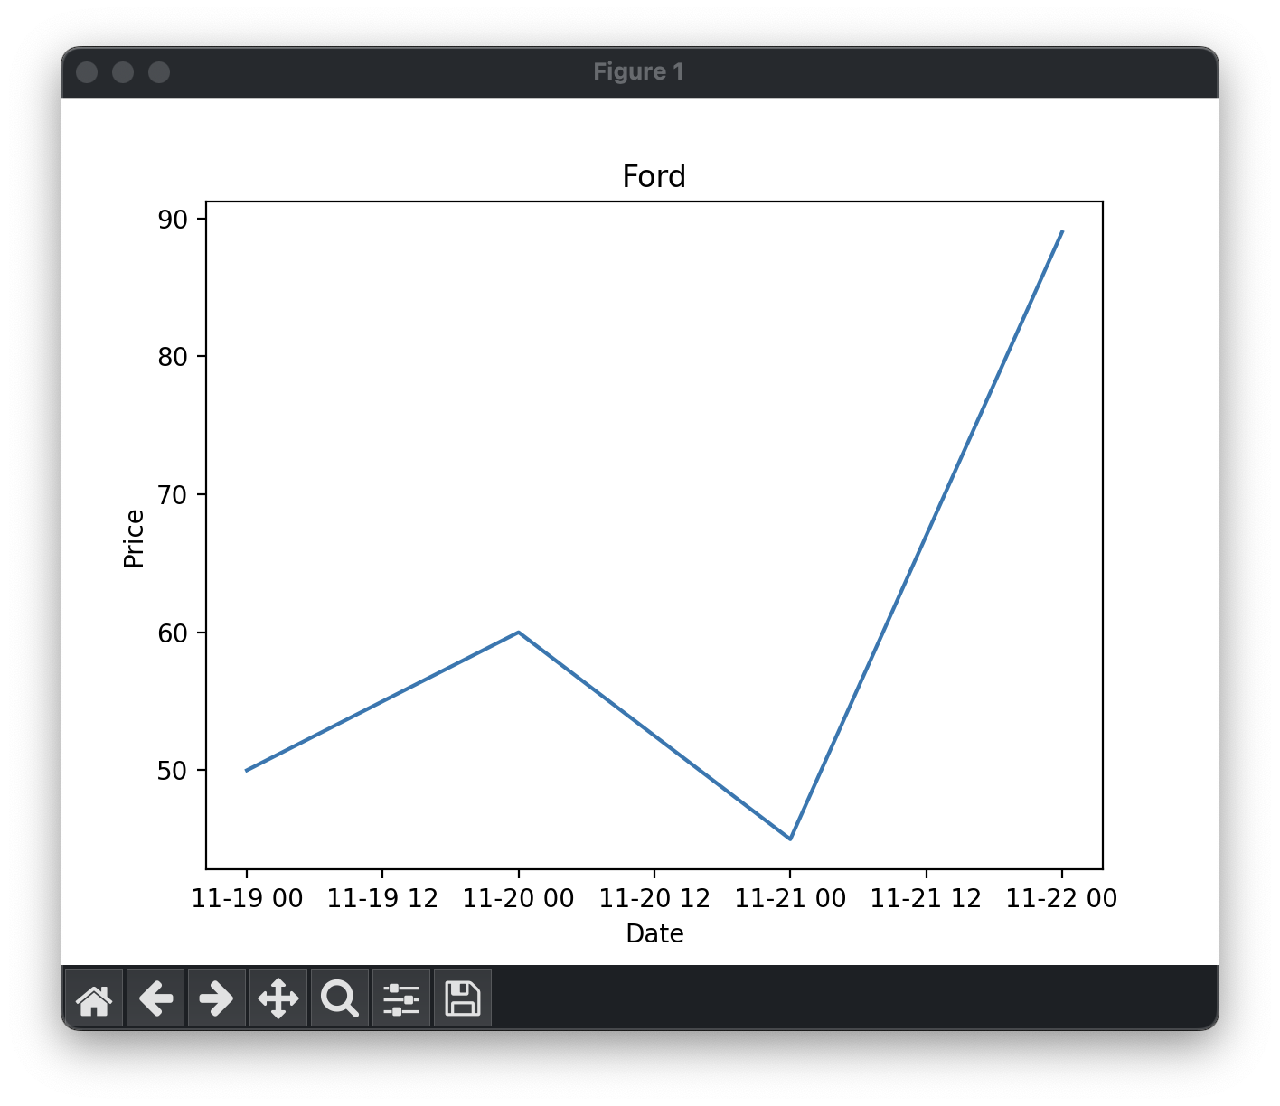
Optional Chart
Paste a screen shot of your stock chart.

Slide 17
File Processing
This section covers file processing, by developing file saving code, and importing of saved data in csv format.

Slide 18
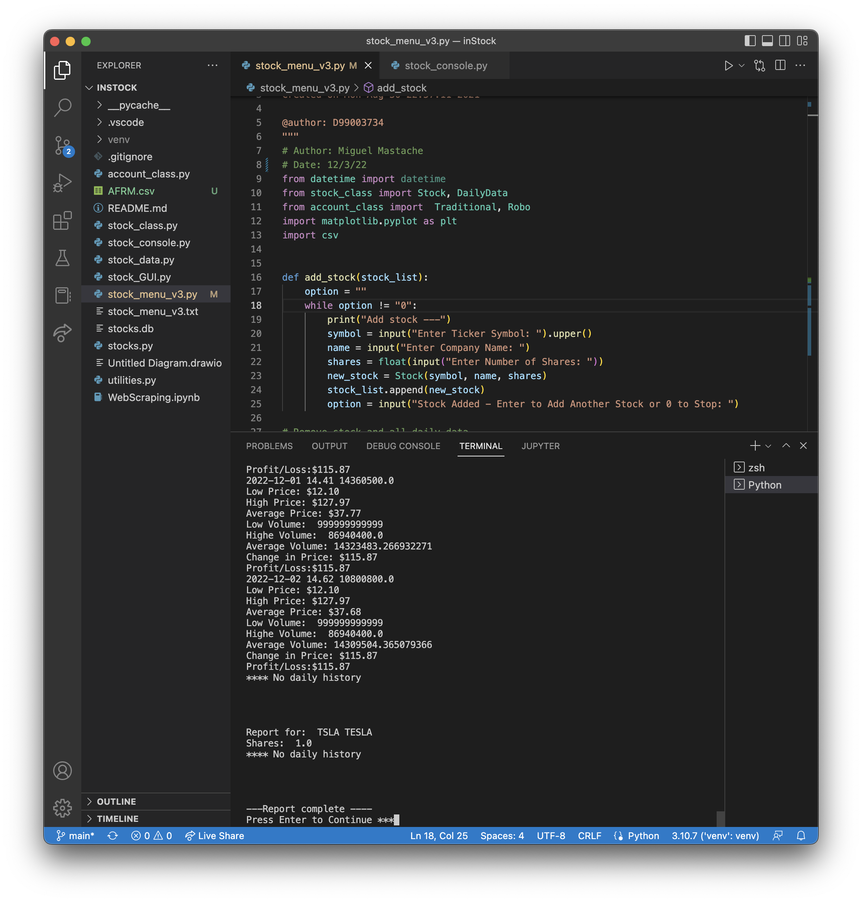
Code

Slide 19
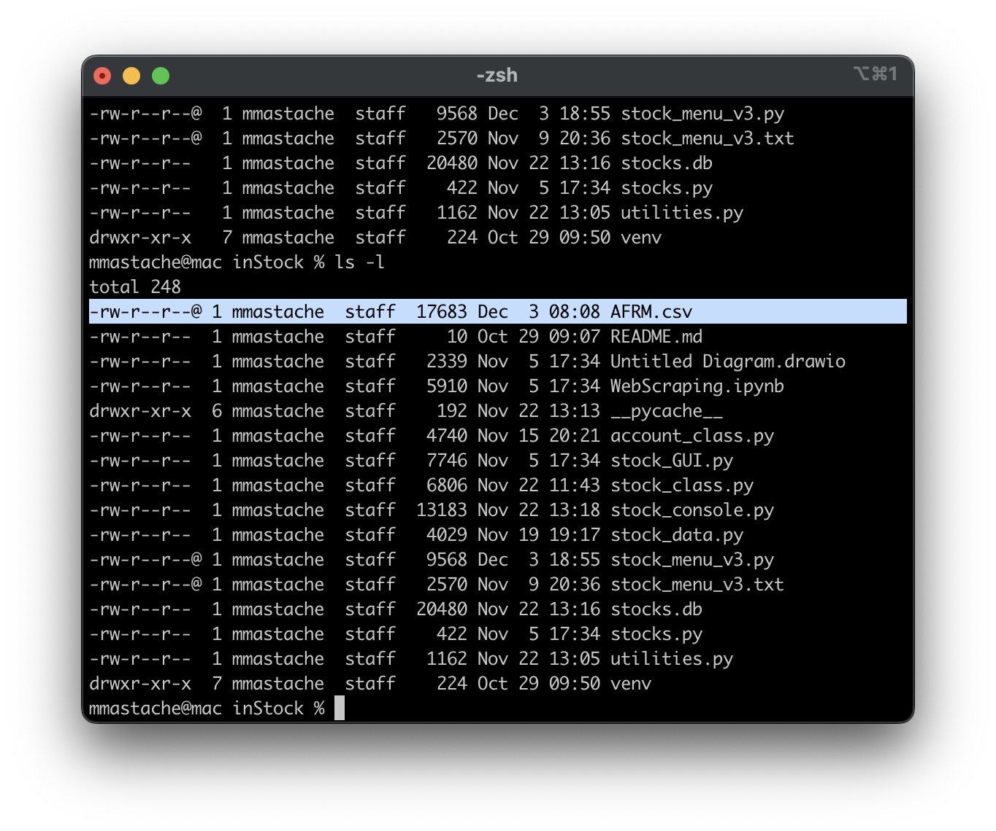
File
Paste a screen shot of the file downloaded from Yahoo finance

Slide 20
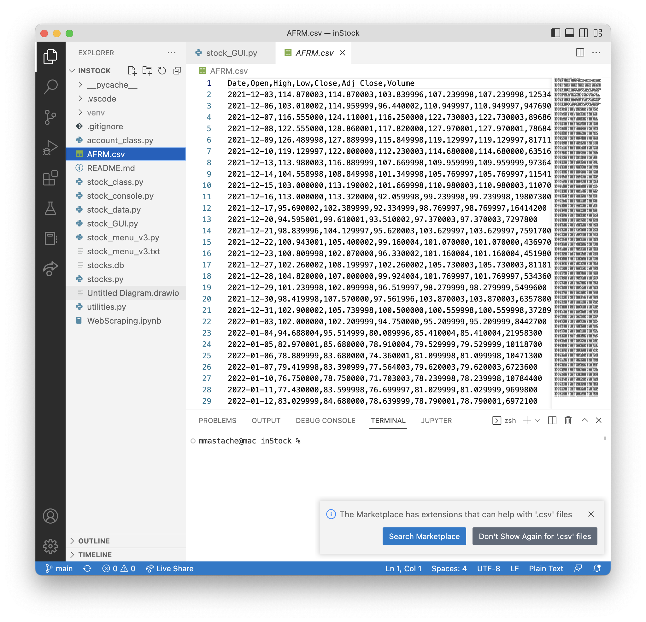
File
Paste a screen shot of the file downloaded from Yahoo finance

Slide 21
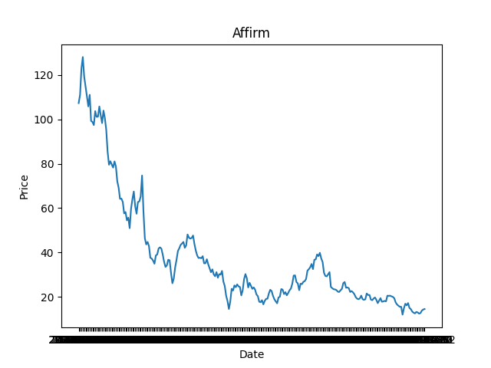
Importing data
Screenshot of the historical data import

Slide 22
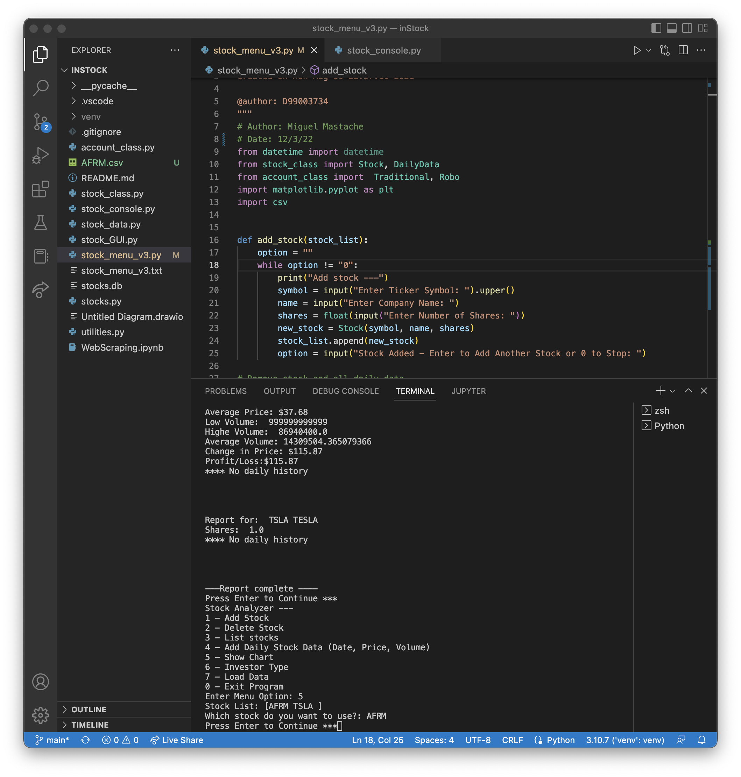
Importing data
Screenshot of the historical data import

Slide 23
GUI
This section covers the development of the graphical user interface for the stock tracking application.

Slide 24
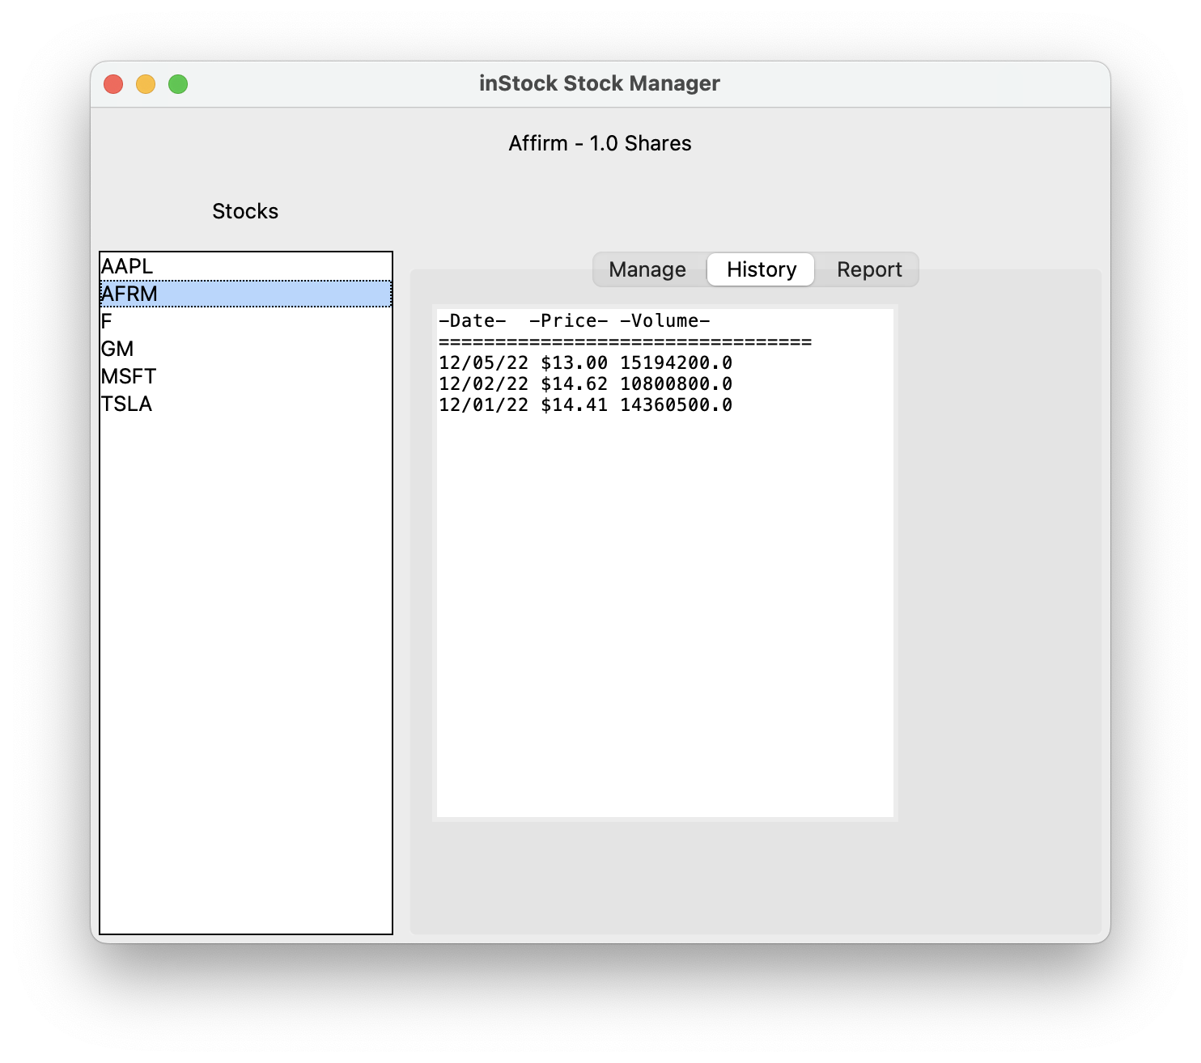
History Tab
Paste a screen shot of your history tab.

Slide 25
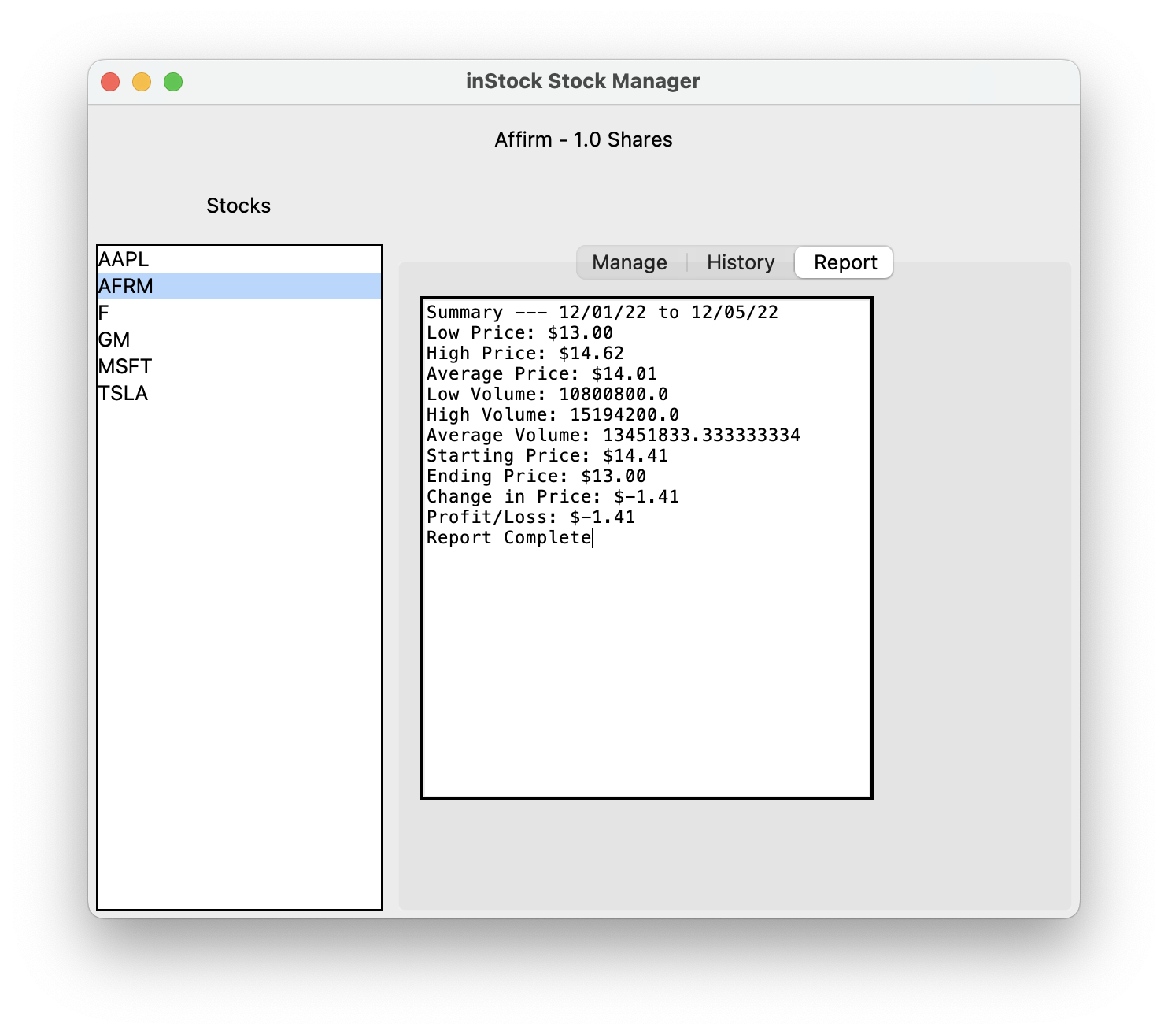
Report Tab
Paste a screen shot of your report tab.

Slide 26
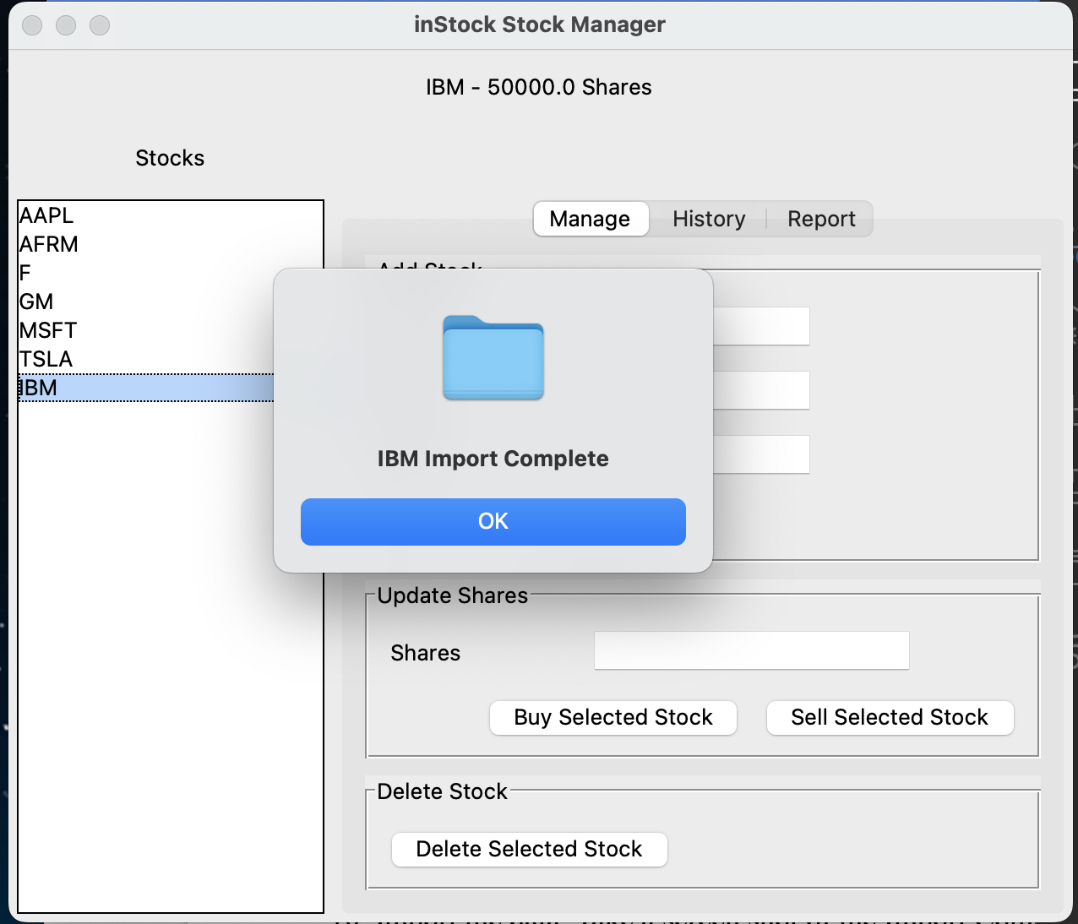
Import Complete
Paste a screen shot of your Import Complete confirmation message.

Slide 27
Challenges
A few challenges were faced in the development of this project. First and foremost, I am not a fan of the limitations imposed by Anaconda. I prefer to use a clean version of python without the conda package. Therefore, I had to learn how to use Visual Studio Code, venv, and pip. Additionally, keeping track of all the installation packages proved to be challenging, but using virtual environments helped address this.

Slide 28
Career skills developed
I became familiar with the use of pyenv on macOS.
Used virtual environments using venv.
Used pip to manage python packages.
Became familiar with Visual Studio Code.
Used object oriented programming.
Became familiar with gui development using tkinter.

Slide 29
Conclusion
Development of this app, allowed me to see how different pieces of software come together and work together to develop a modern gui based application. Additionally, introduced me to further areas of pursuit, in particular web scraping, database processing, and gui development.

