Slide 1
Learning operating systems Linux +
Miguel Mastache
8.18.22

Slide 2
introduction
Operating systems are the interface between the software we want to use, and the hardware needed to use it. To that end this presentation covers some brief highlights on how to use, maintain, and troubleshoot Linux effectively.

Slide 3
Linux file system
This section discusses the linux file system structure.
How to effectively navigate the files system tree.
We demonstrate the ability to:
Create directories and files.
Coy and remove directories and files.
Locate directories and files.

Slide 4
Navigate the Linux filesystem tree
1. What is the pwd command an acronym for? What about the cd command?
Answer here:
pwd: print working directory
cd : change director
2. Explain the differences between a relative path and an absolute/full path in Linux.
Answer here:
“A relative pathname is the pathname of a target file or directory relative to your current directory in the tree. “
“The absolute pathname to a file or directory is the full pathname of a certain file or directory starting from the root directory. “
In the vernacular: A relative file path is a file path, that is relative to the present working directory you are in. Whereas an absolute path is the file path from root to the folder you wish to navigate or point to.
References:
1. Eckert, J. (2019). Linux+ and LPIC-1 Guide to Linux Certification (MindTap Course List) (5th ed.) [E-book]. Cengage Learning.

Slide 5
Create directories and files

Slide 6
Copy and remove directories and files

Slide 7
Locate directories and files

Slide 8
Automation
Automation of tasks using scripting. In this section we create basic shell scripts. Change script permissions and update the shell Path to allow for easy execution.

Slide 9
Create a shell script
1. What are the file permissions of the script?
Answer here: -rw-rw-r--
2. What’s the name of the user-defined variable in the script?
Answer here: text
3. Which redirection meta-character is used in the script? What does it do?
Answer here: >>
These two arrows redirect the output to the filename listed, and appends it to the designated file. However, “>” one sole arrow will overwrite the file named .
References:
1. Eckert, J. (2019). Linux+ and LPIC-1 Guide to Linux Certification (MindTap Course List) (5th ed.) [E-book]. Cengage Learning.
2. Turkey, A (2022). CEIS106 - Operating Systems-Week 3 Project [mp4 video file] Retrieved from: https://devry.webex.com/recordingservice/sites/devry/recording/ccac1efde9fb103abfe900505681ad65/playback

Slide 10
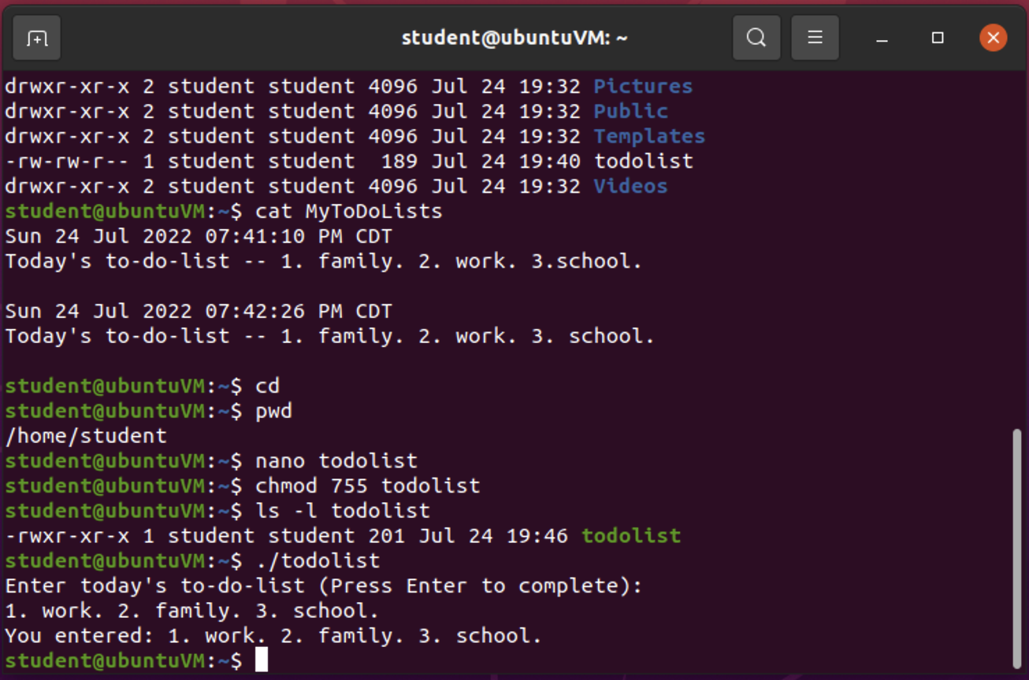
Change script file permissions

Slide 11
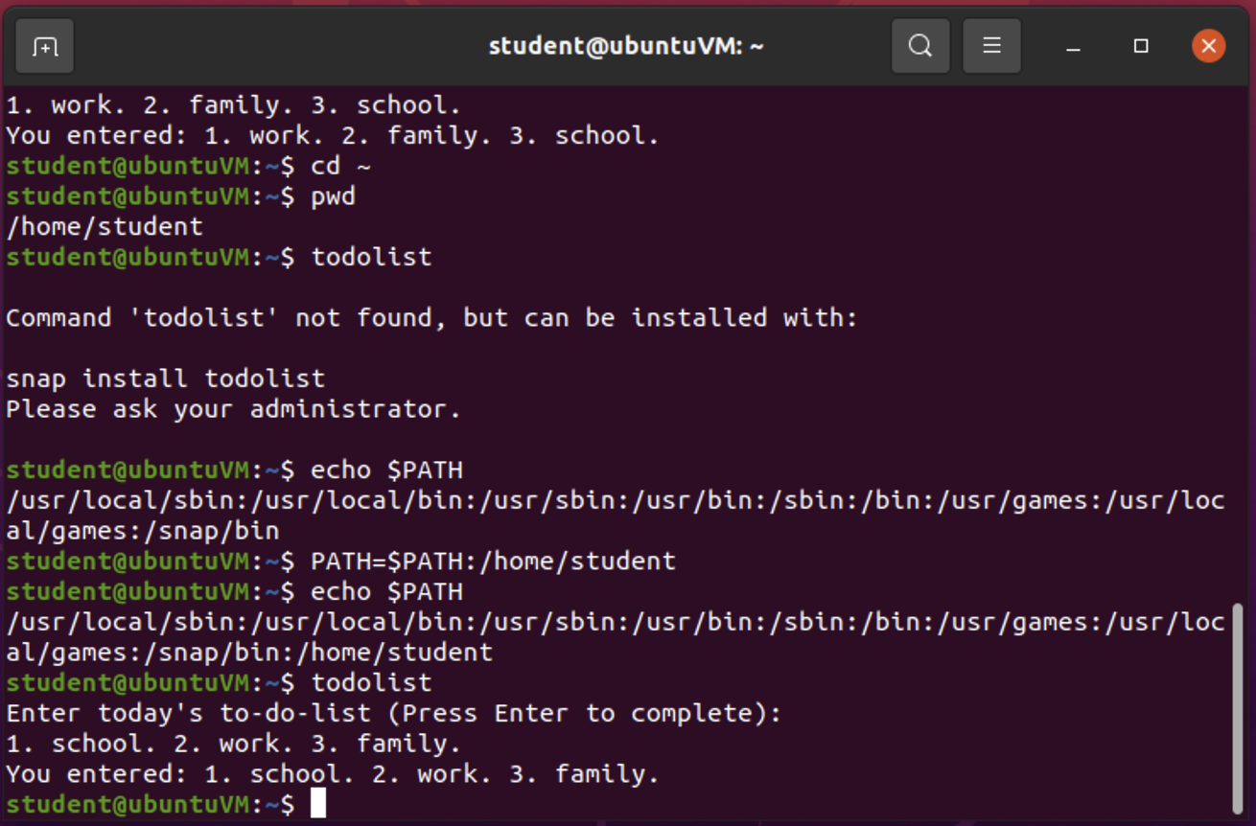
Set the PATH variable

Slide 12
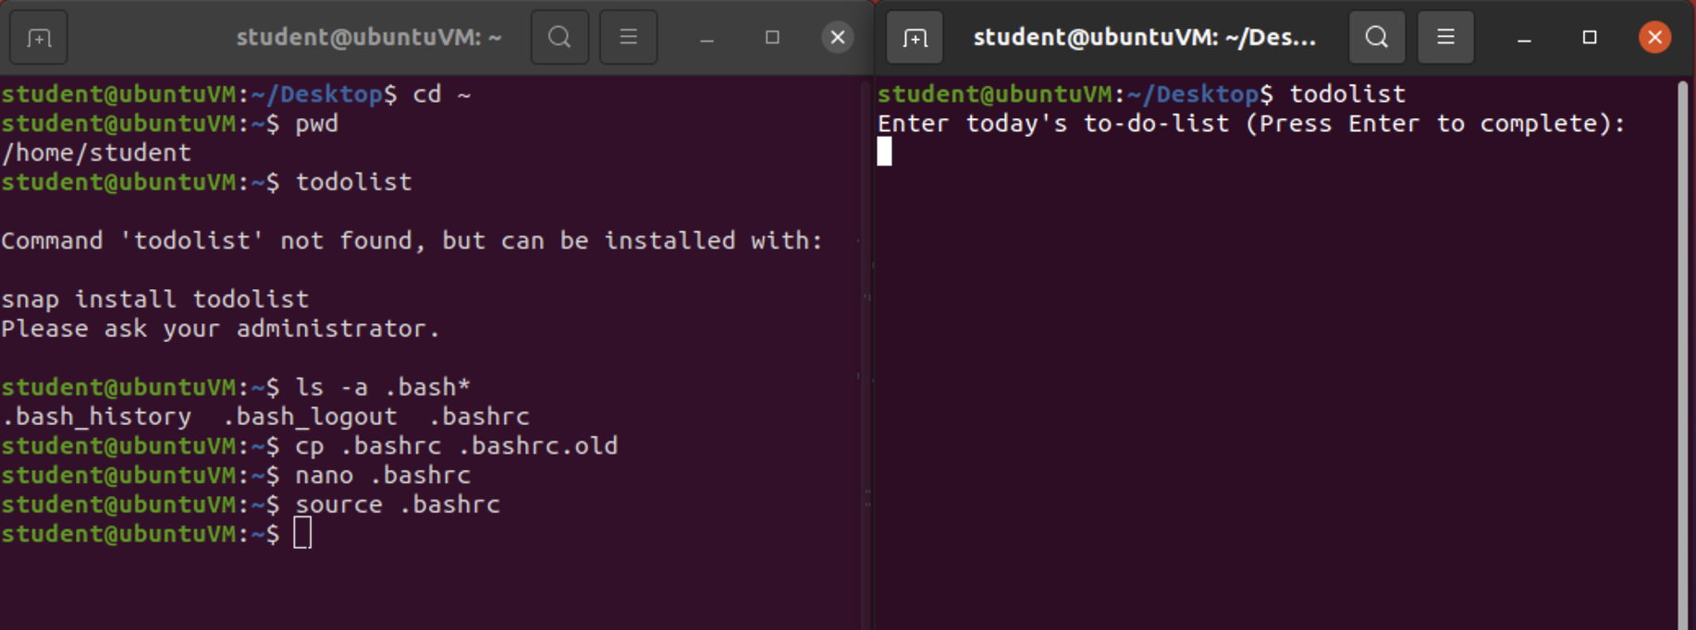
Make the PATH variable permanent
Run the todolist script before and after making the PATH variable permanent. This is a screenshot of both Terminal windows.

Slide 13
User access
This section covers, adding new users, groups, and permissions, and managing the above.

Slide 14
Add users and groups in CLI
1. What does the –m option in the useradd command do?
Answer here: create the user’s home directory
2. What does the -3 option in the tail command do?
Answer here: output the last 3 lines, instead of the last 10.
3. Which line of the /etc/group file lists members of the “students” group? Copy it here.
Answer here:
the last line
students:x:1003:student,mary
References:
1. C. (2019). Ubuntu Manpage: useradd - create a new user or update default new user information. Ubuntu Man Pages. https://manpages.ubuntu.com/manpages/focal/en/man8/useradd.8.html
2. Eckert, J. (2019). Linux+ and LPIC-1 Guide to Linux Certification (MindTap Course List) (5th ed.) [E-book]. Cengage Learning.

Slide 15
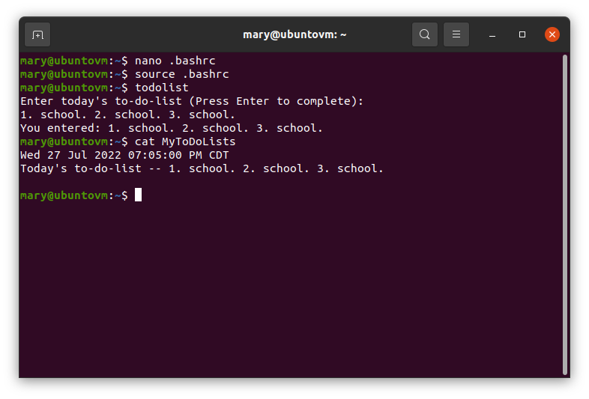
Test user and group settings

Slide 16
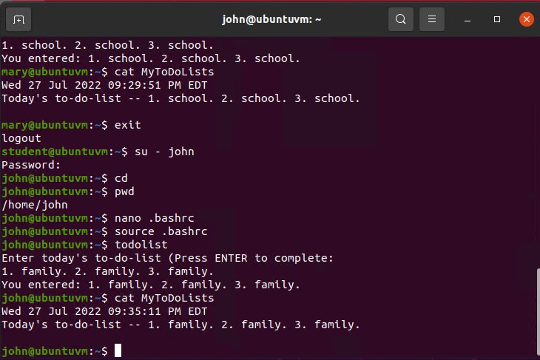
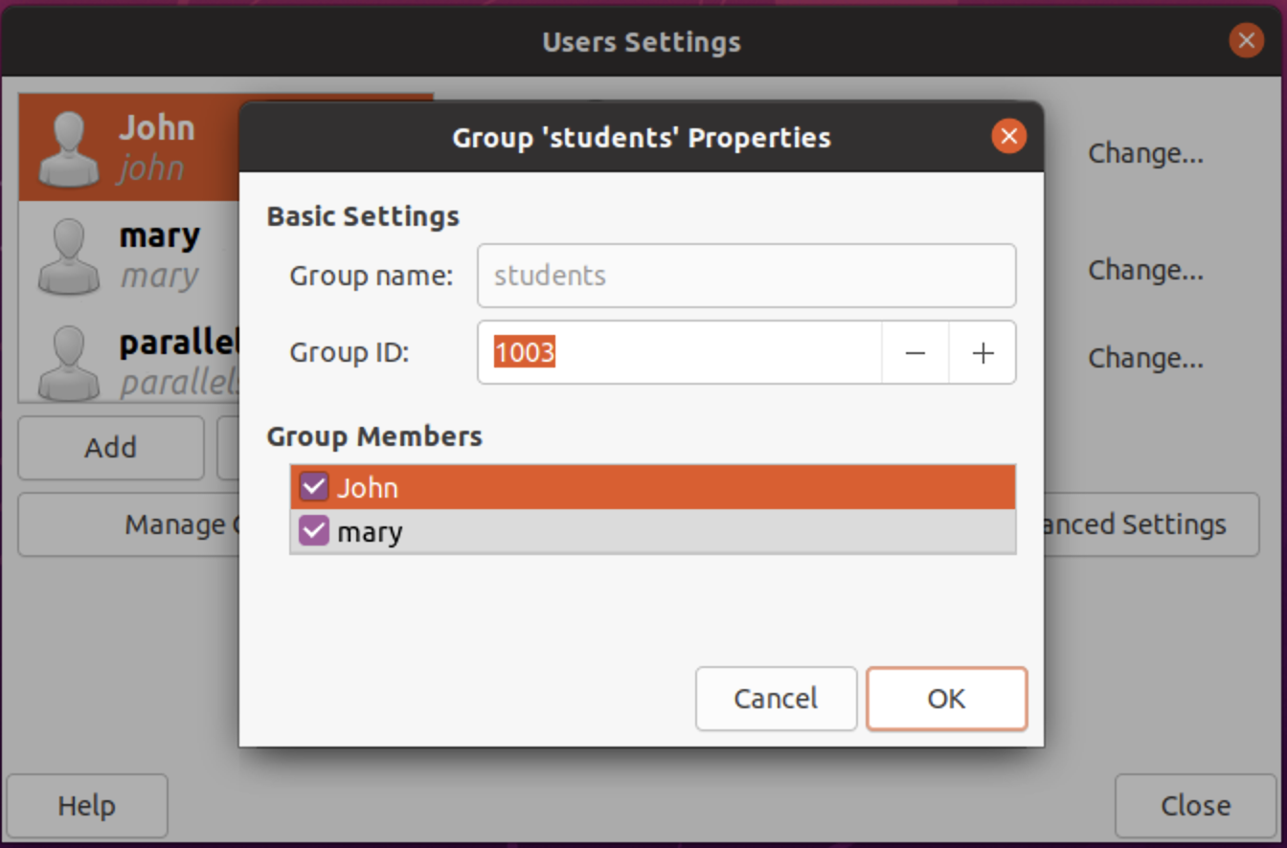
Add users in GUI

Slide 17
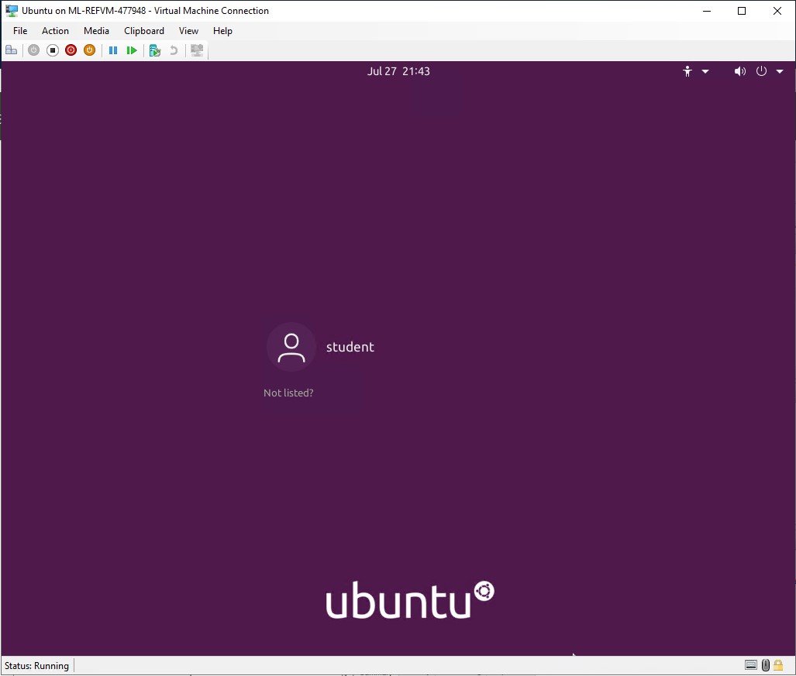
Remove users and groups
A screenshot of the log on page with three user accounts.
A screenshot of the log on page with only your user account (i.e., student).

Slide 18
Network connections
This section covers how to connect to business networks, and the internet. How to manage network interfaces, and use network utilities to manage network connections.

Slide 19
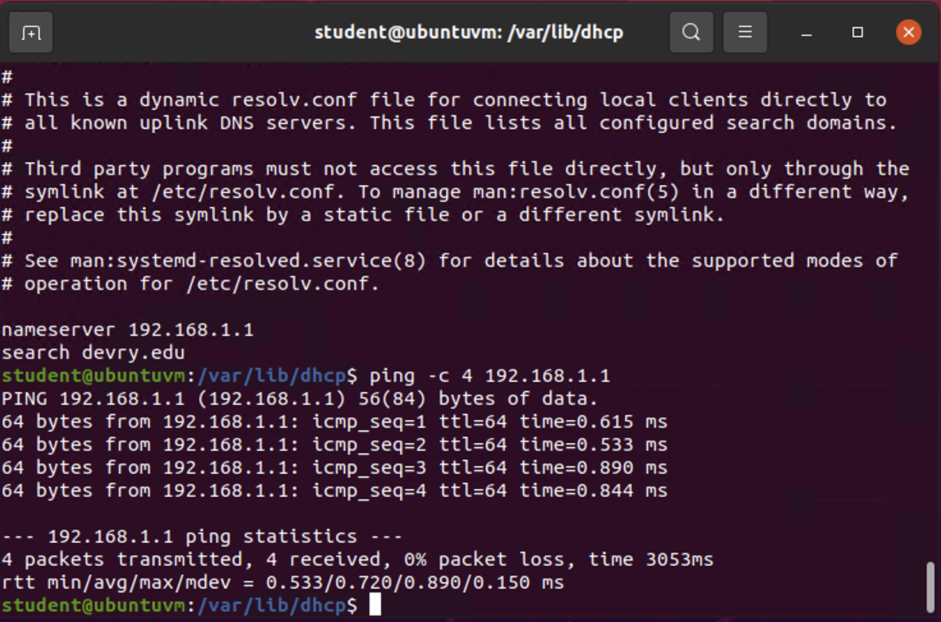
Discover host IP configurations
1. What is the IP address of your Ubuntu machine?
Answer here: “192.168.1.104”
2. What is the IP address of its default gateway?
Answer here:”192.168.1.1”
3. What is the IP address of its DHCP server?
Answer here: “192.168.1.1”
4. What is the IP address of its DNS server?
Answer here: “192.168.1.1”

Slide 20
Manage network interfaces
1. Which DHCP message is shown in the output of the sudo dhclient –v –r eth0 command? [hint: the message name is in uppercase.]
Answer here: “DHCPRELEASE”
2. Which four DHCP messages are shown in the output of the sudo dhclient –v eth0 command? [hint: the message names are in uppercase.]
Answer here:
“DHCPDISCOVER, “DHCPOFFER”, “DHCPREQUEST”,“DCHPACK”
References:
1. Eckert, J. (2019). Linux+ and LPIC-1 Guide to Linux Certification (MindTap Course List) (5th ed.) [E-book]. Cengage Learning.
2. Bird, R (2022). CEIS106 - Operating Systems-Week 5 Project Assistance [mp4 video file] Retrieved from: https://devry.webex.com/devry/ldr.php?RCID=ce1e5d3b6a2b3cf95f899dacb24ea086

Slide 21
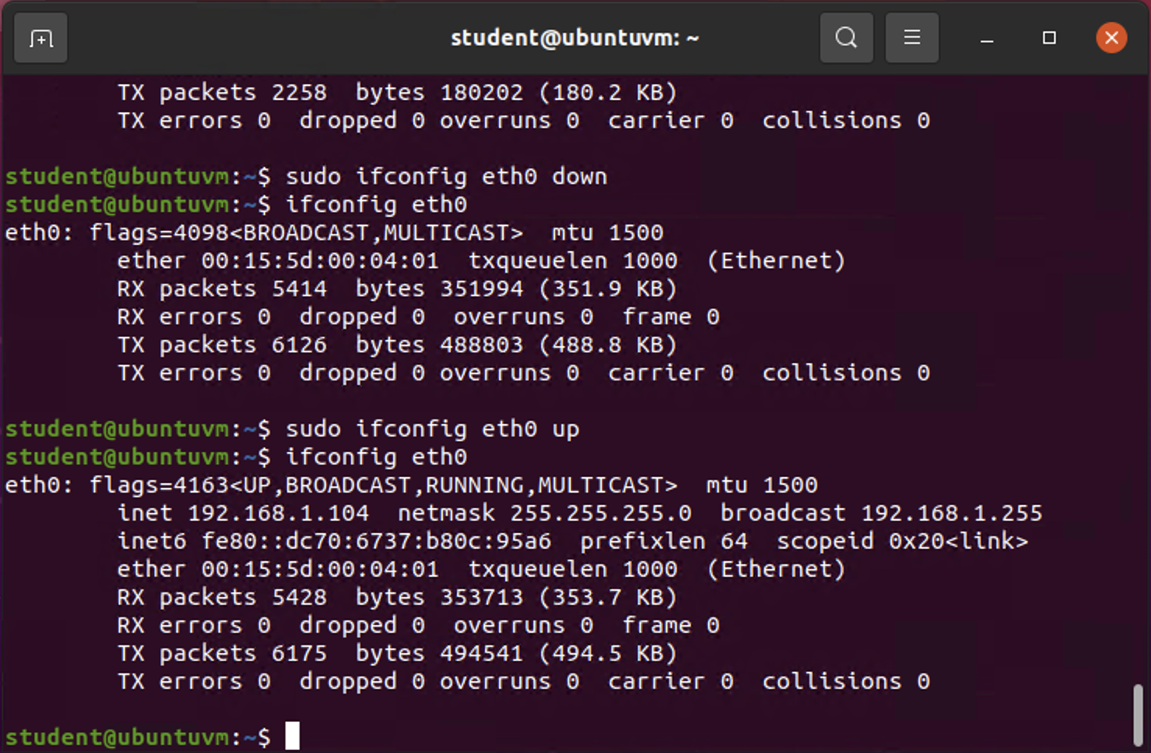
Use network utilities

Slide 22
Linux processes
This section covers how to monitor process, user activities and network bandwidth utilization.

Slide 23
Monitor Linux processes
1. What is the default action of the 15 SIGTERM kill signal?
Answer here: Terminated the process.
2. In the System Monitor window, click on % CPU to sort the processes by CPU load. Which process shows the highest percentage of CPU usage?
Answer here:
Gnome-shell
References:
1. Eckert, J. (2019). Linux+ and LPIC-1 Guide to Linux Certification (MindTap Course List) (5th ed.) [E-book]. Cengage Learning.
2Damian, E. (2022). CEIS106 - Operating Systems-Week 5 Project Assistance [mp4 video file] Retrieved from: https://devry.webex.com/devry/ldr.php?RCID=ce1e5d3b6a2b3cf95f899dacb24ea086

Slide 24
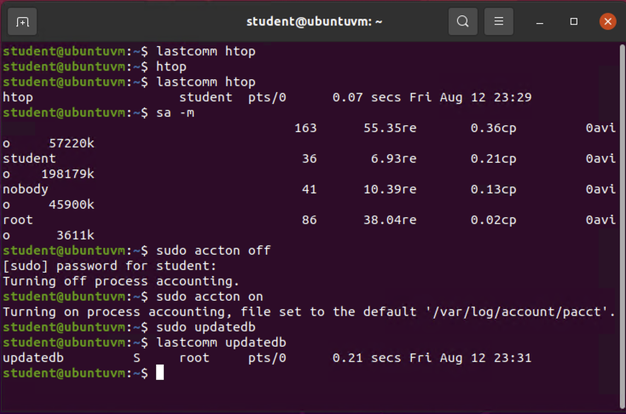
Monitor user activities
Issue the sudo accton on command to turn on GNC accounting. Run the sudo updatedb command. Enter lastcomm updatedb to check if the updatedb command was executed before. Remember to turn off GNC accounting (sudo accton off) after answering the questions.
1. What flag value is displayed in the output?
Answer here: S
2. Why is the name of the user who ran the processes shown as root, not student?
Answer here: because the S flag indicates the process was run by super user because process is run by root.
References:
1. Eckert, J. (2019). Linux+ and LPIC-1 Guide to Linux Certification (MindTap Course List) (5th ed.) [E-book]. Cengage Learning.
2. Damian, E (2022). CEIS106 - Operating Systems-Week 5 Project Assistance [mp4 video file] Retrieved from: https://devry.webex.com/devry/ldr.php?RCID=ce1e5d3b6a2b3cf95f899dacb24ea086

Slide 25
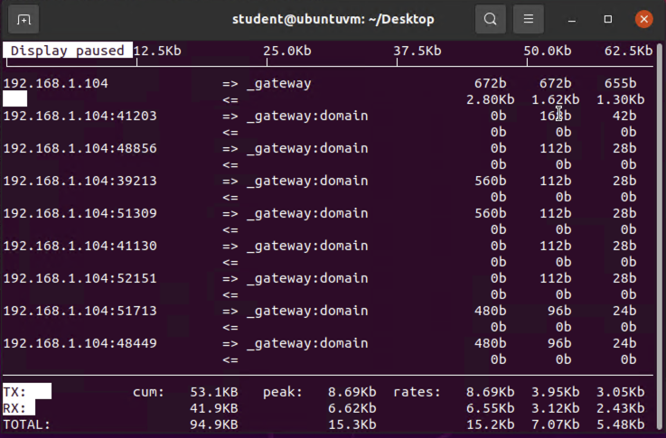
Monitor network bandwidth usage

Slide 26
Challenges
Limitations placed on Azure Labs made connectivity difficult at times. Mouse clicks did not register. On occasion, the remote connection become unresponsive.
Trying to use a local vm, rpi terminal session, and macos terminal caused issues due to lack of full access to library of commands used on Azure Labs instances of Linux.
Keeping track of all commands used, and remember proper use was not always easy. Had to use man to look up proper use quite often.

Slide 27
Career skills
LINUX/UNIX ARE THE DEFACTO STANDARD FOR SOFTWARE DEVELOPMENT WORKSTATIONS, AS WELL AS SERVERS FOR THE TECH SECTOR, AND BUSINESS SECTOR.
GAINED LINUX ADMINISTRATION SKILLS
GAINED LINUX NETWORKING SKILLS
GAINED LINUX SCRIPTING SKILLS
GAINED A WELL ROUNDED KNOWLEDGE OF COMMAND LINE
APPLIED LINUX SKILLS TO MacOS.

Slide 28
Conclusion
Due to my electrical engineering degree, I had some familiarity with the Linux command line. This site has made me much more comfortable with the MacOS terminal as well as the Linux command line. I never appreciated the power of the command line, but with the knowledge of what the commands do and how to use them. I am excited to continue my exploration of scripting, and what I can accomplish.

