Slide 1
Introduction to programming
a python final project
By Miguel Mastache
CEIS 110

Slide 2
Introduction
This project introduces the new programmer to the Python programming language. Including its basic syntax, order of operations, logic, and looping mechanisms. Additionally, we are introduced on how to extend the programs using functions, and function libraries, and how to import functions.
This project allows uses the NOAA SDK to import weather data from the NOAA databases. Using this data we further use the pandas function libraries, to perform some basic data analysis and plotting of this analysis using matplotlib's libraries.

Slide 3
Challenges
Installing anaconda pre-empted my pyenv installation of python 3.10.6. uninstalled anaconda and installed Spyder ide independently. Had to setup Spyder to use system pyenv version of python.
Had to use pip to install the necessary modules, such as pandas, matplotlib to allow for proper function of the programs, and be able to do the analysis.

Slide 4
Career skills
This project helped develop my python programming skills, those using pandas, and matplotlib to perform basic analysis.
This project also allowed for development of basic project planning using flow charts.

Slide 5
Project planning
This section covers the planning and setup of the data analysis project. Including development of a flowchart, and installation of the necessary software packages for performing the analysis.

Slide 6
Flowchart
Include the following processes:
Install python
Download weather data to a database.
Extract weather data from database into a comma separated file with python
Cleanse weather data
Use Excel to manipulate data
Use python data analytics modules to develop graphical models

Slide 7
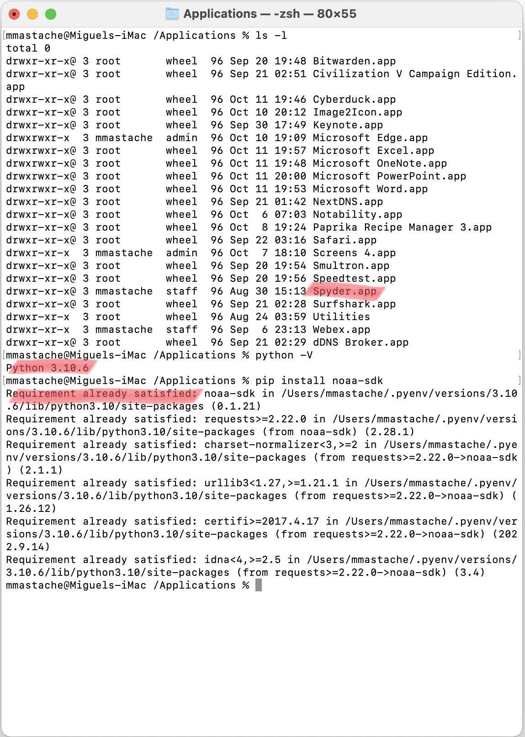
Software Inventory
Used Spyder IDE for this project, as well as Python 3.10.6.
Also installed the noaa-sdk to access noaa data

Slide 8
Downloading weather data
This section covers the programming to access noaa databases using the noaa sdk and extracting the requested data to a sql database with the noaa-sdk.

Slide 9
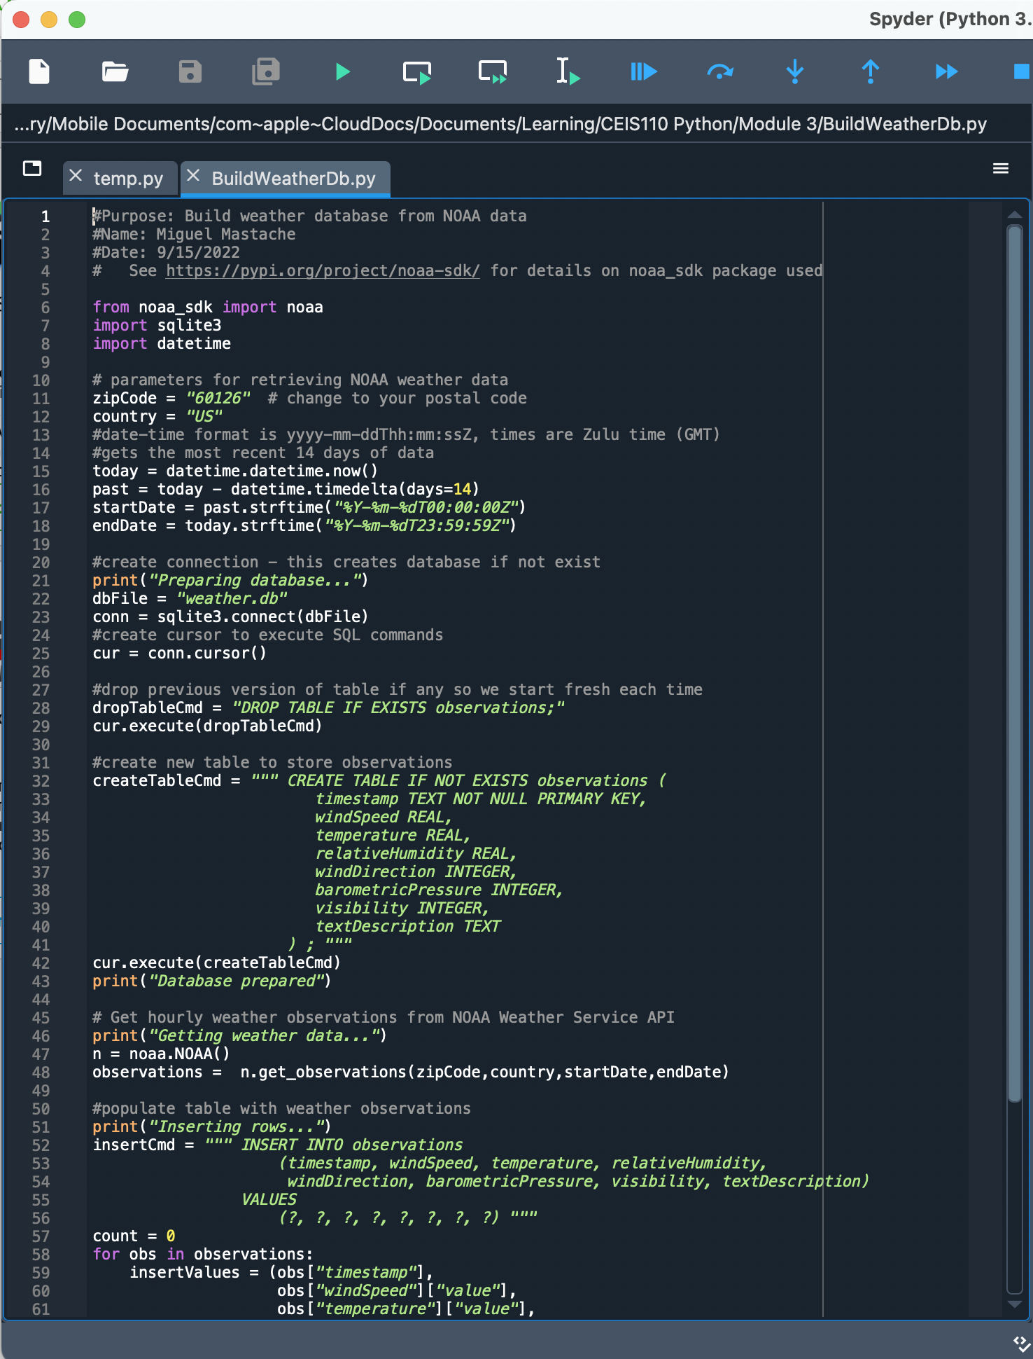
Build WeatherDb.py Code
Screenshot of code in Spyder

Slide 10
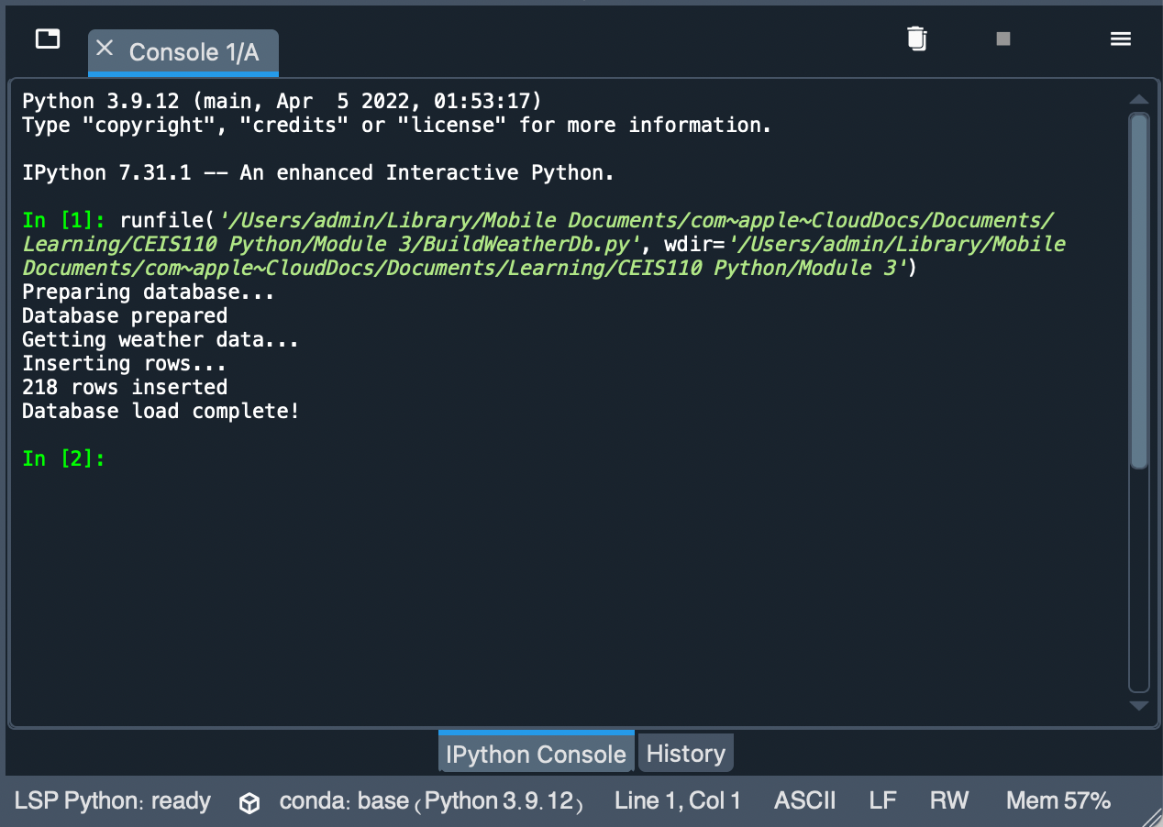
Python Console
Screenshot of program output in Python console showing program executed successfully

Slide 11
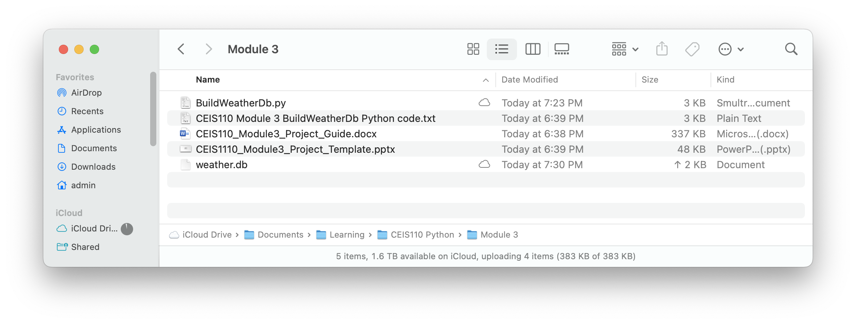
Weather.db File
Screenshot of macOS Finder showing database file Weather.db was created

Slide 12
Querying the database with sql
This section covers connecting to a database, perform queries, and view data using sql queries.

Slide 13
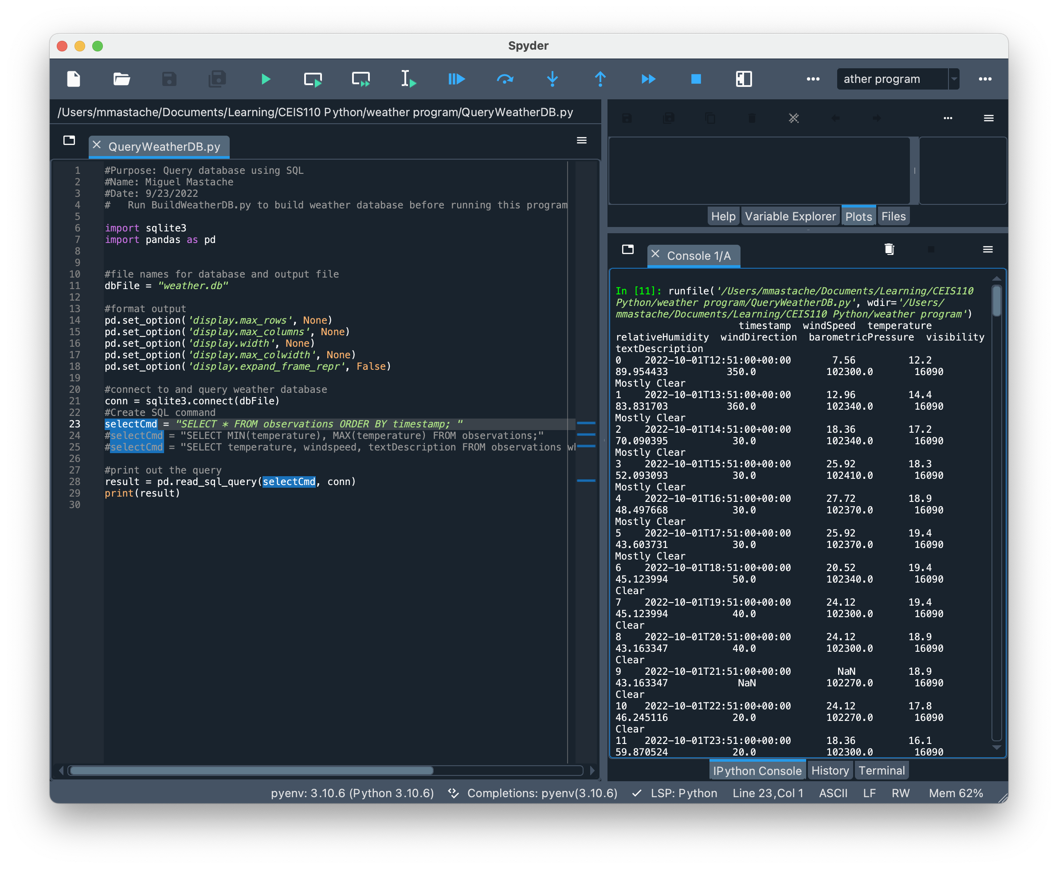
Query to retrieve all columns and all rows
Screenshot of SQL query command and results

Slide 14
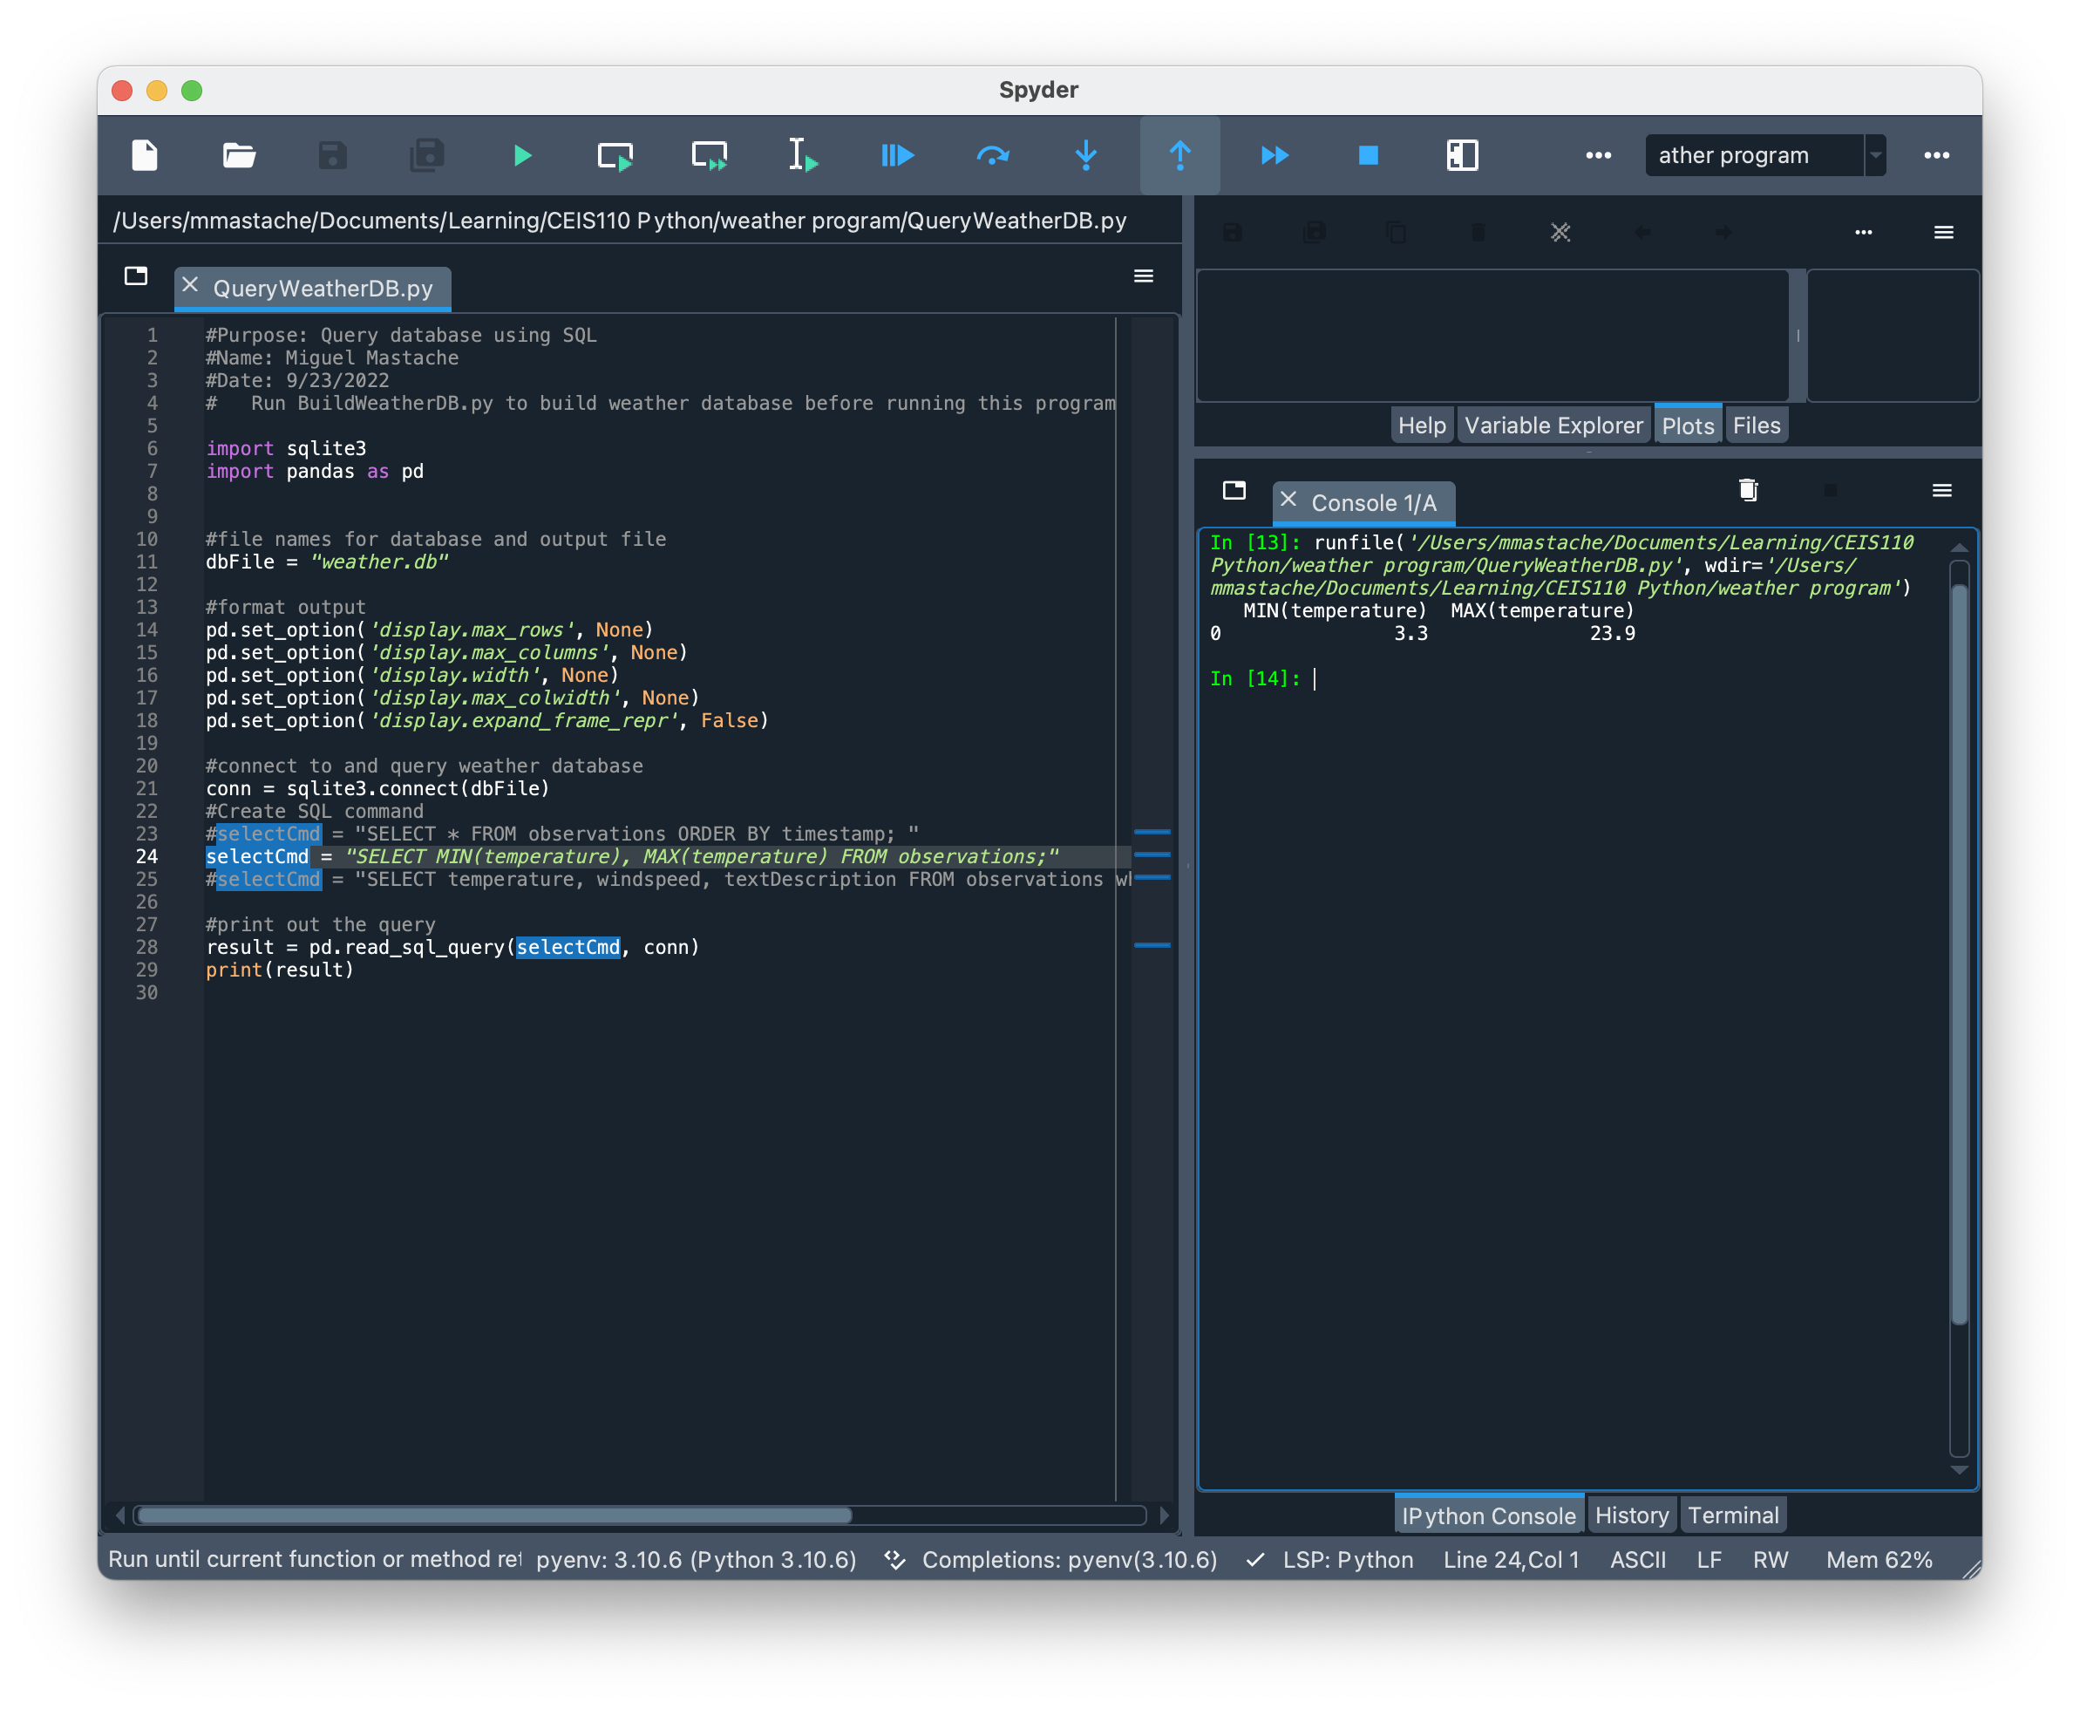
Query to retrieve lowest and highest temperatures
Screenshot of SQL query command and results

Slide 15
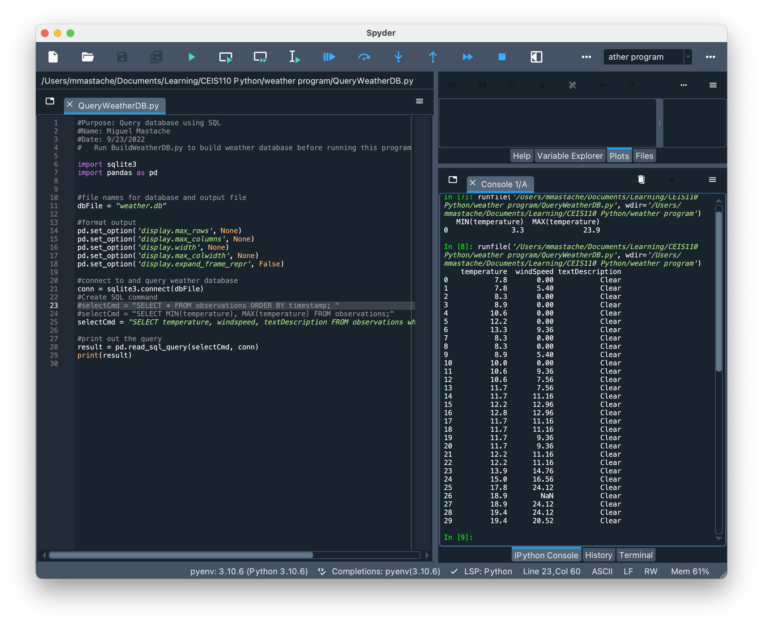
Query to retrieve all clear days (Screenshot)
Screenshot of SQL query command and results

Slide 16
Querying and manipulating data with sql and python
This section covers the retrieval of data from the local database created in the previous section using and sql query in python. The query is the saved in a csv file and cleaned up and used to create a chart in excel.

Slide 17
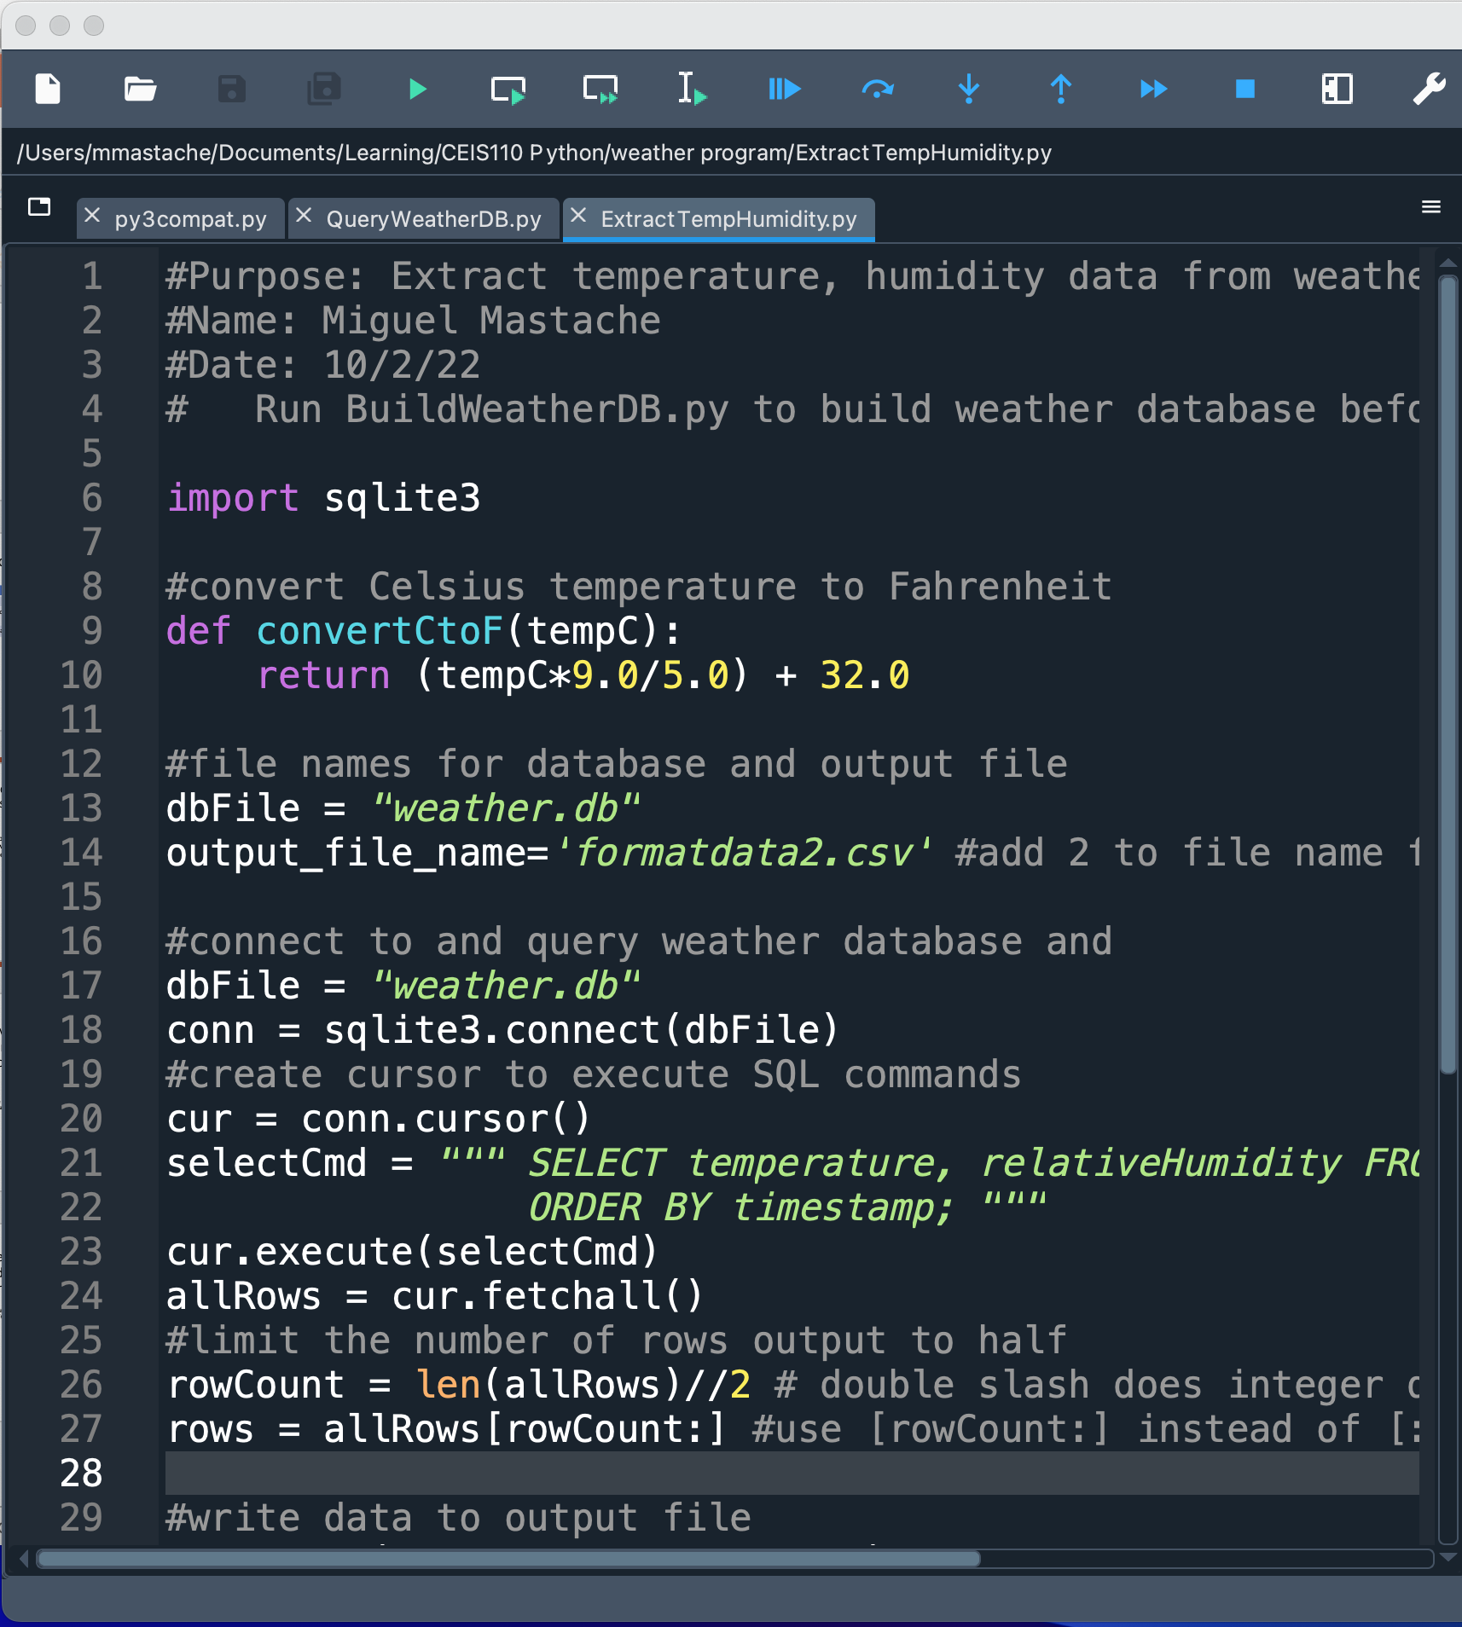
Python code
ExtractTempHumidity.py Python code with your name and date in comments

Slide 18
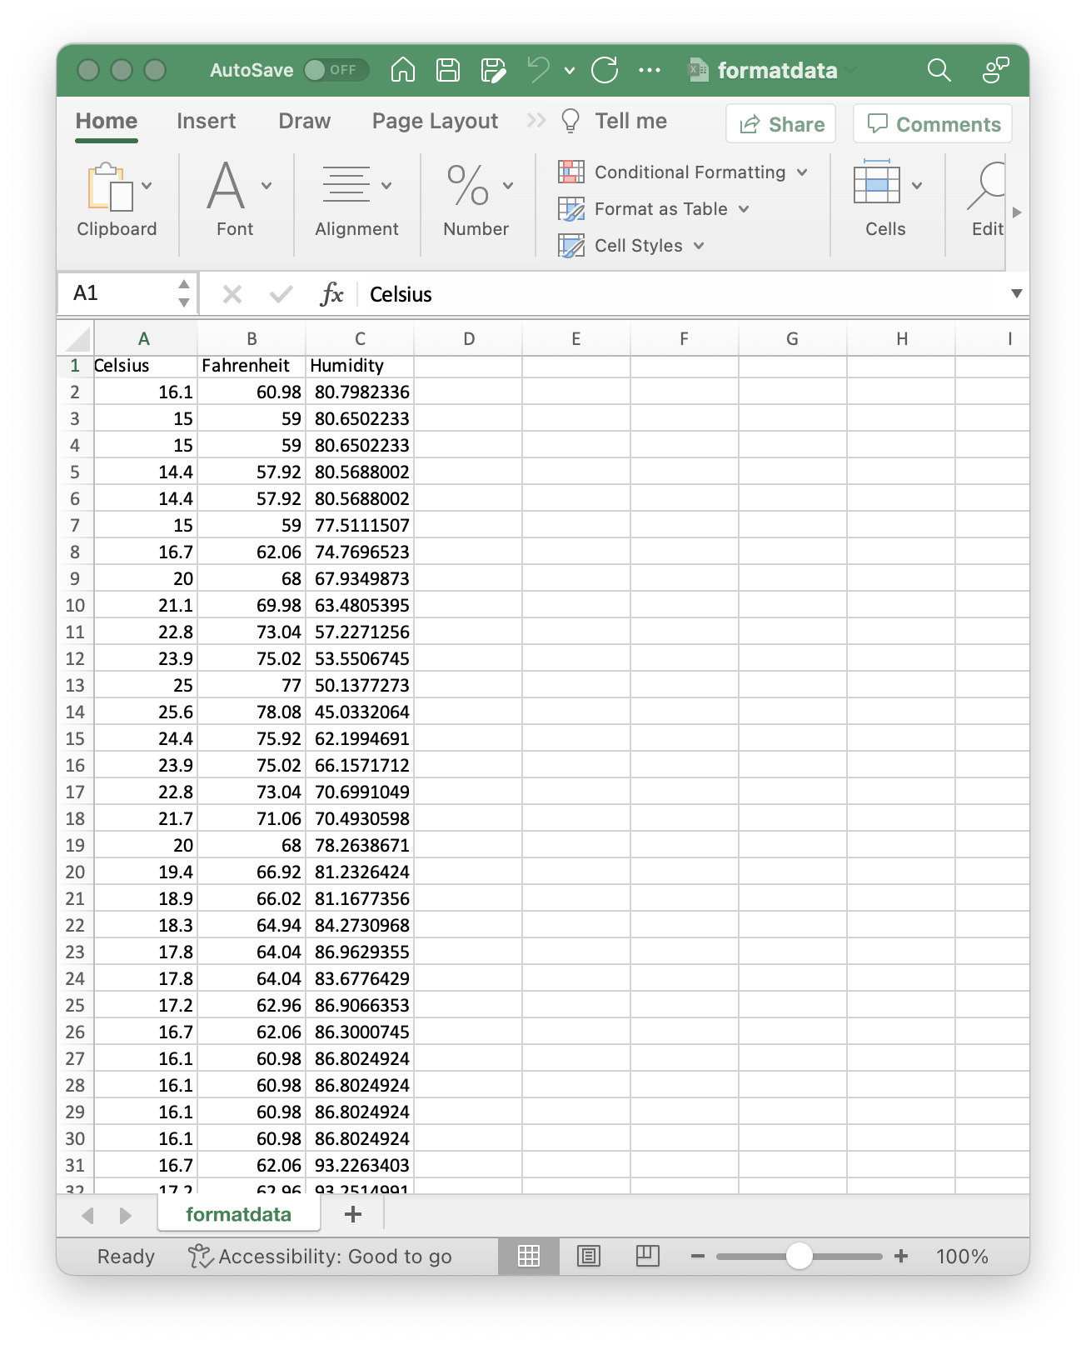
Retrieve and Convert Data to CSV Format
Formatdata file open in Excel showing 3 columns of data

Slide 19
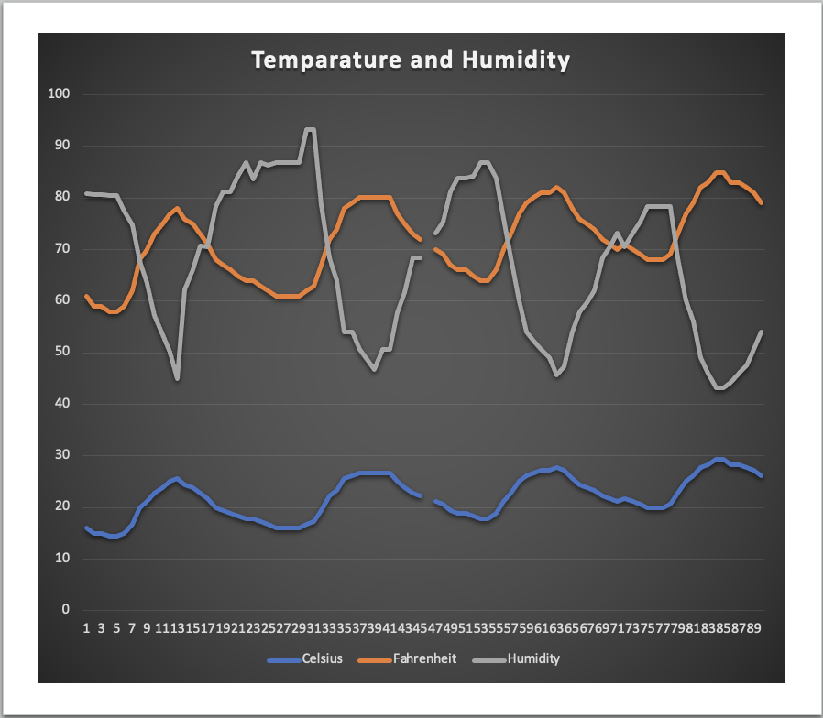
Temperature and Humidity Chart (Graph)
Excel chart based on temperature and humidity data from database

Slide 20
Develop graphical model and interpret results
This section covers the use of the data analytics modules available for python. We use these tools to analyze two data sets at different times.

Slide 21
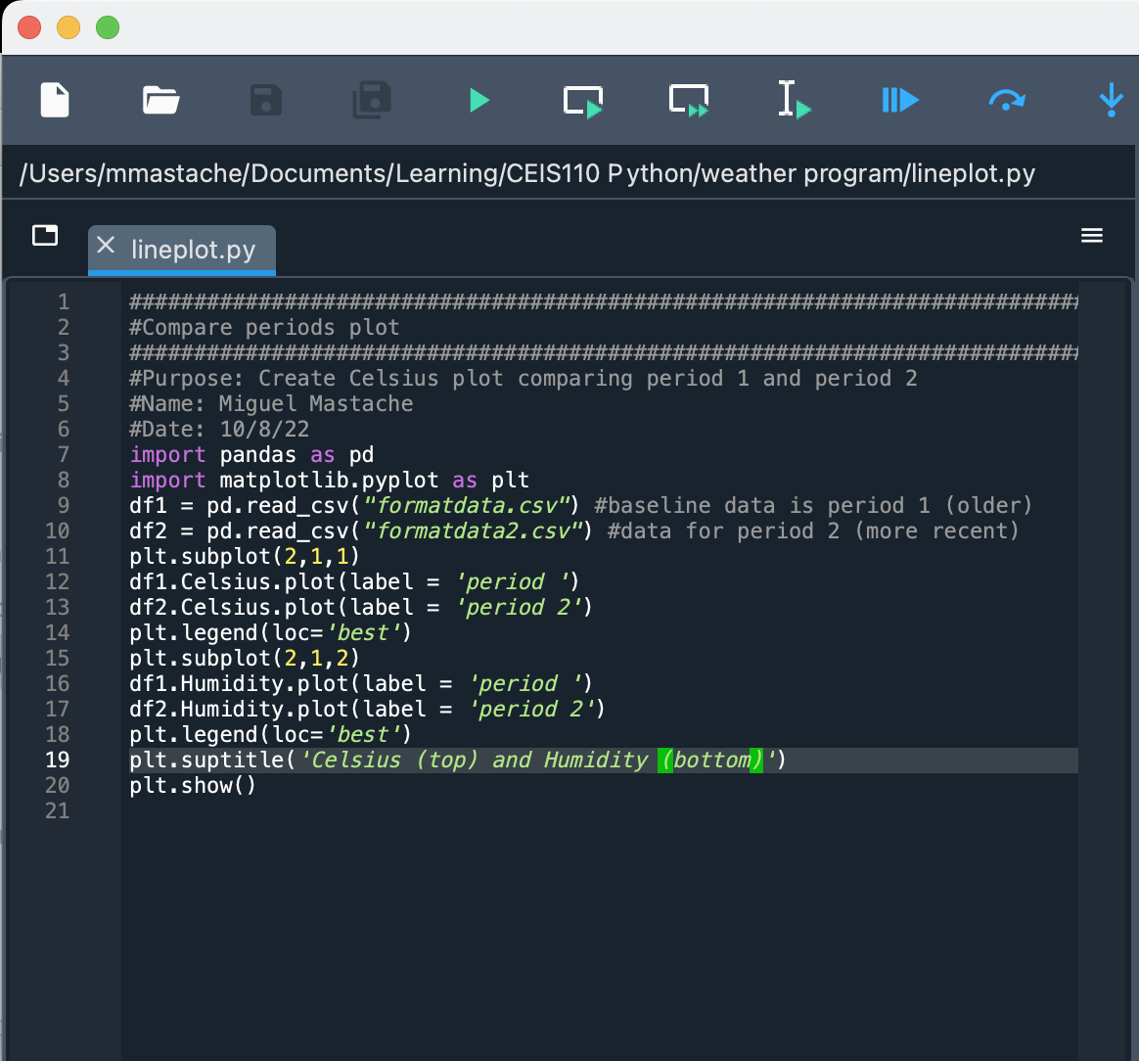
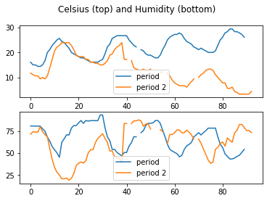
Plot #1: Period 2 temps dropped lower, and humidity spiked higher than period 1.

Slide 22
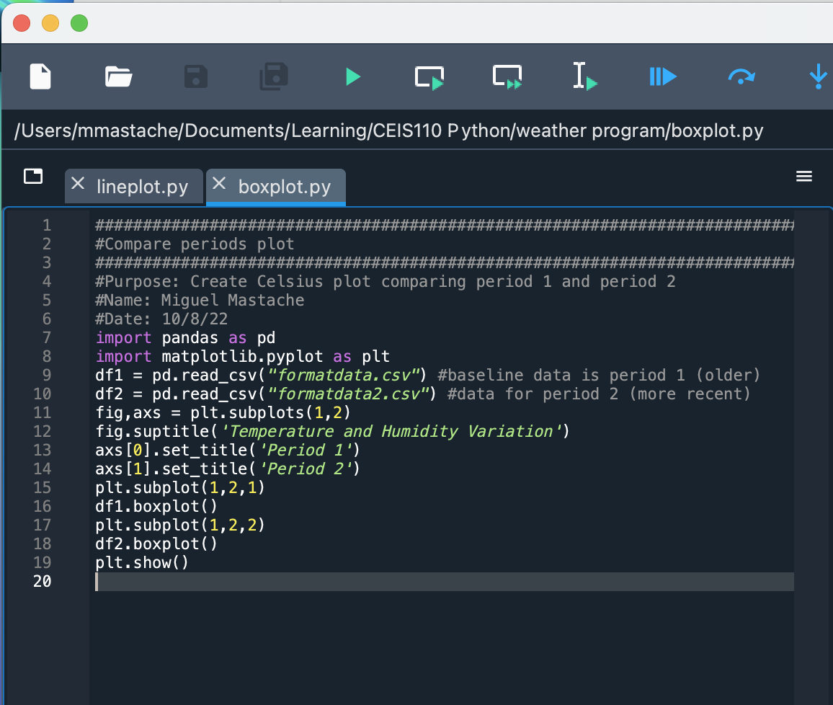
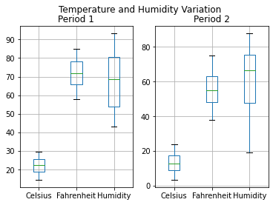
Plot #2: Humidity and Temperature vary more due to the impact of a cold front and rain in the 2nd period. Average humidity is approximately the same at around 70% in both periods.

Slide 23
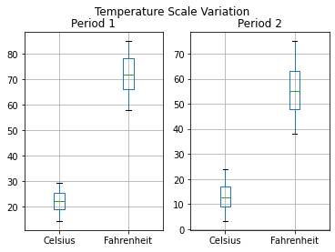
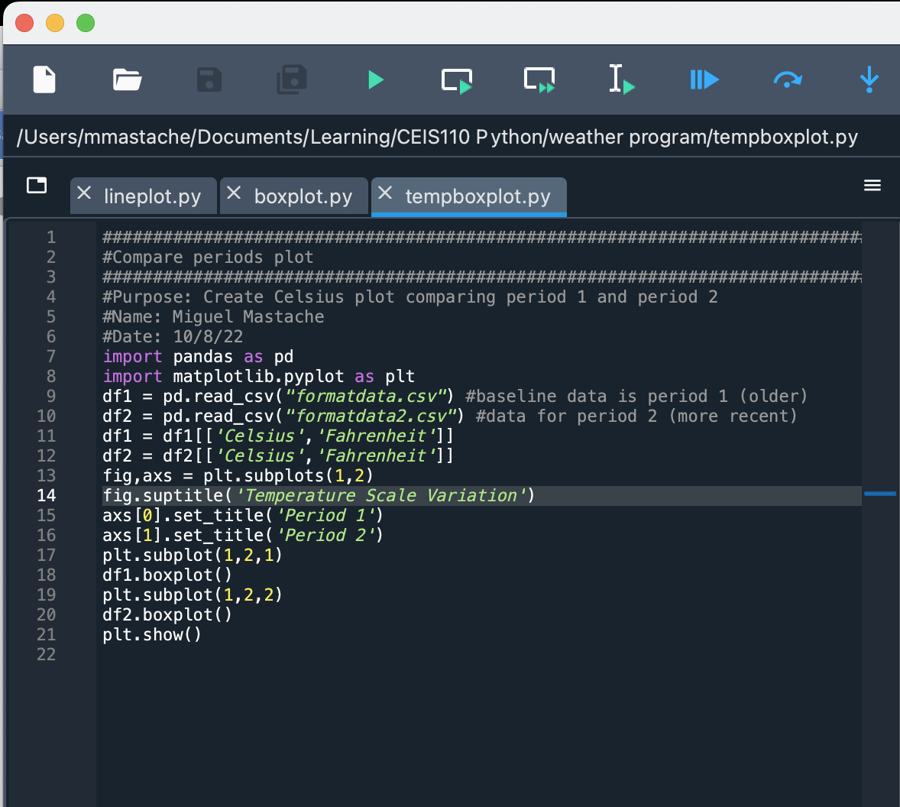
Analysis
Which temperature scale allows for easier determination of temperature extremes?
An African colleague who lived under the metric system, pointed out they prefer Fahrenheit, you’re really cold at 0 degrees F, and really hot at 100 degrees F. Celsius, you are cold at 0 degrees Celsius, and life cannot be sustained at 100 degrees C.
It appears that the Fahrenheit scale has a greater range, allowing for more variation the the numbers representing its temperatures. This variability allows for easier identification at the temperature ranges that humans encounter. 0 degrees Fahrenheit being really cold temperatures for human comfort , to 100 degrees Fahrenheit being summer temperatures that are considered really hot. The corresponding Celsius range is -18 degrees C to 38degrees C. A range of 40 degrees to 100 degrees, or approximately 2x the resolution.

Slide 24
Prediction
I project, that as temperature goes up, humidity will go down. Based on the plotted data. I project that the temperature will climb slowly, and humidity will drop slowly, until another cold front comes through, which will probably cause rain, and humidity will of course spike, and temperatures will fall again. I expect humidty in the 35-70% range, with temps ranging from 5 to 15 degrees C.

Slide 25
conclusion
The introduction to python, allows for development of basic programming skills. These basic skills allow for the development of very powerful programs. The power of python is in its simple syntax, and the modules that extend its capabilities. Combined with ease of access using powerful ide packages that ease the development of programs.
Python is a beautiful programming language to learn and use to streamline the workflow of any worker who has ever had to repeat the same analysis over and over again in excel.

