Slide 1
Home automation and security system demonstrator
By Miguel Mastache
6/23/2022

Slide 2
Introduction
This project is a demonstration of a simple yet effective home security and automation system, using an Arduino microcontroller. This system uses sensors that are readily available. The hardware is controlled by the Arduino microcontroller. It also allows for easy programming, and simulation using the Tinkercad software and Arduino developer kit.

Slide 3
Challenges
This project was not difficult, but there were some challenges and lessons learned. The original Arduino purchased failed shortly after the second module. Two days were spent ensuring wiring the wiring was correct, and researching possible causes, such as incorrect usb drivers. Ultimately, a replacement board was purchased to test out if it was a failed board. The reason for the failure was never identified. Somethings that could have been done to ensure no failure. Make a note that you only need the usb cable for power, and programming, the external power supply is not necessary. Additionally, put electricians' tape on the bottom of the Arduino board, covering the pins, so that you can’t short out the board by accident.
Additionally, realizing that each project builds upon the same circuit, would have saved time in wiring during the first 3 modules.

Slide 4
Career Skills
The career skills practiced while developing this Security System are as follows:
Documentation of components, simulation results, and operation of circuit.
Basic programming using Tinkercad, and C++ for Arduino kit.
Time management, to ensure project completes on time.
Ability to follow pinout and wiring of schematic diagram and instructions.
Troubleshooting skills including web search of possible technical issues, verification of wiring, and using previous project stages as test cases to ensure the project is working as expected.

Slide 5
Conclusion
This project demonstrates the feasibility of using an Arduino board to develop a working home automation and security system, and the ease with which this can be done.
Possible improvements could involve using LED displays to show the serial monitor output, as well as using the ESP232 modules to connect wirelessly to a a smartphone for modification of settings.
Future projects can build upon this one, to develop possible supervisory control and data acquisition applications. (SCADA)

Slide 6
Tinkercad simulation
By Miguel Mastache
6/23/2022

Slide 7
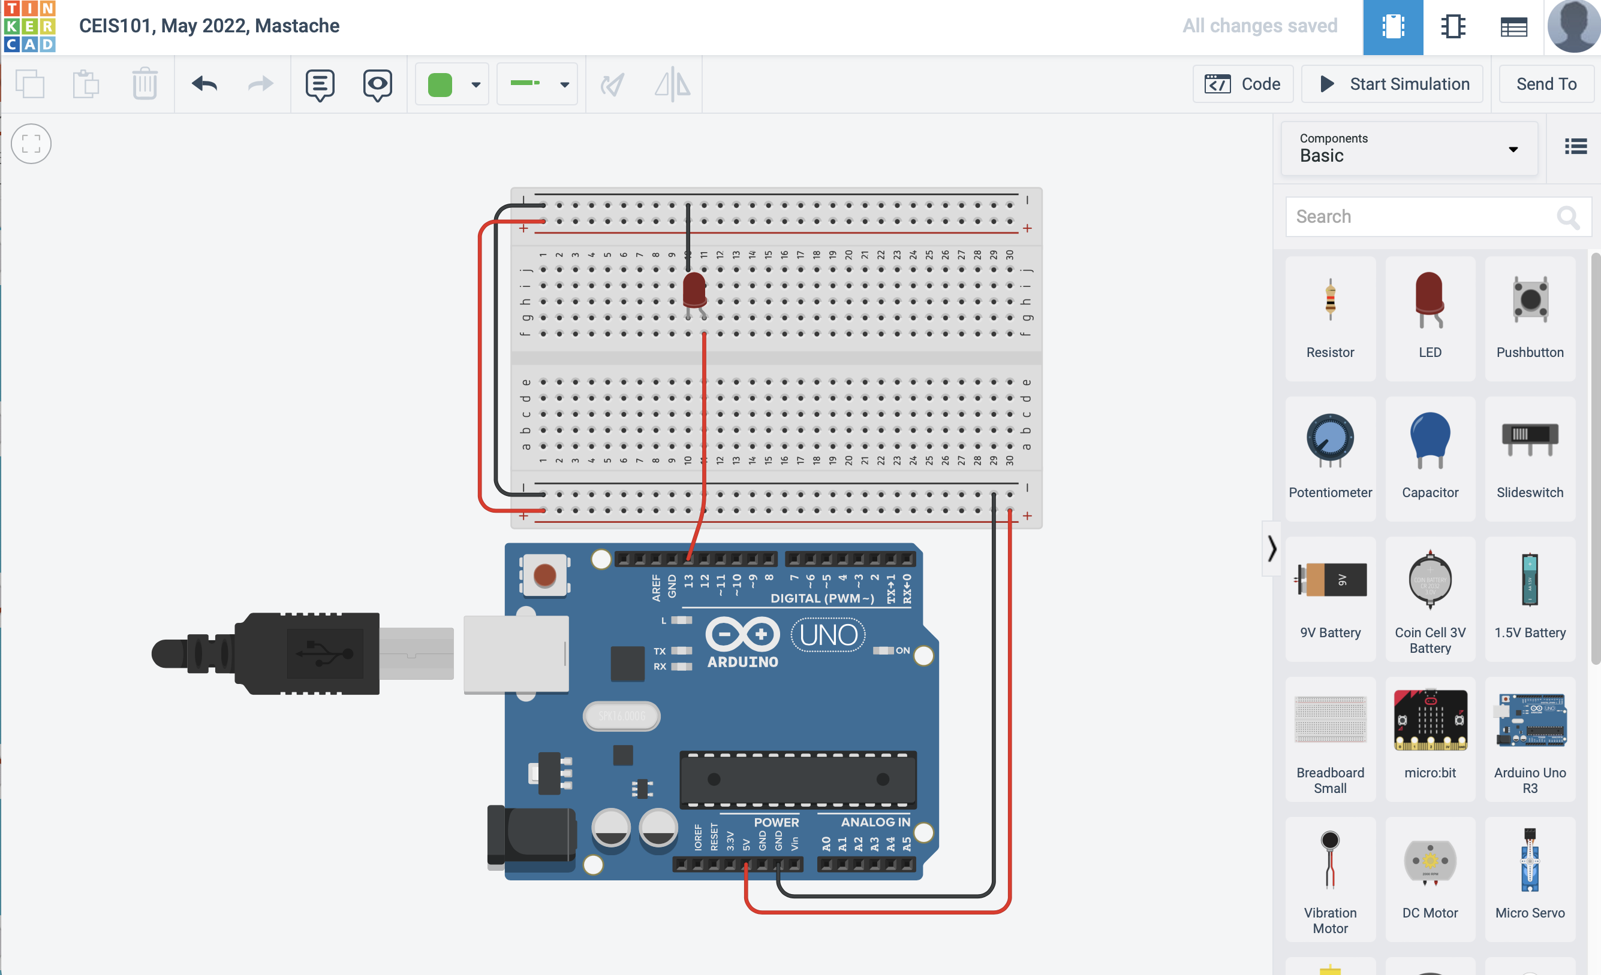
Circuit (Tinkercad Schematic)

Slide 8
Code Basic code using graphical programming available in Tinkercad suite.

Slide 9
Parts Inventory

Slide 10
Inventory of IoT Kit
UCTRONICS Kit
ESP32 (2)
LCD Modules (2)
Breadboards (3)
Mini Router
Patch Cable
Digital Multi Meter
USB to Micro USB (2)
Patch Cable
UCTRONICS Kit
ESP32
USB 2 MICRO USB
LCD Modules
Mini Router

Slide 11
Organization of Project Components
Arduino
Arduino Mega 2560
Breadboard
Resistor 10kΩ
LEDs
Ultrasonic Sensor
Active Buzzer
Photoresistor
Wires
USB Type B cable
Water Sensor
Humidity Sensor
Active Buzzer
USB Cable
Breadboard
Ultrasonic Sensor
10k Ohm Resistors
Wires
Water
Sensor
LED’s
Photo Resistors
Photo Resistors

Slide 12
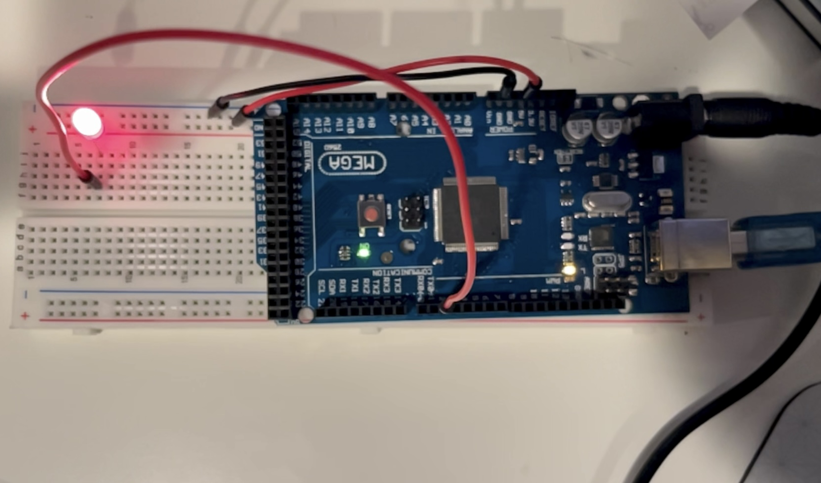
Circuit with red LED on

Slide 13
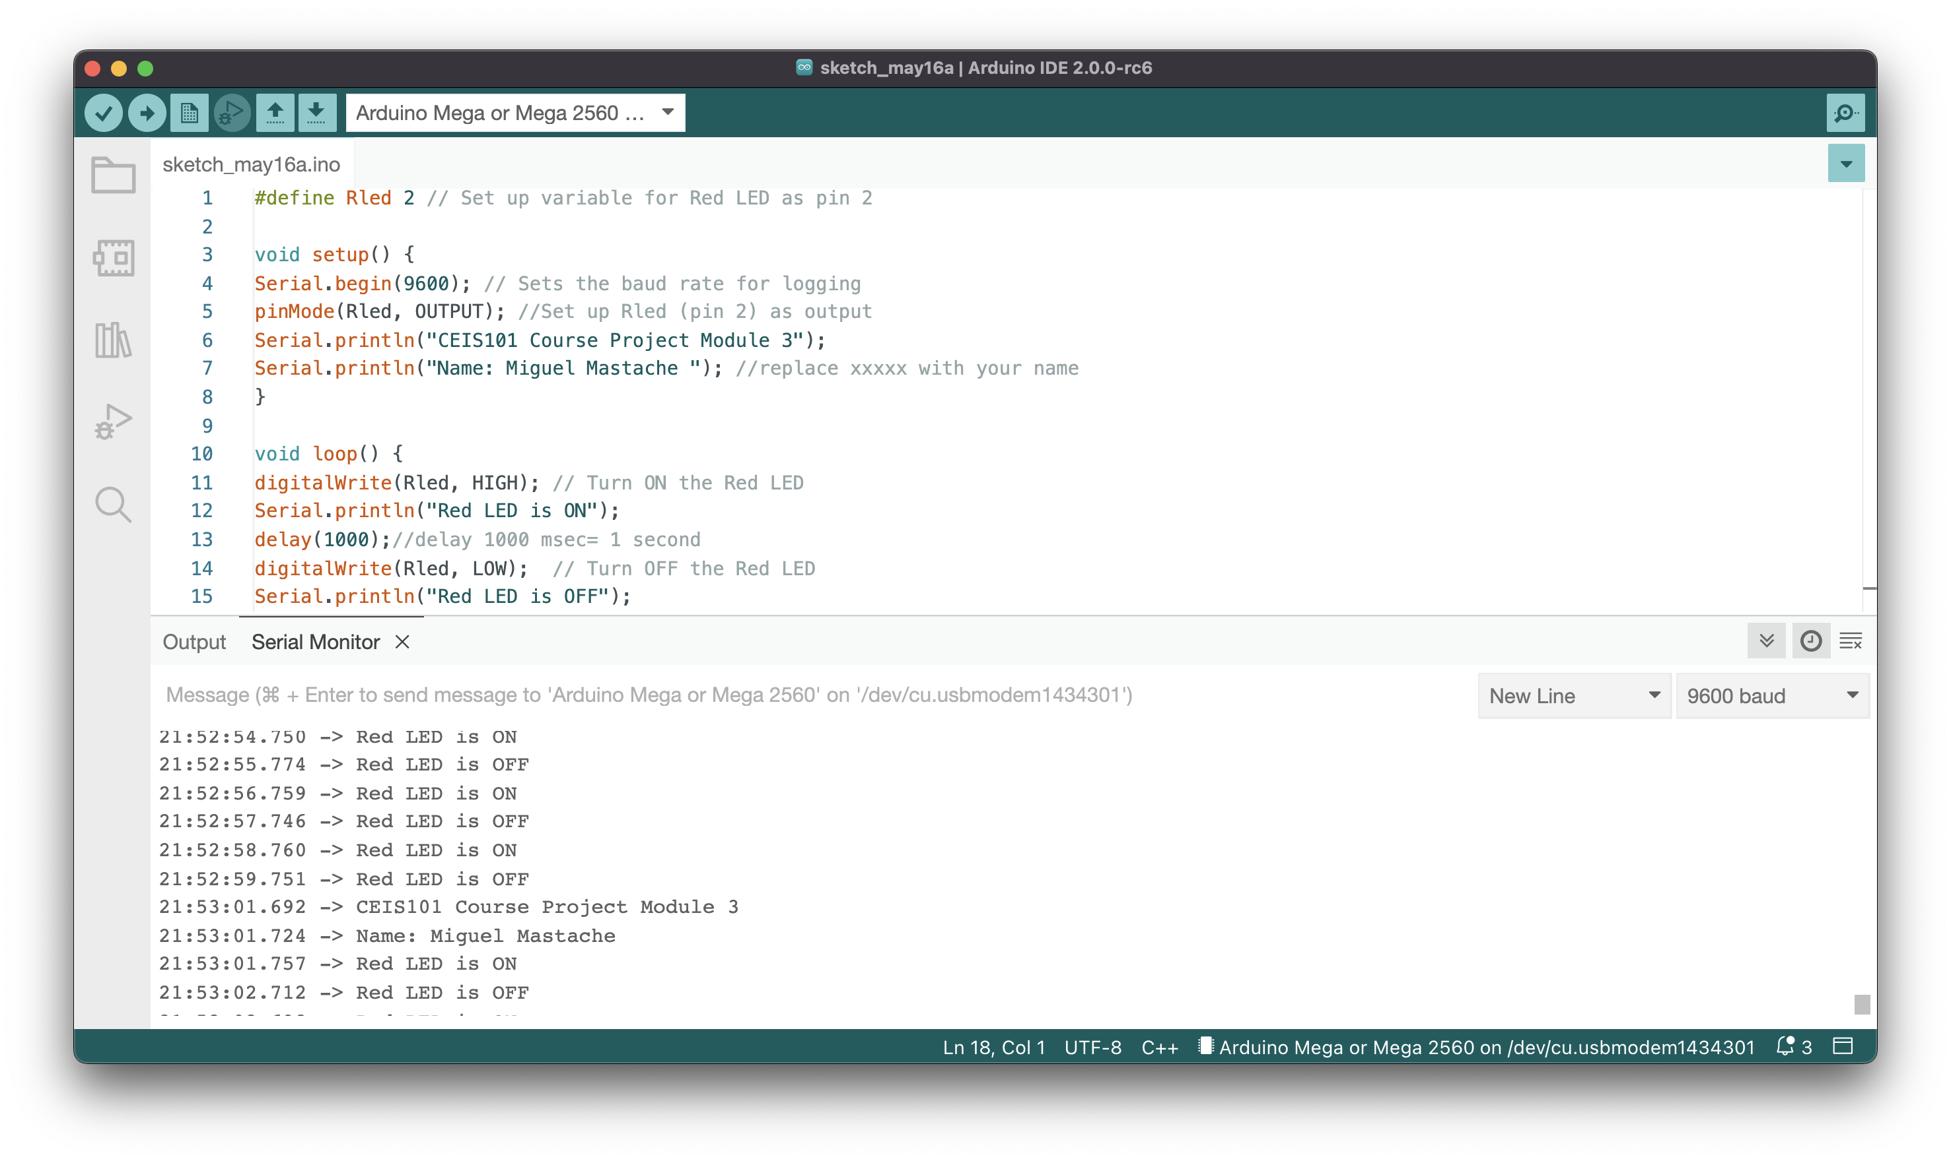
Serial Monitor Showing printed output communicated over serial communications with Arduino.

Slide 14
Door contact sensor

Slide 15
Circuit of door closed with Green LED ON

Slide 16
Circuit of door open with Green LED OFF

Slide 17
Arduino Code

Slide 18
Serial Monitor Demonstrating text alert indicating the door is open.

Slide 19
Adding Distance Sensor to Smart Home System and Conducting Data Analysis

Slide 20
Circuit with green LED on

Slide 21
Circuit with yellow LED on.

Slide 22
Circuit with red LED on

Slide 23
Arduino Code

Slide 24
Plot of data

Slide 25
Adding Automated Light to Smart Home System

Slide 26
Circuit with automated LED off

Slide 27
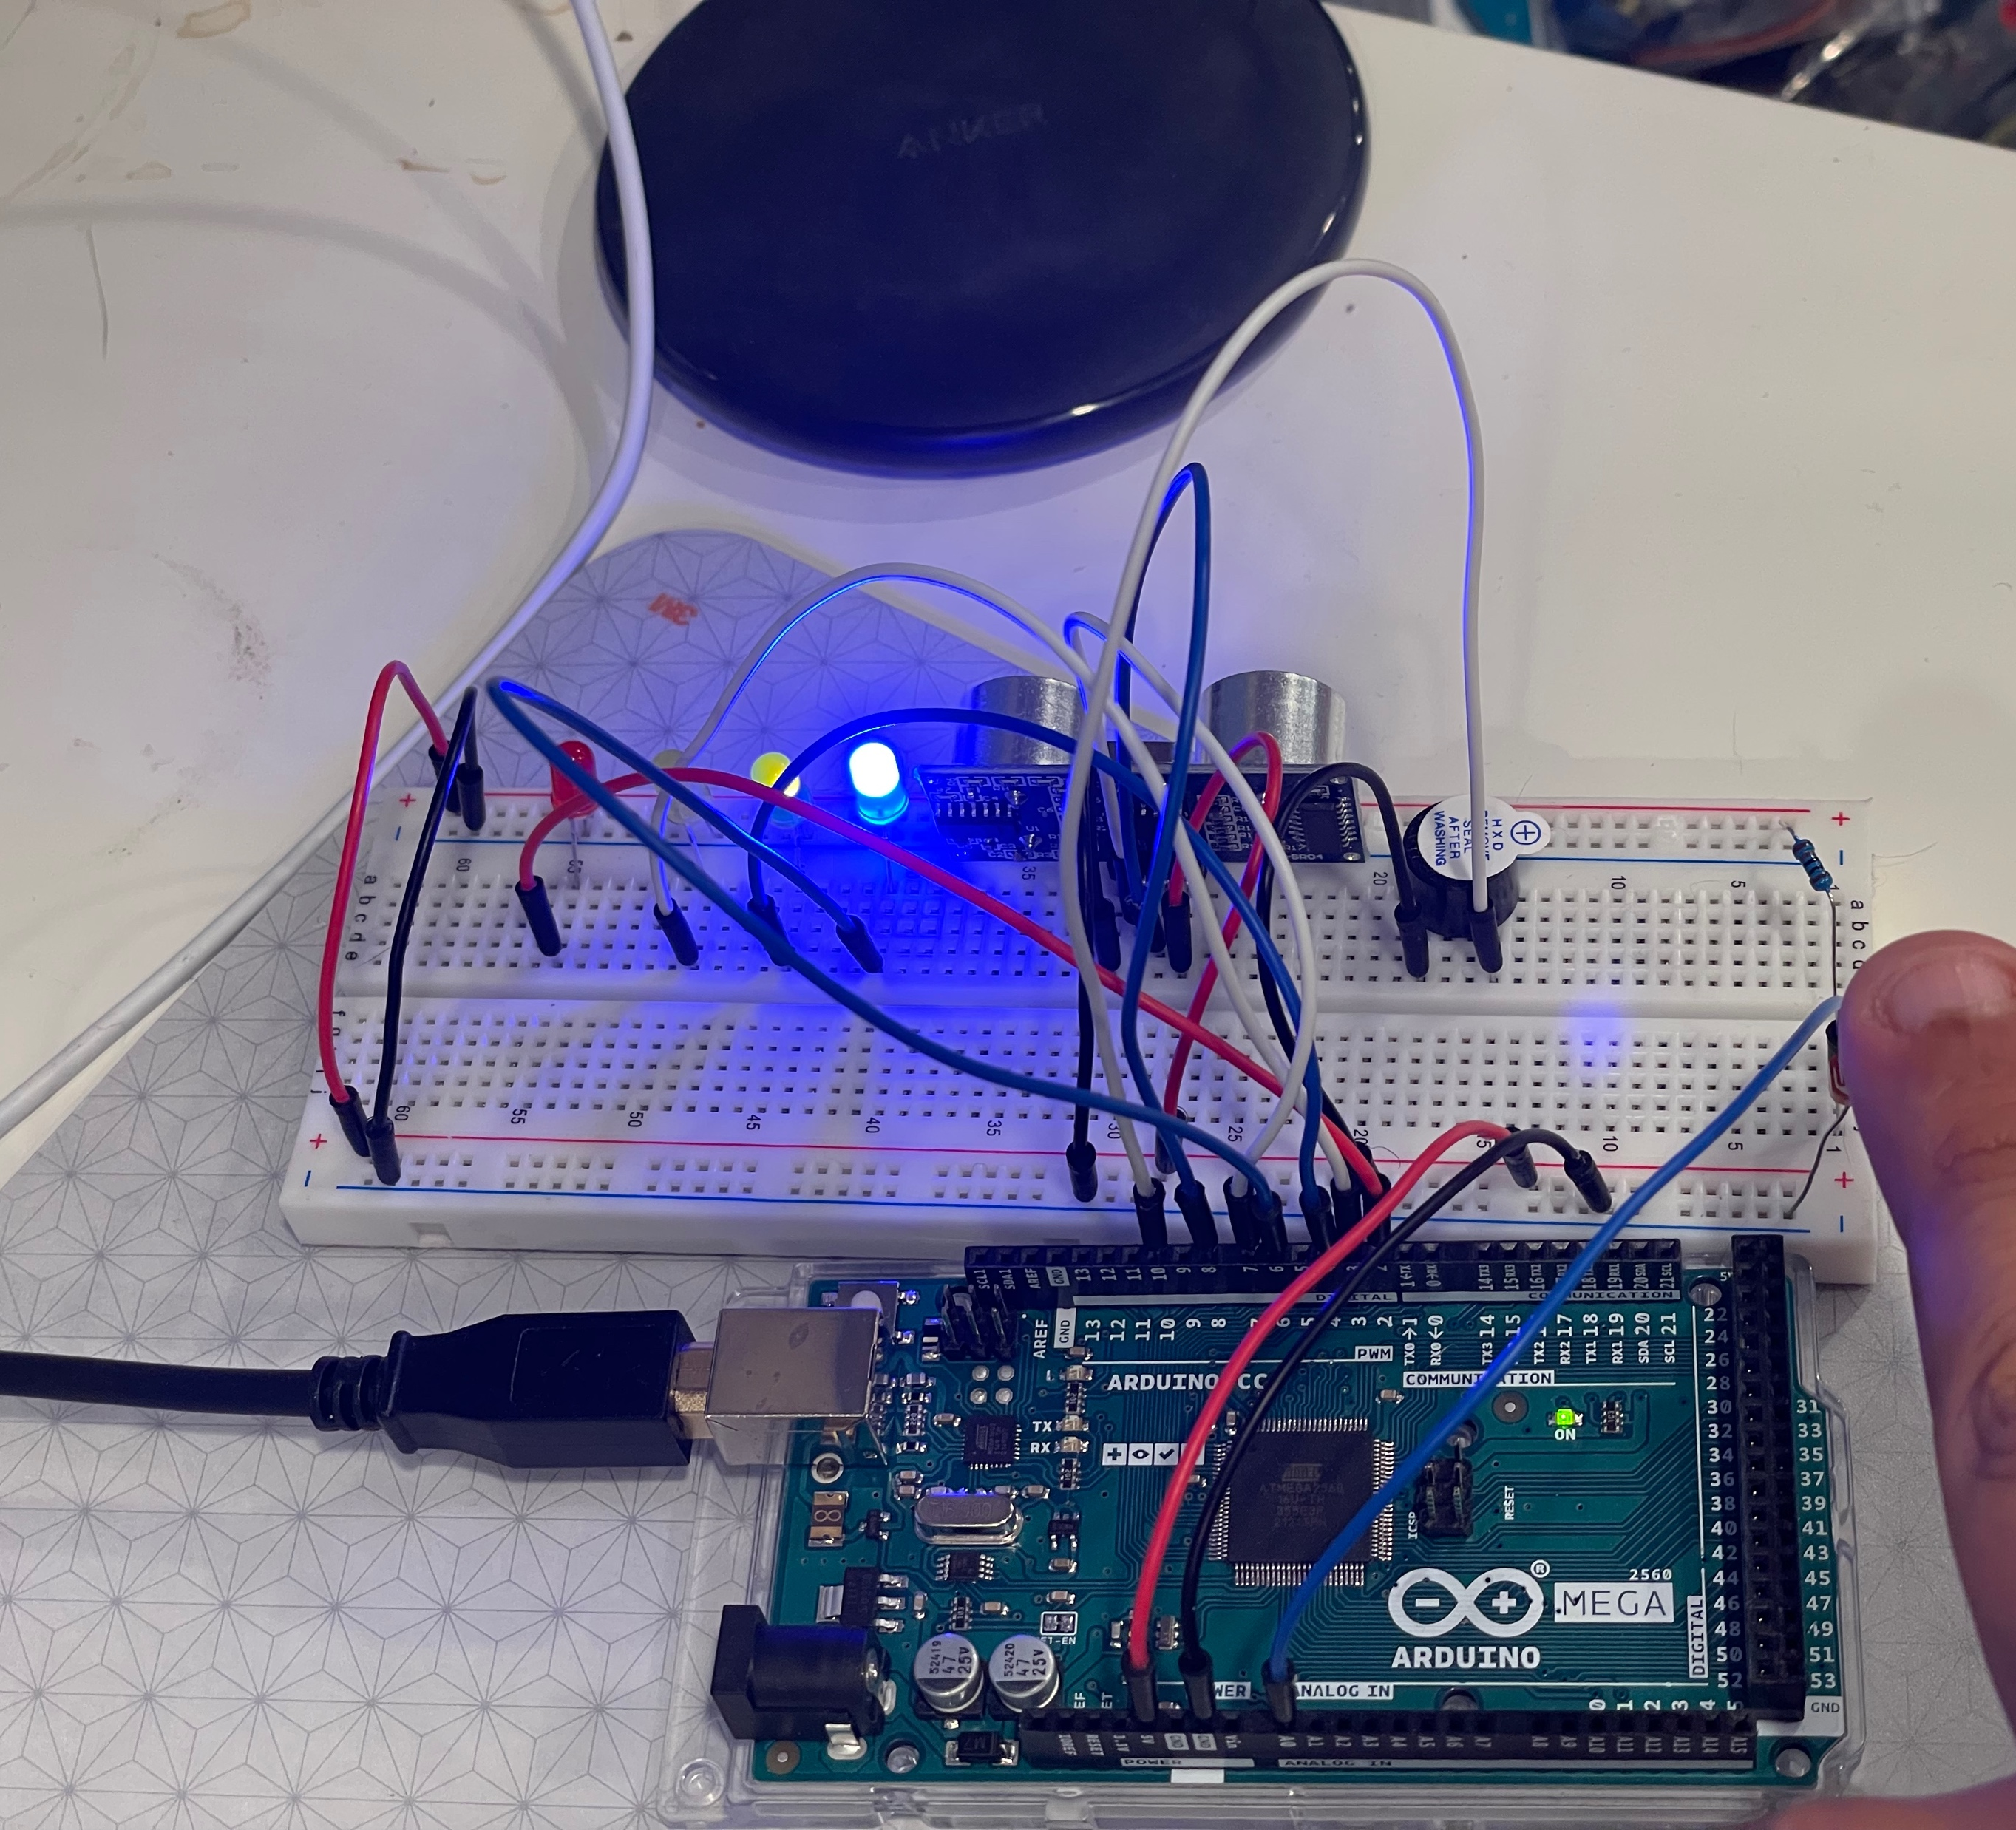
Circuit with automated LED on

Slide 28
Arduino Code

Slide 29
Serial Monitor indicating automated light is on.

Slide 30
Adding Water Sensor and Indicator LED

Slide 31
Circuit with Water Sensor and LED off

Slide 32
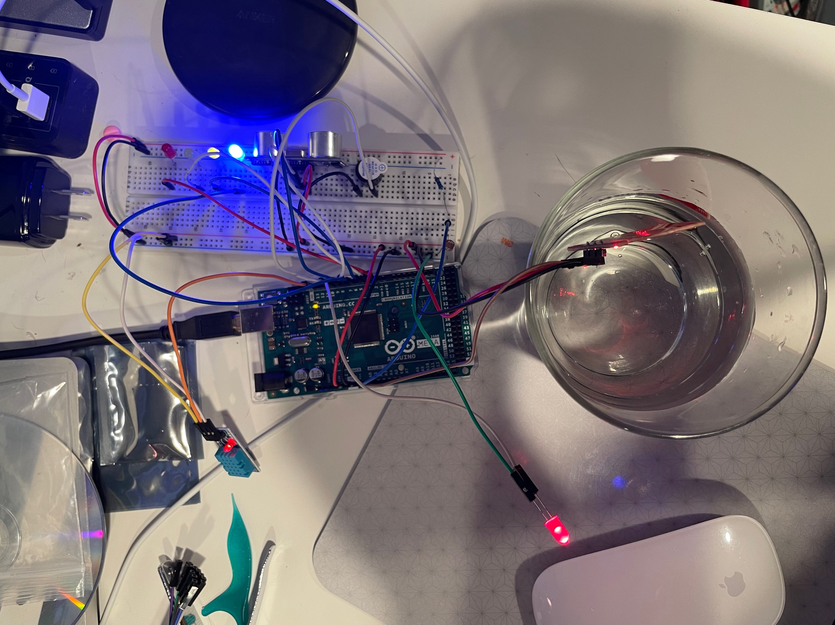
Circuit with water detected LED on

Slide 33
Arduino Code

Slide 34
Serial Monitor Indicating Water is detected.

Slide 35
Adding Humidity Sensor

Slide 36
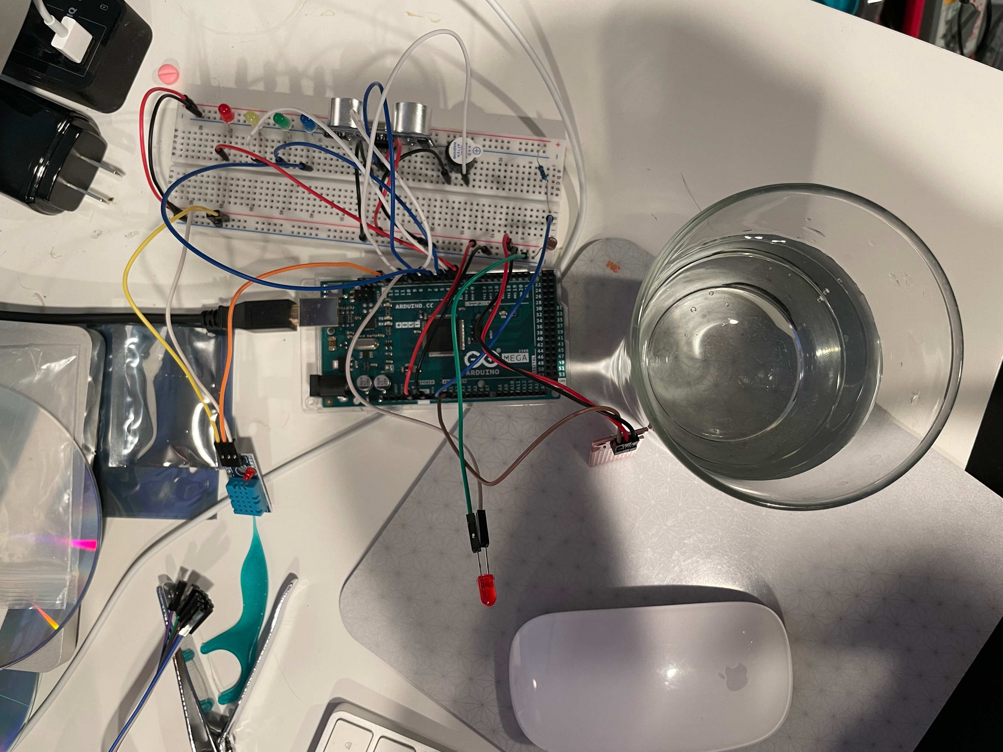
Circuit with Humidity Sensor in off state

Slide 37
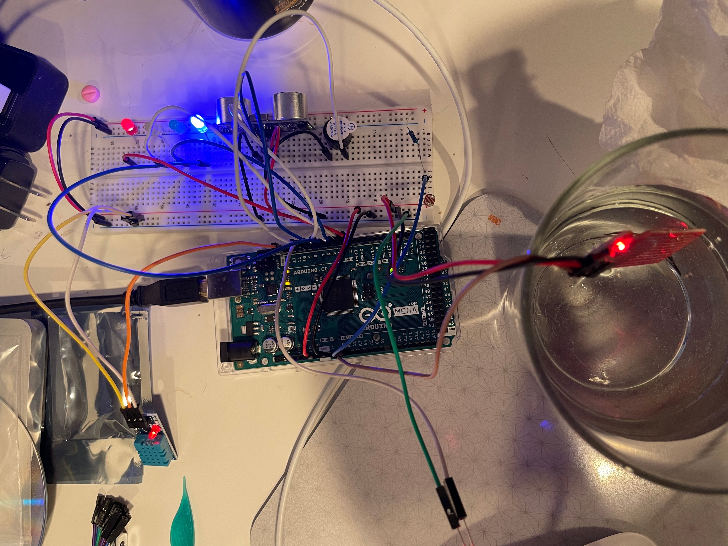
Circuit with Humidity Sensor operating.

Slide 38
Arduino Code

Slide 39
Serial Monitor indicating humidity levels.

Slide 40
Adding Water Sensor , Indicator LED, and Humidity Sensor

Slide 41
Circuit with Water Sensor Indicator LED off and Humidity Sensor

Slide 42
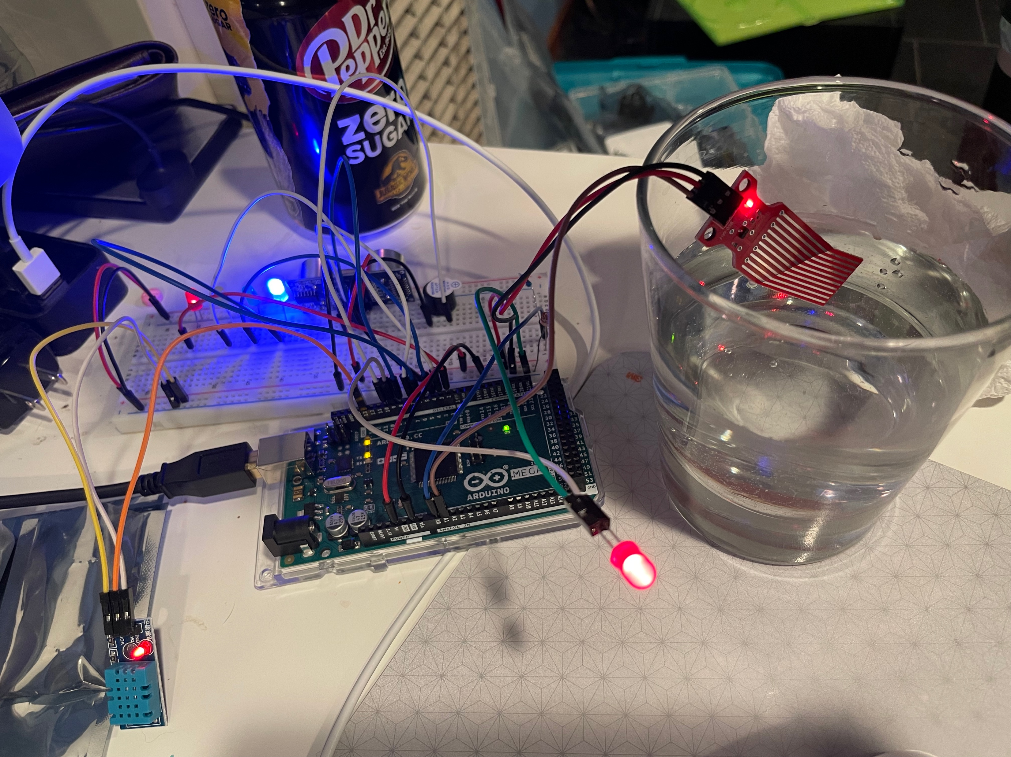
Circuit with sensor suit in on state

Slide 43
Arduino Code

Slide 44
Serial Monitor indicating all sensors operational

